Slide 1

اعمال للَيْلَةُ الْقَدْرِ
A'amaal for
Laylatul Qadr
(23rd night of Ramadan)
(Arabic text with English Translation and Transliteration)
For any errors / comments please write to: duas.org@gmail.com
Kindly recite Sūrat al-Fātiḥah for Marhumeen of all those who have worked towards making this small work possible.

Slide 2
A'amaal for Laylatul Qadr
اعمال للَيْلَةُ الْقَدْرِ
Merits
Some Ahadith indicate that the fate of every believer for the coming year is decreed on this night.
That is why the Du`as for this night ask for special favors in the decree for the year

Slide 3
A'amaal for Laylatul Qadr
اعمال للَيْلَةُ الْقَدْرِ
Merits
It is reported that whoever keeps awake on the nights of Qadr shall have his/her sins forgiven even if they equal the number of the stars in the heavens.

Slide 4
A'amaal for Laylatul Qadr
اعمال للَيْلَةُ الْقَدْرِ
Merits
Among the nights of Ramadhan is one special night, which is better than a thousand months (HQ, 97:3).
Good deeds performed on that single night are more to those performed over a thousand months.
It is the Night of Power (Laylatul Qadr), when the Qur'an was revealed.

Slide 5
A'amaal for Laylatul Qadr
اعمال للَيْلَةُ الْقَدْرِ
Merits
Laylatul Qadr is the night, which is the best night among the nights of the whole year. The “A'amaal” (religious performances) of this night are better than the A'amaal of 1000 months. In this night the divine Annual Decree is passed. The Angels and Roohul Ameen (A highly dignified Angel) descend on this earth, in that night. These call on the Imam of the time (A), and what is ordained (by Allāh (SWT)) for everybody is presented before the Imam (A).
Allama Majlisi (r.a) says, “It is better to take a bath before sunset so that the night prayers may be performed after bath”. .

Slide 6
A'amaal for Laylatul Qadr
اعمال للَيْلَةُ الْقَدْرِ
Merits
“One, who performs the ghusl on the Night of Qadr and remains awake in it (engaged in worship), shall have all his sins forgiven.”
Imām Mūsá ibn Ja‘far al-Kāżim (A.S) - [Reference: Wasaail al-Shia'h, vol. 10, pg. 358]

Slide 7
A'amaal for Laylatul Qadr
اعمال للَيْلَةُ الْقَدْرِ
Merits
“On the Night of Power the gates of Heaven are opened. There for every is no servant who offers prayer in this night, but Allāh for every prostration stores a tree in the Paradise - the tree whose branches and shade is so vast that if a rider travels for one hundred years through its shade he would not be able to cross it; for every ra'kat would build a home for him in Paradise - the home decorated and built by pearls, topaz, and rubies; for every verse recited a crown from the crowns of Paradise; for every praise (tasbeeh) a bird from the birds of Paradise; for every sitting a rank from the ranks of Paradise; for every witnessing (tashahud) - a chamber from the chambers of Paradise, and for every salutation - a robe from the robes of Paradise would be bestowed upon him by Allāh. And at the breaking of the dawn, companions - youthful and sympathetic, houris of Paradise - pure and decorated, servant obedient and well uniformed, horses - most obedient and swift, flowers, greenery, and good smells, running elegant fountain streams, and many other bounties which make the soul pleased and eyes to shine, would also be bestowed upon him by Allāh.”
Holy Prophet (S) - [Reference: Spiritual Journey of the Mystics, Chapter 9. Night of Power (Lailatul-Qadr)]

Slide 8
A'amaal for Laylatul Qadr
اعمال للَيْلَةُ الْقَدْرِ
Recommended general acts for “laylat al-qadr”
  Take a Ghusl preferably near sunset time (wudhu also required) and Give/pre arrange for Sadqah/Charity tonight.
  Recite two Rak`ah Salaat, in every Rak`ah recite Sura-al-Hamd, and Sura Ikhlaas seven times.(for seeking protection against sinning for the seven organs ) After finishing Salat recite 70 times: أَسْتَغْفِرُ اللّهَ وَأَتُوبُ إلَيْهِ
  It is reported from the Prophet (s) that by the time the reciter will rise from his place Allāh (swt) will have forgiven him and his parents. Try to first be really repentant for serious mistakes done, sincerely ask for forgiveness either by: (a) recalling 70 different sins OR (b) feeling remorseful for 10 sins of the 7 main organs: eyes, ears, tongue, hands, mouth, stomach + private parts OR (c) some particular sins that you may have committed repeatedly OR (d) recalling the variety of punishments of different sins and finally resolve NOT TO Repeat them in the future. The Holy Prophet has promised “Whoever performs this act will surely be forgiven by the Almighty even before here rises from his place".

Slide 9
A'amaal for Laylatul Qadr
اعمال للَيْلَةُ الْقَدْرِ
Recite Two Rak`ah Salaat: in every Rak`ah recite Surah al-Fatihah and and Surah al-Tawhid / Ikhlaas seven times, after Salaat recite the following:

Slide 10
A'amaal for Laylatul Qadr
اعمال للَيْلَةُ الْقَدْرِ
Recite 70 times
أَسْتَغْفِرُ اللّهَ وَأَتُوبُ إلَيْهِ.
I seek the forgiveness of Allāh, my Lord, and I repent before Him.
astaghfiru allaha wa atubu ilayhi

Slide 11
A'amaal for Laylatul Qadr
اعمال للَيْلَةُ الْقَدْرِ
Recite 100 times
أَسْتَغْفِرُ اللّهَ رَبِّي وَأَتُوبُ إلَيْهِ
I seek the forgiveness of Allāh, my Lord, and I repent before Him.
astaghfiru allaha rabbi wa atubu ilayhi

Slide 12
A'amaal for Laylatul Qadr
اعمال للَيْلَةُ الْقَدْرِ
Please open the
Holy Qur'an
and recite the following:
When opening the Qur’an and praying for your needs with the intercession of the Qur’an, realize that while the Qur’an is a cure for spiritual illness, it only benefits the pious ones and the evil doers are deprived of its illumination. Thus increase the chances for Qur’an intercession to work on your behalf by earnestly following the rulings of the Qur’an.

Slide 13
اَللَّهُمَّ صَلِّ عَلَى مُحَمَّدٍ وَ آلِ مُحَمَّد
A'amaal for Laylatul Qadr
اعمال للَيْلَةُ الْقَدْرِ
O' Allāh send Your blessings on Muhammad
and the family of Muhammad.
allahumma salli `ala muhammadin wa ali muhammadin

Slide 14
بِسْمِ ٱللَّـهِ ٱلرَّحْمَـٰنِ ٱلرَّحِيمِ
A'amaal for Laylatul Qadr
اعمال للَيْلَةُ الْقَدْرِ
In the Name of Allāh,
the All-beneficent, the All-merciful.
bi-smi llahi r-rahmani r-rahimi

Slide 15
اللّهُمّ إِنّي أَسْأَلُكَ بِكِتَابِكَ المُنْزَلِ وَمَا فِيهِ
A'amaal for Laylatul Qadr
اعمال للَيْلَةُ الْقَدْرِ
O Allāh: I beseech You in the name of Your revealed Book and that which is in it,
allahumma inni as’aluka bikitabika almunzali wa ma fihi

Slide 16
وَفِيهِ اسْمُكَ الأَكْبَرُ وَأَسْمَاؤُكَ الحُسْنَى
A'amaal for Laylatul Qadr
اعمال للَيْلَةُ الْقَدْرِ
and Your Great Name and Your (Other) beautiful names are in it,
wa fihi asmuka al-akbaru wa-asmau ‘uka alhusna

Slide 17
وَمَا يُخَافُ وَيُرْجَى
A'amaal for Laylatul Qadr
اعمال للَيْلَةُ الْقَدْرِ
and in it there is that which warns and gives hope.
wa ma yukhafu wa yurja

Slide 18
أَنْ تَجْعَلَنِي مِنْ عُتَقَائِكَ مِنَ النَّارِ.
A'amaal for Laylatul Qadr
اعمال للَيْلَةُ الْقَدْرِ
That You may include me among those who have been set free from the Hellfire.
an taj`alany min `utaqa’ika mina alnnari

Slide 19


Slide 20
A'amaal for Laylatul Qadr
اعمال للَيْلَةُ الْقَدْرِ
Please place the
Holy Qur'an
on the head and recite the following:
While placing the Qur’an on the head, remind yourself that true salvation can only be achieved by always keeping the rules of Qur’an ahead of us to follow. The fact that we put the Qur’an on our head is a sign of respect and reverence. We beseech Allāh (SWT) by the thaqalayn - the speaking and the silent Qur'an. - Holy Qur'an (39:56) Pray for Aql/Intelligence to be Kamil ( complete) ,it is Kashe (submits) to Qur’an & acquires Noor ( light) from it.

Slide 21
اَللَّهُمَّ صَلِّ عَلَى مُحَمَّدٍ وَ آلِ مُحَمَّد
A'amaal for Laylatul Qadr
اعمال للَيْلَةُ الْقَدْرِ
O' Allāh send Your blessings on Muhammad
and the family of Muhammad.
allahumma salli `ala muhammadin wa ali muhammadin

Slide 22
بِسْمِ ٱللَّـهِ ٱلرَّحْمَـٰنِ ٱلرَّحِيمِ
A'amaal for Laylatul Qadr
اعمال للَيْلَةُ الْقَدْرِ
In the Name of Allāh,
the All-beneficent, the All-merciful.
bi-smi llahi r-rahmani r-rahimi

Slide 23
اللّهُمّ بِحَقّ هذَا القُرْآنِ
A'amaal for Laylatul Qadr
اعمال للَيْلَةُ الْقَدْرِ
O Allāh: for the sake of this (Holy) Qur'an,
allahumma bihaqqi hadha alqur’ani

Slide 24
وَبِحَقّ مَنْ أَرْسَلْتَهُ بِهِ
A'amaal for Laylatul Qadr
اعمال للَيْلَةُ الْقَدْرِ
and for the sake of that person through whom You sent it,
wa bihaqqi man arsaltahu bihi

Slide 25
وَبِحَقّ كُلّ مُؤْمِنٍ مَدَحْتَهُ فِيهِ
A'amaal for Laylatul Qadr
اعمال للَيْلَةُ الْقَدْرِ
and for the sake of those believers who have been praised therein,
wa bihaqqi kulli mu’minin madahtahu fihi

Slide 26
وَبِحَقّكَ عَلَيْهِمْ
A'amaal for Laylatul Qadr
اعمال للَيْلَةُ الْقَدْرِ
and in the name of Your obligation to them,
wa bihaqqka `alayhim

Slide 27
فَلا أَحَدَ أَعْرَفُ بِحَقّكَ مِنْكَ.
A'amaal for Laylatul Qadr
اعمال للَيْلَةُ الْقَدْرِ
no one is aware of Your obligation more than You.
fala ahada a`rafu bihaqqka minka

Slide 28
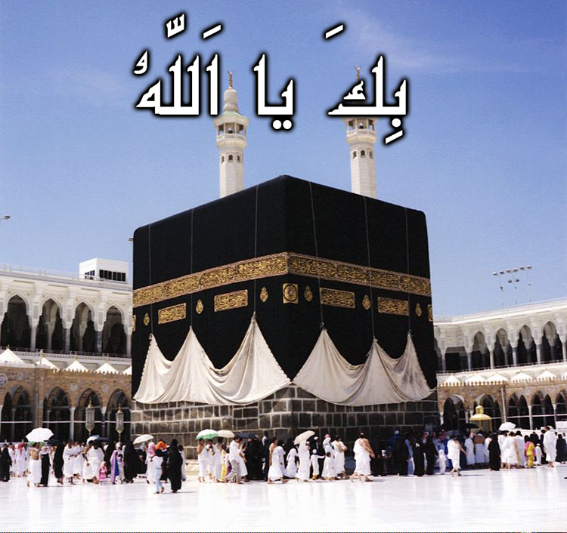
A'amaal for Laylatul Qadr
اعمال للَيْلَةُ الْقَدْرِ
Recite 10 Times

Slide 29

A'amaal for Laylatul Qadr
اعمال للَيْلَةُ الْقَدْرِ
Recite 10 Times
Quick Facts:
Name: Muhammed (S)
Titles: Al Mustafa, As Saadiq (The Truthful), Al Ameen (The Trusted)
Kuniyah: Abul Qassim
Father: Abdallah bin Abdul Muttalib
Mother: Amina Bint Wahab
Birthday: 17 Rabee’ Al Awaal, 570 AC (Year of the Elephant) in Makkah
Death: 28 Safar, 11 AH in Medina

Slide 30
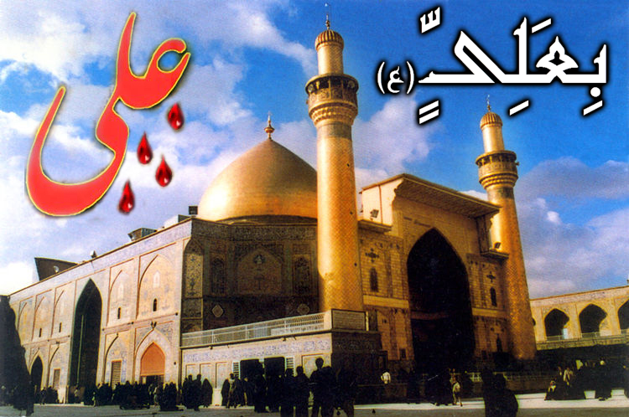
A
A'amaal for Laylatul Qadr
اعمال للَيْلَةُ الْقَدْرِ
Recite 10 Times
Quick Facts:
Name: Ali (A)
Titles: Murtadha, Ameer ul Mu’mineen (King of the Believers), Abu Turaab, Asad Ullah (The lion of Allah)
Kuniyah: Abul Hassan
Father: Abu Talib
Mother: Fatemah Bint Asad
Birthday: 13 Rajab – 23 Years before Hijra, inside the Holy Ka’baa in Makkah
Death: 21 Ramadhan, 40 AH in Kufa
E
T

Slide 31

A'amaal for Laylatul Qadr
اعمال للَيْلَةُ الْقَدْرِ
Recite 10 Times
Quick Facts:
Name: Fatemah (A)
Titles: Zahra (Radiant), Zakiyyah (Pure), Radhiyyah (Satisfied), Tahera (Chaste), Ummul Aimmah (Mother of Imams) & Umme Abiha (Mother of her Father)
Father: Prophet Muhammed (S)
Mother: Bibi Khadijah Bint Khuwailid
Birthday: 20 Jamaadil Aakhar in Makkah
Death: 14 Jamaadil Awwal, 11 AH in Medina

Slide 32
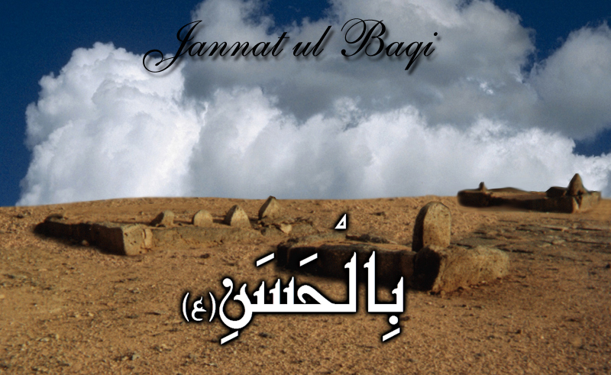
A'amaal for Laylatul Qadr
اعمال للَيْلَةُ الْقَدْرِ
Recite 10 Times
Quick Facts:
Name: Hassan (A)
Title: Al Mujtaba (The Chosen One)
Kuniyah: Abu Muhammed
Father: Imam Ali (A)
Mother: Bibi Fatemah (A)
Birthday: 15 Ramadhan, 3 AH, Medina
Death: 7 Safar, 50 AH, Medina

Slide 33

A'amaal for Laylatul Qadr
اعمال للَيْلَةُ الْقَدْرِ
Recite 10 Times
Quick Facts:
Name: Hussain (A)
Title: Sayyid ash Shuhada (Leader of Martyrs)
Kuniyah: Aba Abdillah
Father: Imam Ali (A)
Mother: Bibi Fatemah (A)
Birthday: 3 Sha’baan, 4 AH in Medina
Death: Ashura, 10 Muharram, 61 AH in Kerbala

Slide 34
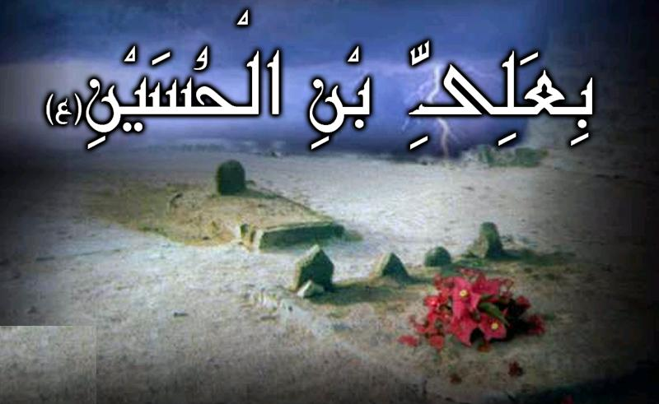
A'amaal for Laylatul Qadr
اعمال للَيْلَةُ الْقَدْرِ
Recite 10 Times
Quick Facts:
Name: Ali (A)
Titles: Zain ul Abideen (Beauty of the Worshippers), Sajjad (The Prostrating), Syed us Saajideen (Leader of those who Prostrate)
Kuniyah: Abu Muhammed
Father: Imam Hussain (A)
Mother: Bibi Shahr Banu
Birthday: 5 Sha’baan, 38 AH in Medina
Death: 25 Muharram, 95 AH in Medina

Slide 35
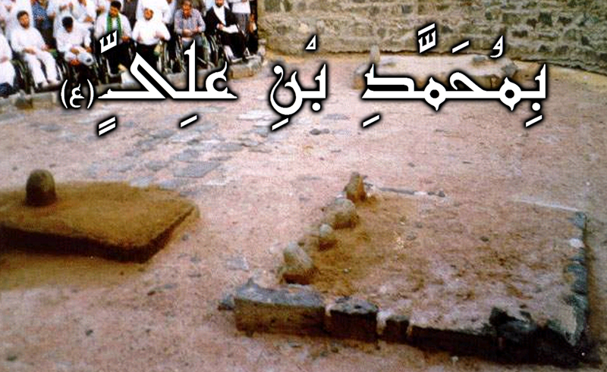
A'amaal for Laylatul Qadr
اعمال للَيْلَةُ الْقَدْرِ
Recite 10 Times
Quick Facts:
Name: Muhammed (A)
Titles: Baqir, Hadi (Guide)
Kuniyah: Abu Ja’far
Father: Imam Ali Bin Hussain (A)
Mother: Fatemah Bint Hassan (Daughter of Imam Hassan (A))
Birthday: 1 Rajab – 57 AH in Medina
Death: 7 Dhul Hijjah, 114 AH in Medina

Slide 36
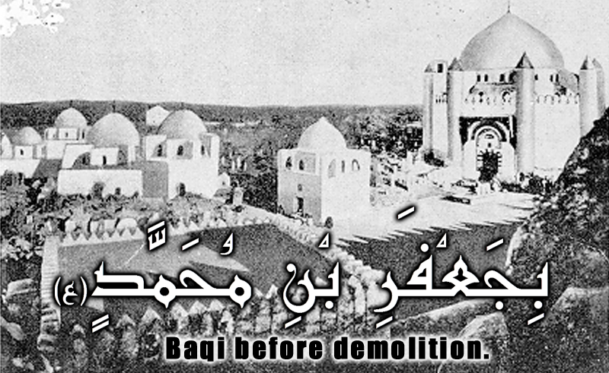
A'amaal for Laylatul Qadr
اعمال للَيْلَةُ الْقَدْرِ
Recite 10 Times
Quick Facts:
Name: Ja’far (A)
Titles: Fadhil (Excellent), Khashiful Haqaiq (Revealer of Mysteries), Sadiq (Truthful)
Kuniyah: Aba Abdillah
Father: Imam Muhammed Al Baqir (A)
Mother: Fatemah
Birthday: 17 Rabee’ al Awwal, 82 AH in Medina
Death: 25 Shawwal, 148 AH in Medina

Slide 37
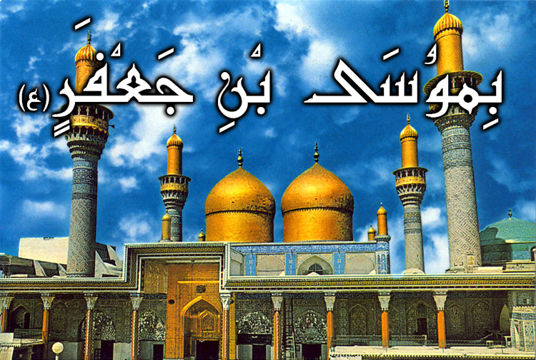
A'amaal for Laylatul Qadr
اعمال للَيْلَةُ الْقَدْرِ
Recite 10 Times
Quick Facts:
Name: Musa (A)
Titles: Al Kaadhim, Bab Al Hawaaij (Door of Wishes), Faquih
Kuniyah: Abu Ibrahim
Father: Imam Ja’far bin Muhammed (A)
Mother: Hamida Al Barbaria
Birthday: 7 Safar, 128 AH in Abwa (Between Makkah & Medina)
Death: 25 Rajab, 183 AH in Baghdad

Slide 38
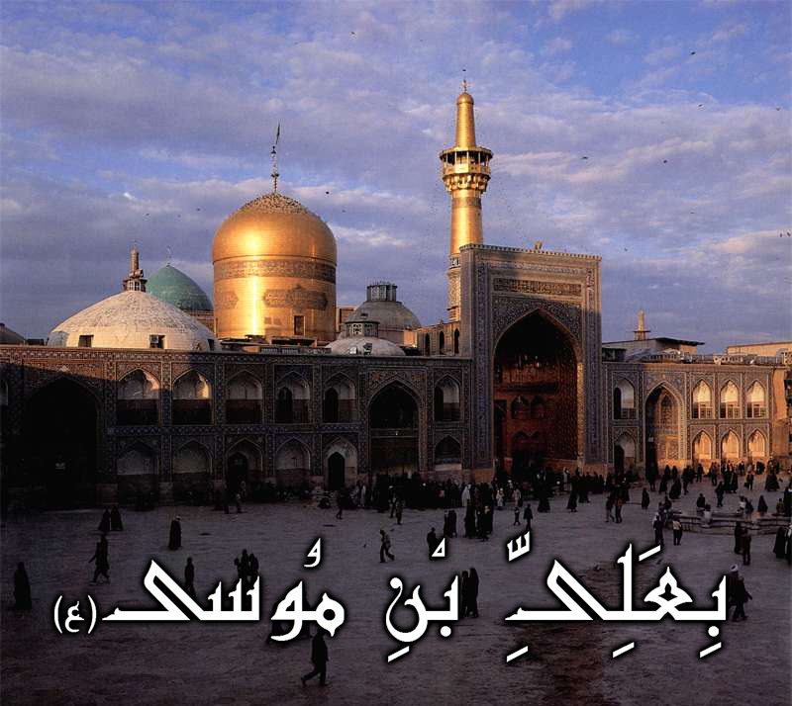
A'amaal for Laylatul Qadr
اعمال للَيْلَةُ الْقَدْرِ
Recite 10 Times
Quick Facts:
Name: Ali (A)
Titles: Ar Redha, Ghareeb Al Ghuraba
Kuniyah: Abul Hassan
Father: Imam Musa bin Ja’far (A)
Mother: Najma
Birthday: 11 Dhul Qa’dah, 148 AH in Medina
Death: 29 Safar, 203 AH in Mashad

Slide 39
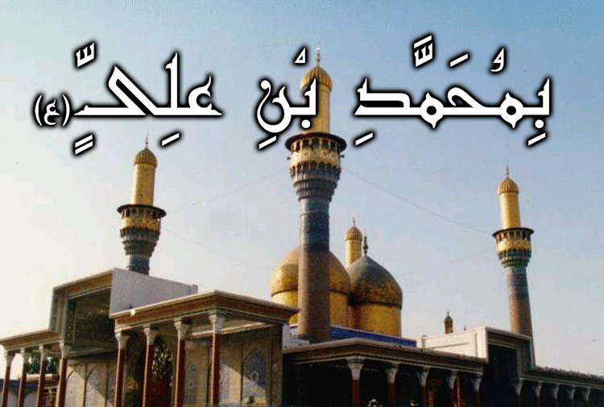
A'amaal for Laylatul Qadr
اعمال للَيْلَةُ الْقَدْرِ
Recite 10 Times
Quick Facts:
Name: Muhammed (A)
Titles: At Taqi, Al Jawaad
Kuniyah: Abul Ja’far
Father: Imam Ali bin Musa (A)
Mother: Sabika (Also known as Khaizaroon)
Birthday: 10 Rajab, 195 AH in Medina
Death: 29 Dhul Qa’dah, 220 AH in Baghdad

Slide 40
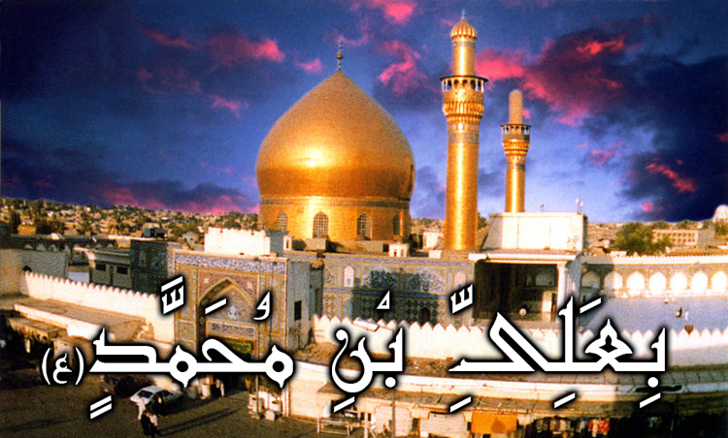
A'amaal for Laylatul Qadr
اعمال للَيْلَةُ الْقَدْرِ
Recite 10 Times
Quick Facts:
Name: Ali (A)
Titles: An Naqi, Al Hadi (The Guide)
Kuniyah: Abul Hassan
Father: Imam Muhammed bin Ali (A)
Mother: Sumana
Birthday: 15 Dhul Hijjah, 212 AH in Surba (Suburb of Medina)
Death: 3 Rajab, 254 AH in Samarra

Slide 41
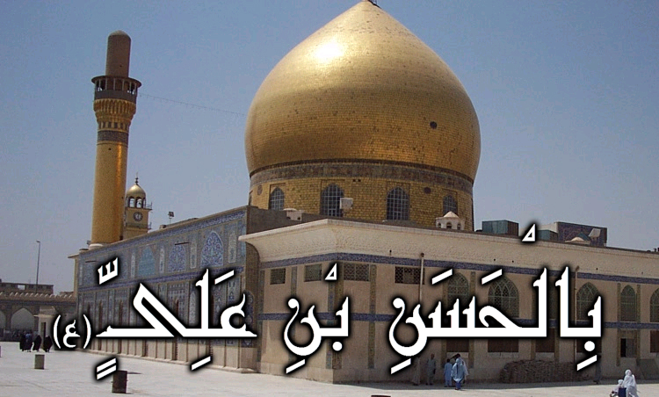
A'amaal for Laylatul Qadr
اعمال للَيْلَةُ الْقَدْرِ
Recite 10 Times
Quick Facts:
Name: Hassan (A)
Title: Al Askary
Kuniyah: Abu Muhammed
Father: Imam Ali bin Muhammed (A)
Mother: Saleel (Also known as Hudaitha)
Birthday: 10 Rabee’ Al Aakhar, 232 AH in Medina
Death: 8 Rabee’ Al Awwal, 260 AH in Samarra

Slide 42

A'amaal for Laylatul Qadr
اعمال للَيْلَةُ الْقَدْرِ
Recite 10 Times
Quick Facts:
Name: Muhammed (A)
Titles: Mahdi (The Guided One), Hujjah (The proof of Allah), Al Muntazar (One who awaits the order of Allah), Al Muntazir (The one who is awaited), Saahib Az Zamaan (Master of the Age), Al Qaaim (The steadfast)
Kuniyah: Abul Qassim
Father: Imam Hassan bin Ali (A)
Mother: Malika (Also known as Narjis)
Birthday: 15 Sha’baan, 255 AH

Slide 44
دعاء حجة
Dua’a Hujjat
Muhammad ibn `Isa, through his series of narrators, has reported the Holy Infallibles (a.s) as saying, “You may repeat the following supplication at the twenty-third night of Ramadan in all states—standing, sitting, prostrating... etc. It is furthermore preferable if you repeat it all over the month of Ramadan whenever you have an opportunity and also all over your lifetime. You may begin with statements of glorifying Almighty Allāh and praying for sending blessings upon the Holy Prophet and then say:

Slide 45
اَللَّهُمَّ صَلِّ عَلَى مُحَمَّدٍ وَ آلِ مُحَمَّد
A'amaal for Laylatul Qadr
اعمال للَيْلَةُ الْقَدْرِ
O' Allāh send Your blessings on Muhammad
and the family of Muhammad.
allahumma salli `ala muhammadin wa ali muhammadin

Slide 46
بِسْمِ ٱللَّـهِ ٱلرَّحْمَـٰنِ ٱلرَّحِيمِ
A'amaal for Laylatul Qadr
اعمال للَيْلَةُ الْقَدْرِ
In the Name of Allāh,
the All-beneficent, the All-merciful.
bi-smi llahi r-rahmani r-rahimi

Slide 47
اللّهُمّ كُنْ لِوَلِيّكَ الحُجّةِ ابْنِ الحَسَنِ
A'amaal for Laylatul Qadr
اعمال للَيْلَةُ الْقَدْرِ
O Allāh: (please) be for Your representative, al-Hujjah, son of al-Hasan—
allahumma kun liwaliyyka alhujjati abni alhasani

Slide 48
صَلَوَاتُكَ عَلَيْهِ وَعَلَى آبَائِهِ
A'amaal for Laylatul Qadr
اعمال للَيْلَةُ الْقَدْرِ
Your blessings be on him and on his forefathers
salawatuka `alayhi wa `ala aba’ihi

Slide 49
فِي هذِهِ السَّاعَةِ وَفي كُلّ سَاعَةٍ
A'amaal for Laylatul Qadr
اعمال للَيْلَةُ الْقَدْرِ
now and at all times
fi hadhihi alssa`ati wa fi kull sa`atin

Slide 50
وَلِيّاً وَحَافِظاً
A'amaal for Laylatul Qadr
اعمال للَيْلَةُ الْقَدْرِ
(please, be his) friend and guardian
waliyyan wa hafizan

Slide 51
وَقَائِداً وَنَاصِراً
A'amaal for Laylatul Qadr
اعمال للَيْلَةُ الْقَدْرِ
And leader and helper
wa qa’idan wa nasiran

Slide 52
وَدَلِيلاً وَعَيْناً
A'amaal for Laylatul Qadr
اعمال للَيْلَةُ الْقَدْرِ
And guide and watcher
wa dalilan wa `aynan

Slide 53
حَتَّى تُسْكِنَهُ أَرْضَكَ طَوْعاً
A'amaal for Laylatul Qadr
اعمال للَيْلَةُ الْقَدْرِ
So that You shall allow him to prevail on Your lands willingly
hatta tuskinahu ardaka taw`an

Slide 54
وَتُمَتّعَهُ فِيهَا طَوِيلاً.
A'amaal for Laylatul Qadr
اعمال للَيْلَةُ الْقَدْرِ
And You shall make him enjoy it for a long time.
wa tumatt`ahu fiha tawilan

Slide 55
يَا مُدَبّرَ الأُمُورِ،
A'amaal for Laylatul Qadr
اعمال للَيْلَةُ الْقَدْرِ
It is also recommended to say the following supplication:
O the Director of all affairs;
ya mudabbira ala’umuri

Slide 56
يَا بَاعِثَ مَنْ فِي القُبُورِ،
A'amaal for Laylatul Qadr
اعمال للَيْلَةُ الْقَدْرِ
O the Resurrector of all those in graves;
ya ba`itha man fi alquburi

Slide 57
يَا مُجْرِيَ البُحُورِ،
A'amaal for Laylatul Qadr
اعمال للَيْلَةُ الْقَدْرِ
O He Who causes oceans to flow;
ya mujriya albuhuri

Slide 58
يَا مُلَيّنَ الحَدِيدِ لِدَاوُدَ
A'amaal for Laylatul Qadr
اعمال للَيْلَةُ الْقَدْرِ
O He Who made the iron pliant for (Prophet) David;
ya mulayyina alhadidi lidawuda

Slide 59
صَلّ عَلَى مُحَمّدٍ وَآلِ مُحَمّدٍ…
A'amaal for Laylatul Qadr
اعمال للَيْلَةُ الْقَدْرِ
(Please) send blessings upon Muhammad and the Household of Muhammad…
salli `ala muhammadin wa ali muhammadin…

Slide 61
اللّيْلَة اللّيْلَةَ.
A'amaal for Laylatul Qadr
اعمال للَيْلَةُ الْقَدْرِ
This very night; this very night.
al-laylata al-laylata
You may raise both your hands while saying this supplication.
It is also recommended to repeat this supplication in all states—sitting, standing, prostrating... etc. at this night as well during the last nights of Ramadan.

Slide 62
اَللَّهُمَّ صَلِّ عَلَى مُحَمَّدٍ وَ آلِ مُحَمَّد
A'amaal for Laylatul Qadr
اعمال للَيْلَةُ الْقَدْرِ
O' Allāh send Your blessings on Muhammad
and the family of Muhammad.
allahumma salli `ala muhammadin wa ali muhammadin

Slide 63
A'amaal for Laylatul Qadr
اعمال للَيْلَةُ الْقَدْرِ
Short Du’a for the night of Qadr
اللّهُمّ إِنّي أَمْسَيْتُ لَكَ عَبْداً دَاخِراً
allahumma inni amsaytu laka `abdan dakhiran
Mentioning this du`a, Shaykh Kaf`ami has related that Imam Ali ibn al-Husayn (A) recited this du`a during these nights while standing (qiyam), bowing (rukou`) and performing prostration (sajdah).

Slide 64
اَللَّهُمَّ صَلِّ عَلَى مُحَمَّدٍ وَ آلِ مُحَمَّد
A'amaal for Laylatul Qadr
اعمال للَيْلَةُ الْقَدْرِ
O' Allāh send Your blessings on Muhammad
and the family of Muhammad.
allahumma salli `ala muhammadin wa ali muhammadin

Slide 65
بِسْمِ ٱللَّـهِ ٱلرَّحْمَـٰنِ ٱلرَّحِيمِ
A'amaal for Laylatul Qadr
اعمال للَيْلَةُ الْقَدْرِ
In the Name of Allāh,
the All-beneficent, the All-merciful.
bi-smi llahi r-rahmani r-rahimi

Slide 66
اللّهُمّ إِنّي أَمْسَيْتُ لَكَ عَبْداً دَاخِراً
A'amaal for Laylatul Qadr
اعمال للَيْلَةُ الْقَدْرِ
O Allāh: surely, I am at this evening Your passive slave;
allahumma inni amsaytu laka `abdan dakhiran

Slide 67
لا أَمْلِكُ لِنَفْسِي نَفْعاً وَلا ضَرّاً
A'amaal for Laylatul Qadr
اعمال للَيْلَةُ الْقَدْرِ
I have no control of hurt or good to myself,
la amliku linafsy naf`an wa la darran

Slide 68
وَلا أَصْرِفُ عَنْهَا سُوءً،
A'amaal for Laylatul Qadr
اعمال للَيْلَةُ الْقَدْرِ
And I cannot drive back any evil from myself,
wa la asrifu `anha su‘an

Slide 69
أَشْهَدُ بِذلِكَ عَلَى نَفْسِي،
A'amaal for Laylatul Qadr
اعمال للَيْلَةُ الْقَدْرِ
I testify to so against myself,
ash-hadu bidhalika `ala nafsi

Slide 70
وَأَعْتَرِفُ لَكَ بِضَعْفِ قُوّتِي،
A'amaal for Laylatul Qadr
اعمال للَيْلَةُ الْقَدْرِ
And to You do I confess of my powerlessness
wa a`tarifu laka bida`fi quwwati

Slide 71
وَقِلّةِ حِيلَتِي،
A'amaal for Laylatul Qadr
اعمال للَيْلَةُ الْقَدْرِ
And my feebleness
wa qillati hilati

Slide 72
فَصَلّ عَلَى مُحَمّدٍ وَآلِ مُحَمّدٍ
A'amaal for Laylatul Qadr
اعمال للَيْلَةُ الْقَدْرِ
So, (please do) send blessings upon Muhammad and the Household of Muhammad,
fasall `ala muhammadin wa ali muhammadin

Slide 73
وَأَنْجِزْ لِي مَا وَعَدْتَنِي
A'amaal for Laylatul Qadr
اعمال للَيْلَةُ الْقَدْرِ
And fulfill that of which You have promised me,
wa anjiz li ma wa`adtany

Slide 74
وَجَمِيعَ المُؤْمِنِينَ وَالمُؤْمِنَاتِ
A'amaal for Laylatul Qadr
اعمال للَيْلَةُ الْقَدْرِ
As well as all the believing men and women,
wa jami`a almu'minina wal-mu'minati

Slide 75
مِنَ المَغْفِرَةِ فِي هذِهِ اللّيْلَةِ،
A'amaal for Laylatul Qadr
اعمال للَيْلَةُ الْقَدْرِ
That is Your forgiveness at this night.
mina almaghfirati fi hadhihi allaylati

Slide 76
وَأَتْمِمْ عَلَيّ مَا آتَيْتَنِي
A'amaal for Laylatul Qadr
اعمال للَيْلَةُ الْقَدْرِ
And accomplish that which You have conferred upon me,
wa atmim `alayya ma ataytany

Slide 77
فَإِنّي عَبْدُكَ المِسكِينُ المُسْتَكِينُ
A'amaal for Laylatul Qadr
اعمال للَيْلَةُ الْقَدْرِ
For I am Your slave—the poor, the humble,
fa’inni `abduka almiskinu almustakinu

Slide 78
الضّعِيفُ الفَقِيرُ المَهِينُ.
A'amaal for Laylatul Qadr
اعمال للَيْلَةُ الْقَدْرِ
The weak, the needy, the humiliated.
aldda`ifu alfaqiru almahinu

Slide 79
اللّهُمّ لا تَجْعَلْنِي نَاسِياً لِذِكْرِكَ فِيمَا أَوْلَيْتَنِي،
A'amaal for Laylatul Qadr
اعمال للَيْلَةُ الْقَدْرِ
O Allāh: (please) do not make me negligent of the mention of You as regards that which You have bestowed upon me,
allahumma la taj`alny nasiyan lidhikrika fima awlaytani

Slide 80
وَلا غَافِلاً لإحْسَانِكَ فِيمَا أَعْطَيْتَنِي،
A'amaal for Laylatul Qadr
اعمال للَيْلَةُ الْقَدْرِ
And do not make me inadvertent to Your favors to me as regards that which You have given me,
wa la ghafilan liihsanika fima a`taytani

Slide 81
وَلا آيِساً مِنْ إِجَابَتِكَ وَإِنْ أَبْطَأَتْ عَنّي
A'amaal for Laylatul Qadr
اعمال للَيْلَةُ الْقَدْرِ
And do not make me despair of Your responding to me, even if such response is postponed,
wa la ayisan min ijabatika wa in abtat `anni

Slide 82
فِي سَرَّاءَ أَوْ ضَرَّاءَ
A'amaal for Laylatul Qadr
اعمال للَيْلَةُ الْقَدْرِ
Whether I be in prosperity or adversity
fi sarra‘a aw darra‘a

Slide 83
أَوْ شِدّةٍ أَوْ رَخَاءٍ
A'amaal for Laylatul Qadr
اعمال للَيْلَةُ الْقَدْرِ
Or hardship or comfort
aw shiddatin aw rakha‘in

Slide 84
أَوْ عَافِيَةٍ أَوْ بَلاءٍ
A'amaal for Laylatul Qadr
اعمال للَيْلَةُ الْقَدْرِ
Or well-being or ordeal,
aw `afiyatin aw bala‘in

Slide 85
أَوْ بُؤْسٍ أَوْ نَعْمَاءَ
A'amaal for Laylatul Qadr
اعمال للَيْلَةُ الْقَدْرِ
Or misery or bliss.
aw bu'sin aw na`ma‘a

Slide 86
إِنّكَ سَمِيعُ الدّعَاءِ.
A'amaal for Laylatul Qadr
اعمال للَيْلَةُ الْقَدْرِ
Verily, You are the Hearer of prayers.
innaka sami`u alddu`a‘i

Slide 87
فَلا أَحَدَ أَعْرَفُ بِحَقّكَ مِنْكَ.
A'amaal for Laylatul Qadr
اعمال للَيْلَةُ الْقَدْرِ
no one is aware of Your obligation more than You.
fala ahada a`rafu bihaqqka minka

Slide 88
A'amaal for Laylatul Qadr
اعمال للَيْلَةُ الْقَدْرِ
Short recommended Du’a for the night of Qadr
اللّهُمّ اجْعَلْ فِيمَا تَقْضِي وَتُقَدّرُ
allahumma aj`al fima taqdy wa tuqaddiru
It is recommended to recite the following supplication

Slide 89
اَللَّهُمَّ صَلِّ عَلَى مُحَمَّدٍ وَ آلِ مُحَمَّد
A'amaal for Laylatul Qadr
اعمال للَيْلَةُ الْقَدْرِ
O' Allāh send Your blessings on Muhammad
and the family of Muhammad.
allahumma salli `ala muhammadin wa ali muhammadin

Slide 90
بِسْمِ ٱللَّـهِ ٱلرَّحْمَـٰنِ ٱلرَّحِيمِ
A'amaal for Laylatul Qadr
اعمال للَيْلَةُ الْقَدْرِ
In the Name of Allāh,
the All-beneficent, the All-merciful.
bi-smi llahi r-rahmani r-rahimi

Slide 91
اللّهُمّ اجْعَلْ فِيمَا تَقْضِي وَفِيمَا تُقَدّرُ
A'amaal for Laylatul Qadr
اعمال للَيْلَةُ الْقَدْرِ
O Allāh: (please), among the matters that You decide and make,
allahumma ij`al fima taqdy wa fima tuqaddiru

Slide 92
مِنَ الأَمْرِ المَحْتُومِ
A'amaal for Laylatul Qadr
اعمال للَيْلَةُ الْقَدْرِ
From among the inevitable affairs,
mina alamri almahtumi

Slide 93
وَفِيمَا تَفْرُقُ مِنَ الأَمْرِ الحَكِيمِ
A'amaal for Laylatul Qadr
اعمال للَيْلَةُ الْقَدْرِ
And from among the wise matters that You make distinct,
wa fima tafruqu mina alamri alhakimi

Slide 94
فِي لَيْلَةِ القَدْرِ
A'amaal for Laylatul Qadr
اعمال للَيْلَةُ الْقَدْرِ
At the Grand Night
fi laylati alqadri

Slide 95
مِنَ القَضَاءِ الّذِي لا يُرَدّ وَلا يُبَدّلُ
A'amaal for Laylatul Qadr
اعمال للَيْلَةُ الْقَدْرِ
From among the act that is neither rejected nor altered,
mina alqada‘i alladhy la yuraddu wa la yubaddalu

Slide 96
أَنْ تَكْتُبَنِي مِنْ حُجَّاجِ بَيْتِكَ الحَرَامِ
A'amaal for Laylatul Qadr
اعمال للَيْلَةُ الْقَدْرِ
That You decide me to be with the pilgrims to Your Holy House,
an taktubany min hujjaji baytika alharami

Slide 97
فِي عَامِي هذَا
A'amaal for Laylatul Qadr
اعمال للَيْلَةُ الْقَدْرِ
At this year,
fi `amy hadha

Slide 98
المَبْرُورِ حَجّهُمُ،
A'amaal for Laylatul Qadr
اعمال للَيْلَةُ الْقَدْرِ
Those whose pilgrimage is admitted,
almabruri hajjuhumu

Slide 99
المَشْكُورِ سَعْيُهُمُ،
A'amaal for Laylatul Qadr
اعمال للَيْلَةُ الْقَدْرِ
Whose efforts are praised,
almashkuri sa`yuhumu

Slide 100
المَغْفُورِ ذُنُوبُهُمُ،
A'amaal for Laylatul Qadr
اعمال للَيْلَةُ الْقَدْرِ
Whose sins are forgiven,
almaghfuri dhunubuhumu

Slide 101
المُكَفّرِ عَنْهُمْ سَيّئَاتُهُمْ،
A'amaal for Laylatul Qadr
اعمال للَيْلَةُ الْقَدْرِ
And whose offenses and pardoned.
almukaffari `anhum sayyi’atuhum

Slide 102
وَاجْعَلْ فِيمَا تِقْضِي وَتُقَدّرُ
A'amaal for Laylatul Qadr
اعمال للَيْلَةُ الْقَدْرِ
And (please), among the matters that You decide and make,
waj`al fima tiqdy wa tuqaddru

Slide 103
أَنْ تُطِيلَ عُمْرِي،
A'amaal for Laylatul Qadr
اعمال للَيْلَةُ الْقَدْرِ
Decide to prolong my lifetime,
an tutila `umri

Slide 104
وَتُوَسّعَ لِي فِي رِزْقِي.
A'amaal for Laylatul Qadr
اعمال للَيْلَةُ الْقَدْرِ
And to expand my sustenance.
wa tuwassi`a li fi rizqi

Slide 105
اَللَّهُمَّ صَلِّ عَلَى مُحَمَّدٍ وَ آلِ مُحَمَّد
A'amaal for Laylatul Qadr
اعمال للَيْلَةُ الْقَدْرِ
O' Allāh send Your blessings on Muhammad
and the family of Muhammad.
allahumma salli `ala muhammadin wa ali muhammadin

Slide 106
A'amaal for Laylatul Qadr
اعمال للَيْلَةُ الْقَدْرِ
Short recommended Du’a for the night of Qadr
يَا بَاطِناً فِي ظُهُورِهِ
ya batinan fi zuhurihi
It is recommended to recite the following supplication mentioned in the book of ‘Iqbal al-A`mal’:

Slide 107
اَللَّهُمَّ صَلِّ عَلَى مُحَمَّدٍ وَ آلِ مُحَمَّد
A'amaal for Laylatul Qadr
اعمال للَيْلَةُ الْقَدْرِ
O' Allāh send Your blessings on Muhammad
and the family of Muhammad.
allahumma salli `ala muhammadin wa ali muhammadin

Slide 108
بِسْمِ ٱللَّـهِ ٱلرَّحْمَـٰنِ ٱلرَّحِيمِ
A'amaal for Laylatul Qadr
اعمال للَيْلَةُ الْقَدْرِ
In the Name of Allāh,
the All-beneficent, the All-merciful.
bi-smi llahi r-rahmani r-rahimi

Slide 109
يَا بَاطِناً فِي ظُهُورِهِ،
A'amaal for Laylatul Qadr
اعمال للَيْلَةُ الْقَدْرِ
O He Who is intrinsic though He is evident,
ya batinan fi zuhurihi

Slide 110
ويَا ظَاهِراً فِي بُطُونِهِ،
A'amaal for Laylatul Qadr
اعمال للَيْلَةُ الْقَدْرِ
And He Who is evident though He is intrinsic;
wia zahiran fi butunihi

Slide 111
وَيَا بَاطِناً لَيْسَ يَخْفَى،
A'amaal for Laylatul Qadr
اعمال للَيْلَةُ الْقَدْرِ
O He Who is intrinsic that is not missed
wa ya batinan laysa yakhfa

Slide 112
وَيَا ظَاهِراً لَيْسَ يُرَى،
A'amaal for Laylatul Qadr
اعمال للَيْلَةُ الْقَدْرِ
And He Who is evident but He cannot be seen;
wa ya zahiran laysa yura

Slide 113
يَا مَوْصُوفاً لا يَبْلُغُ بِكَيْنُونَتِهِ مَوْصُوفٌ وَلا حَدّ مَحْدُودٌ،
A'amaal for Laylatul Qadr
اعمال للَيْلَةُ الْقَدْرِ
O He Who is described, but neither any other described thing nor can any boundary attain His Being;
ya mawsufan la yablughu bikaynunatihi mawsufun wa la hadd mahdudun

Slide 114
وَيَا غَائِباً غَيْرَ مَفْقُودٍ،
A'amaal for Laylatul Qadr
اعمال للَيْلَةُ الْقَدْرِ
O He Who is absent but not lost,
wa ya gha’iban ghayra mafqudin

Slide 115
وَيَا شَاهِداً غَيْرَ مَشْهُودٍ،
A'amaal for Laylatul Qadr
اعمال للَيْلَةُ الْقَدْرِ
And He Who is present but not witnessed.
wa ya shahidan ghayra mashhudin

Slide 116
يُطْلَبُ فَيُصَابُ،
A'amaal for Laylatul Qadr
اعمال للَيْلَةُ الْقَدْرِ
When He is sought, He shall be obtained,
yutlabu fayusabu

Slide 117
وَلَمْ يَخْلُ مِنْهُ السّمَاوَاتُ وَالأَرْضُ وَمَا بَيْنَهُمَا طَرْفَةَ عَيْنٍ،
A'amaal for Laylatul Qadr
اعمال للَيْلَةُ الْقَدْرِ
And neither the heavens, nor the earth nor can anything that is between them be empty of Him.
wa lam yakhlu minhu alssamawatu wal-ardu wa ma baynahuma tarfata `aynin

Slide 118
لا يُدْرَكُ بِكَيْفٍ،
A'amaal for Laylatul Qadr
اعمال للَيْلَةُ الْقَدْرِ
He cannot be realized by asking ‘How is He?’
layudraku bikayfin

Slide 119
وَلا يُؤَيّنُ بِأَيْنٍ وَلا بِحَيْثٍ،
A'amaal for Laylatul Qadr
اعمال للَيْلَةُ الْقَدْرِ
And His place cannot be identified by asking, ‘Where is He?’ or ‘What is His place?’
wa la yu´ayyanu bi-ainin wa la bihaythin

Slide 120
أَنْتَ نُورُ النّورِ وَرَبّ الأَرْبَابِ،
A'amaal for Laylatul Qadr
اعمال للَيْلَةُ الْقَدْرِ
You are verily the light of all lights and the Lord of all lords.
anta nuru alnnuri wa rabb alarbabi

Slide 121
أَحَطْتَ بِجَمِيعِ الأُمورِ،
A'amaal for Laylatul Qadr
اعمال للَيْلَةُ الْقَدْرِ
You have comprehended all things.
ahatta bijami`i ala’umuri

Slide 122
سُبحَانَ مَنْ لَيْسَ كَمِثِلهِ شَيْءٌ
A'amaal for Laylatul Qadr
اعمال للَيْلَةُ الْقَدْرِ
Glory be to Him Whose like is nonexistent,
subhana man laysa kamithilhi shay‘un

Slide 123
وَهُوَ السّميعُ البَصيرُ!
A'amaal for Laylatul Qadr
اعمال للَيْلَةُ الْقَدْرِ
And He is the All-hearing, the All-seeing.
wa huwa alssami`u albasiru!

Slide 124
سبحَانَ مَنْ هُوَ هكَذَا وَلا هَكَذَا غَيْرُه!
A'amaal for Laylatul Qadr
اعمال للَيْلَةُ الْقَدْرِ
Glory be to Him Who is in this state and nothing else can be ever in his state.
subhana man huwa hkadha wa la hakadha ghayruh!

Slide 125
اَللَّهُمَّ صَلِّ عَلَى مُحَمَّدٍ وَ آلِ مُحَمَّد
A'amaal for Laylatul Qadr
اعمال للَيْلَةُ الْقَدْرِ
O' Allāh send Your blessings on Muhammad
and the family of Muhammad.
allahumma salli `ala muhammadin wa ali muhammadin

Slide 126
A'amaal for Laylatul Qadr
اعمال للَيْلَةُ الْقَدْرِ
Du’a for the 23rd night of Ramadan
يَا رَبّ لَيْلَةِ القَدْرِ
ya rabba laylati alqadri
It is recommended to recite the following supplication’:

Slide 127
اَللَّهُمَّ صَلِّ عَلَى مُحَمَّدٍ وَ آلِ مُحَمَّد
A'amaal for Laylatul Qadr
اعمال للَيْلَةُ الْقَدْرِ
O' Allāh send Your blessings on Muhammad
and the family of Muhammad.
allahumma salli `ala muhammadin wa ali muhammadin

Slide 128
بِسْمِ ٱللَّـهِ ٱلرَّحْمَـٰنِ ٱلرَّحِيمِ
A'amaal for Laylatul Qadr
اعمال للَيْلَةُ الْقَدْرِ
In the Name of Allāh,
the All-beneficent, the All-merciful.
bi-smi llahi r-rahmani r-rahimi

Slide 129
يَا رَبّ لَيْلَةِ القَدْرِ
A'amaal for Laylatul Qadr
اعمال للَيْلَةُ الْقَدْرِ
O the Lord of the Grand Night
ya rabba laylati alqadri

Slide 130
وَجَاعِلَهَا خَيْراً مِنْ أَلْفِ شَهْرٍ،
A'amaal for Laylatul Qadr
اعمال للَيْلَةُ الْقَدْرِ
And He Who decided it to be better than one thousand months;
wa ja`ilaha khayran min alfi shahrin

Slide 131
وَرَبّ اللّيْلِ وَالنّهَارِ
A'amaal for Laylatul Qadr
اعمال للَيْلَةُ الْقَدْرِ
And the Lord of night and day
wa rabba allayli wal-nnahari

Slide 132
وَالجِبَالِ وَالبِحَارِ
A'amaal for Laylatul Qadr
اعمال للَيْلَةُ الْقَدْرِ
And the Lord of mountains and oceans,
wal-jibali wal-bihari

Slide 133
وَالظّلَمِ وَالأَنْوَارِ
A'amaal for Laylatul Qadr
اعمال للَيْلَةُ الْقَدْرِ
And the Lord of darkness and light,
wal-zzulami wal-anwari

Slide 134
وَالأَرْضِ وَالسّمَاءِ،
A'amaal for Laylatul Qadr
اعمال للَيْلَةُ الْقَدْرِ
And the earth and the heavens.
wal-ardi wal-ssama‘i

Slide 135
يَا بَارِئُ يَا مُصَوّرُ
A'amaal for Laylatul Qadr
اعمال للَيْلَةُ الْقَدْرِ
O the Maker, O the Fashioner,
ya bari’u ya musawwiru

Slide 136
يَا حَنَّانُ يَا مَنَّانُ،
A'amaal for Laylatul Qadr
اعمال للَيْلَةُ الْقَدْرِ
O the All-tender, O the All-favorer
ya hannanu ya mannanu

Slide 137
يَا اللّهُ يَا رَحْمَانُ
A'amaal for Laylatul Qadr
اعمال للَيْلَةُ الْقَدْرِ
O Allāh, O the All-beneficent,
ya allahu ya rahmanu

Slide 138
يَا اللّهُ يَا قَيّومُ
A'amaal for Laylatul Qadr
اعمال للَيْلَةُ الْقَدْرِ
O Allāh, O the Self-Subsisting,
ya allahu ya qayyumu

Slide 139
يَا اللّهُ يَا بَدِيعُ،
A'amaal for Laylatul Qadr
اعمال للَيْلَةُ الْقَدْرِ
O Allāh, O the wonderful Originator,
ya allahu ya badi`u

Slide 140
يَا اللّهُ يَا اللّهُ يَا اللّهُ
A'amaal for Laylatul Qadr
اعمال للَيْلَةُ الْقَدْرِ
O Allāh; O Allāh; O Allāh;
ya allahu ya allahu ya allahu

Slide 141
لَكَ الأَسْمَاءُ الحُسْنَى،
A'amaal for Laylatul Qadr
اعمال للَيْلَةُ الْقَدْرِ
To You are the Most Excellent Names,
laka alasma‘u alhusna

Slide 142
وَالأَمْثَالُ العُلْيَا،
A'amaal for Laylatul Qadr
اعمال للَيْلَةُ الْقَدْرِ
And the most elevated examples,
wal-amthalu al`ulia

Slide 143
وَالكِبْرِيَاءُ وَالآلاءُ،
A'amaal for Laylatul Qadr
اعمال للَيْلَةُ الْقَدْرِ
And greatness and bounties.
wal-kibrya‘u wal-ala‘u

Slide 144
أَسْأَلُكَ أَنْ تُصَلّيَ عَلَى مُحَمّدٍ وَآلِ مُحَمّدٍ،
A'amaal for Laylatul Qadr
اعمال للَيْلَةُ الْقَدْرِ
I beseech You to bless Muhammad and the Household of Muhammad,
as’aluka an tusalliya `ala muhammadin wa ali muhammadin

Slide 145
وَأَنْ تَجْعَلَ اسْمِي فِي هذِهِ اللّيْلَةِ فِي السّعَدَاءِ،
A'amaal for Laylatul Qadr
اعمال للَيْلَةُ الْقَدْرِ
And to include my name with the list of the happiest ones,
wa an taj`ala asmy fi hadhihi allaylati fi alssu`ada‘i

Slide 146
وَرُوحِي مَعَ الشّهَدَاءِ،
A'amaal for Laylatul Qadr
اعمال للَيْلَةُ الْقَدْرِ
And to add my soul to the martyrs,
wa ruhy ma`a alshshuhada‘i

Slide 147
وَإِحْسَانِي فِي عِلّيّينَ،
A'amaal for Laylatul Qadr
اعمال للَيْلَةُ الْقَدْرِ
And record my good deeds in the most exalted rank
wa ihsany fi `illiyyina

Slide 148
وَإِسَاءَتِي مَغْفُورَةً،
A'amaal for Laylatul Qadr
اعمال للَيْلَةُ الْقَدْرِ
And to decide my offense to be forgiven,
wa isa‘aty maghfuratan

Slide 149
وَأَنْ تَهَبَ لِي يَقِيناً تُبَاشِرُ بِهِ قَلْبِي،
A'amaal for Laylatul Qadr
اعمال للَيْلَةُ الْقَدْرِ
And to grant me certitude that fills in my heart
wa an tahaba li yaqinan tubashiru bihi qalbi

Slide 150
وَإِيمَاناً يُذْهِبُ الشّكّ عَنّي،
A'amaal for Laylatul Qadr
اعمال للَيْلَةُ الْقَدْرِ
and a faith which drives doubt away from me
wa ‘imanan yudhhibu alshshkk `anni

Slide 151
وَتُرْضِيَنِي بِمَا قَسَمْتَ لِي،
A'amaal for Laylatul Qadr
اعمال للَيْلَةُ الْقَدْرِ
And to make me feel satisfied with that which You decide for me
wa turdiyany bima qasamta li

Slide 152
وَآتِنَا فِي الدّنْيَا حَسَنَةً،
A'amaal for Laylatul Qadr
اعمال للَيْلَةُ الْقَدْرِ
And (please) grant us reward in this world
wa atina fi alddunya hasanatan

Slide 153
وَفِي الآخِرَةِ حَسَنَةً،
A'amaal for Laylatul Qadr
اعمال للَيْلَةُ الْقَدْرِ
And reward in the Hereafter,
wa fi alakhirati hasanatan

Slide 154
وَقِنَا عَذَابَ النَّارِ الحَرِيقِ،
A'amaal for Laylatul Qadr
اعمال للَيْلَةُ الْقَدْرِ
And save us from the torment of the burning Fire,
wa qina `adhaba alnnari alhariqi

Slide 155
وَارْزُقْنِي فِيهَا ذِكْرَكَ وَشُكْرَكَ وَالرّغْبَةَ إِلَيْكَ،
A'amaal for Laylatul Qadr
اعمال للَيْلَةُ الْقَدْرِ
And (also) confer upon us at this night Your mentioning, thanking You, and desiring for You,
warzuqny fiha dhikraka wa shukraka wal-rraghbata ilayka

Slide 156
وَالإِنَابَةَ وَالتّوْفِيقَ لِمَا وَفّقْتَ لَهُ مُحَمّداً وَآلَ مُحَمّدٍ
A'amaal for Laylatul Qadr
اعمال للَيْلَةُ الْقَدْرِ
And turning to You, and success to that to which You led Muhammad and the Household of Muhammad,
wal-inabata wal-ttawfiqa lima waffaqta lahu muhammadan wa ala muhammadin

Slide 157
عَلَيْهِ وَعَلَيْهِمُ السّلامُ.
A'amaal for Laylatul Qadr
اعمال للَيْلَةُ الْقَدْرِ
peace be upon him and them.
`alayhi wa `alayhimu alssalamu

Slide 158
اَللَّهُمَّ صَلِّ عَلَى مُحَمَّدٍ وَ آلِ مُحَمَّد
A'amaal for Laylatul Qadr
اعمال للَيْلَةُ الْقَدْرِ
O' Allāh send Your blessings on Muhammad
and the family of Muhammad.
allahumma salli `ala muhammadin wa ali muhammadin

Slide 159
A'amaal for Laylatul Qadr
اعمال للَيْلَةُ الْقَدْرِ
Short recommended Du’a for the night of Qadr
اَللَّهُمَّ ٱرْزُقْنَا تَوْفِيقَ ٱلطَّاعَةِ
allahumma irzuqna tawfiqa altta`ati
Shaykh Kaf`ami in al-Misbah has written that it was the du`a of Imam Mahdi (A).

Slide 160
اَللَّهُمَّ صَلِّ عَلَى مُحَمَّدٍ وَ آلِ مُحَمَّد
A'amaal for Laylatul Qadr
اعمال للَيْلَةُ الْقَدْرِ
O' Allāh send Your blessings on Muhammad
and the family of Muhammad.
allahumma salli `ala muhammadin wa ali muhammadin

Slide 161
بِسْمِ ٱللَّـهِ ٱلرَّحْمَـٰنِ ٱلرَّحِيمِ
A'amaal for Laylatul Qadr
اعمال للَيْلَةُ الْقَدْرِ
In the Name of Allāh,
the All-beneficent, the All-merciful.
bi-smi llahi r-rahmani r-rahimi

Slide 162
اَللَّهُمَّ ٱرْزُقْنَا تَوْفِيقَ ٱلطَّاعَةِ
A'amaal for Laylatul Qadr
اعمال للَيْلَةُ الْقَدْرِ
O Allāh, (please do) grant us success to obey (You),
allahumma irzuqna tawfiqa altta`ati

Slide 163
وَبُعْدَ ٱلْمَعْصِيَةِ
A'amaal for Laylatul Qadr
اعمال للَيْلَةُ الْقَدْرِ
remoteness from disobedience (to You),
wa bu`da alma`siyati

Slide 164
وَصِدْقَ ٱلنِّيّةِ
A'amaal for Laylatul Qadr
اعمال للَيْلَةُ الْقَدْرِ
true intention,
wa sidqa alnniyyati

Slide 165
وَعِرْفَانَ ٱلْحُرْمَةِ
A'amaal for Laylatul Qadr
اعمال للَيْلَةُ الْقَدْرِ
and identification of sanctity.
wa `irfana alhurmati

Slide 166
وَاكْرِمْنَا بِٱلْهُدَىٰ وَٱلاِسْتِقَامَةِ
A'amaal for Laylatul Qadr
اعمال للَيْلَةُ الْقَدْرِ
(Please do) honor us with true guidance and straightforwardness,
wa akrimna bilhuda wal-istiqamati

Slide 167
وَسَدِّدْ الْسِنَتَنَا بِٱلصَّوَابِ وَٱلْحِكْمَةِ
A'amaal for Laylatul Qadr
اعمال للَيْلَةُ الْقَدْرِ
dedicate our tongues to truth and wisdom,
wa saddid alsinatana bilssawabi walhikmati

Slide 168
وَٱمْلَا قُلُوبَنَا بِٱلْعِلْمِ وَٱلْمَعْرِفَةِ
A'amaal for Laylatul Qadr
اعمال للَيْلَةُ الْقَدْرِ
fill our hearts with knowledge and learning,
wamla' qulubana bil`ilmi walma`rifati

Slide 169
وَطَهِّرْ بُطُونَنَا مِنَ ٱلْحَرَامِ وَٱلشُّبْهَةِ
A'amaal for Laylatul Qadr
اعمال للَيْلَةُ الْقَدْرِ
purify our stomachs from illegally and suspiciously gotten food,
wa tahhir butunana mina alharami walshshubhati

Slide 170
وَٱكْفُفْ ايْدِيَنَا عَنِ ٱلظُّلْمِ وَٱلسَّرِقَةِ
A'amaal for Laylatul Qadr
اعمال للَيْلَةُ الْقَدْرِ
withhold our hands from oppression and larceny,
wakfuf aydiyana `an alzzulmi walssariqati

Slide 171
وَٱغْضُضْ ابْصَارَنَا عَنِ ٱلْفُجُورِ وَٱلْخِيَانَةِ
A'amaal for Laylatul Qadr
اعمال للَيْلَةُ الْقَدْرِ
turn our sights away from licentiousness and treachery,
waghdud absarana `an alfujuri walkhiyanati

Slide 172
وَٱسْدُدْ اسْمَاعَنَا عَنِ ٱللَّغْوِ وَٱلْغِيبَةِ
A'amaal for Laylatul Qadr
اعمال للَيْلَةُ الْقَدْرِ
and block our hearings against vainness and backbiting,
wasdud asma`ana `an allaghwi walghibati

Slide 173
وَتَفَضَّلْ عَلَىٰ عُلَمَائِنَا بِٱلزُّهْدِ وَٱلنَّصِيحَةِ
A'amaal for Laylatul Qadr
اعمال للَيْلَةُ الْقَدْرِ
confer upon our scholars with asceticism and advice,
wa tafaddal `ala `ulama'ina bilzzuhdi walnnasihati

Slide 174
وَعَلَىٰ ٱلْمُتَعَلِّمِينَ بِٱلْجُهْدِ وَٱلرَّغْبَةِ
A'amaal for Laylatul Qadr
اعمال للَيْلَةُ الْقَدْرِ
upon the learners with hard work and desire (to learning),
wa `ala almuta`allimina biljuhdi walrraghbati

Slide 175
وَعَلَىٰ ٱلْمُسْتَمِعِينَ بِٱلاِتِّبَاعِ وَٱلْمَوْعِظَةِ
A'amaal for Laylatul Qadr
اعمال للَيْلَةُ الْقَدْرِ
upon the listeners with following and learning (lessons),
wa `ala almustami`ina bil-ittiba`i walmaw`izati

Slide 176
وَعَلَىٰ مَرْضَىٰ ٱلْمُسْلِمِينَ بِٱلشِّفَاءِ وَٱلرَّاحَةِ
A'amaal for Laylatul Qadr
اعمال للَيْلَةُ الْقَدْرِ
upon the Muslim patients with cure and comfort,
wa `ala marda almuslimina bilshshafa'i walrrahati

Slide 177
وَعَلَىٰ مَوْتَاهُمْ بِٱلرَّافَةِ وَٱلرَّحْمَةِ
A'amaal for Laylatul Qadr
اعمال للَيْلَةُ الْقَدْرِ
upon the dead Muslims with kindness and mercy,
wa `ala mawtahum bilrra'fati walrrahmati

Slide 178
وَعَلَىٰ مَشَايِخِنَا بِٱلْوَقَارِ وَٱلسَّكِينَةِ
A'amaal for Laylatul Qadr
اعمال للَيْلَةُ الْقَدْرِ
upon our aged people with somberness and gentleness,
wa `ala mashayikhina bilwaqari walssakinati

Slide 179
وَعَلَىٰ ٱلشَّبَابِ بِٱلإِنَابَةِ وَٱلتَّوْبَةِ
A'amaal for Laylatul Qadr
اعمال للَيْلَةُ الْقَدْرِ
upon the youths with turning (to You) and repentance,
wa `ala alshshababi bil-inabati walttawbati

Slide 180
وَعَلَىٰ ٱلنِّسَاءِ بِٱلْحَيَاءِ وَٱلْعِفَّةِ
A'amaal for Laylatul Qadr
اعمال للَيْلَةُ الْقَدْرِ
upon the women with shyness and chastity,
wa `ala alnnisa'i bilhaya'i wal`iffati

Slide 181
وَعَلَىٰ ٱلاغْنِيَاءِ بِٱلتَّوَاضُعِ وَٱلسَّعَةِ
A'amaal for Laylatul Qadr
اعمال للَيْلَةُ الْقَدْرِ
upon the rich with modesty and ample giving,
wa `ala al-aghniya'i bilttawadu`i walssa`ati

Slide 182
وَعَلَىٰ ٱلْفُقَرَاءِ بِٱلصَّبْرِ وَٱلْقَنَاعَةِ
A'amaal for Laylatul Qadr
اعمال للَيْلَةُ الْقَدْرِ
upon the poor with patience and satisfaction,
wa `ala alfuqara'i bilssabri walqana`ati

Slide 183
وَعَلَىٰ ٱلْغُزَاةِ بِٱلنَّصْرِ وَٱلْغَلَبَةِ
A'amaal for Laylatul Qadr
اعمال للَيْلَةُ الْقَدْرِ
upon the warriors with triumph and supremacy,
wa `ala alghuzati bilnnasri walghalabati

Slide 184
وَعَلَىٰ ٱلاسَرَاءِ بِٱلْخَلاَصِ وَٱلرَّاحَةِ
A'amaal for Laylatul Qadr
اعمال للَيْلَةُ الْقَدْرِ
upon the prisoners with release and comfort,
wa `ala al-usara'i bilkhalasi walrrahati

Slide 185
وَعَلَىٰ ٱلامَرَاءِ بِٱلْعَدْلِ وَٱلشَّفَقَةِ
A'amaal for Laylatul Qadr
اعمال للَيْلَةُ الْقَدْرِ
upon the rulers with justice and sympathy,
wa `ala al-umara'i bil`adli walshshafaqati

Slide 186
وَعَلَىٰ ٱلرَّعِيَّةِ بِٱلإِنْصَافِ وَحُسْنِ ٱلسِّيرَةِ
A'amaal for Laylatul Qadr
اعمال للَيْلَةُ الْقَدْرِ
and upon the subjects with impartiality and good behavior.
wa `ala alrra`iyyati bil-insafi wa husni alssirati

Slide 187
وَبَارِكْ لِلْحُجَّاجِ وَالزُّوَّارِ فِي ٱلزَّادِ وَٱلنَّفَقَةِ
A'amaal for Laylatul Qadr
اعمال للَيْلَةُ الْقَدْرِ
(Please do) bless the pilgrims to Mecca and the visitors (of the tombs of the saints) with provision and expenditure,
wa barik lilhujjaji walzzuwwari fi alzzadi walnnafaqati

Slide 188
وَٱقْضِ مَا اوْجَبْتَ عَلَيْهِمْ مِنَ ٱلْحَجِّ وَٱلْعُمْرَةِ
A'amaal for Laylatul Qadr
اعمال للَيْلَةُ الْقَدْرِ
and help them settle the Hajj and `Umrah that You have made incumbent upon them,
waqdi ma awjabta `alayhim min alhajj wal`umrati

Slide 189
بِفَضْلِكَ وَرَحْمَتِكَ يَا ارْحَمَ ٱلرَّاحِمِينَ
A'amaal for Laylatul Qadr
اعمال للَيْلَةُ الْقَدْرِ
in the name of Your grace and mercy, O most merciful of all those who show mercy!
bifadlika wa rahmatika ya arhama alrrahimina

Slide 190
اَللَّهُمَّ صَلِّ عَلَى مُحَمَّدٍ وَ آلِ مُحَمَّد
A'amaal for Laylatul Qadr
اعمال للَيْلَةُ الْقَدْرِ
O' Allāh send Your blessings on Muhammad
and the family of Muhammad.
allahumma salli `ala muhammadin wa ali muhammadin

Slide 191
A'amaal for Laylatul Qadr
اعمال للَيْلَةُ الْقَدْرِ
Short recommended Du’a for the night of Qadr
يَا ذَا الّذِي كَانَ قَبْلَ كُلّ شَيْءٍ
ya dhalladhy kana qabla kulli shay‘in

Slide 192
اَللَّهُمَّ صَلِّ عَلَى مُحَمَّدٍ وَ آلِ مُحَمَّد
A'amaal for Laylatul Qadr
اعمال للَيْلَةُ الْقَدْرِ
O' Allāh send Your blessings on Muhammad
and the family of Muhammad.
allahumma salli `ala muhammadin wa ali muhammadin

Slide 193
بِسْمِ ٱللَّـهِ ٱلرَّحْمَـٰنِ ٱلرَّحِيمِ
A'amaal for Laylatul Qadr
اعمال للَيْلَةُ الْقَدْرِ
In the Name of Allāh,
the All-beneficent, the All-merciful.
bi-smi llahi r-rahmani r-rahimi

Slide 194
يَا ذَا الّذِي كَانَ قَبْلَ كُلّ شَيْءٍ،
A'amaal for Laylatul Qadr
اعمال للَيْلَةُ الْقَدْرِ
O He Who has been always there before all things,
ya dhalladhy kana qabla kulli shay‘in

Slide 195
ثُمّ خَلَقَ كُلّ شَيْءٍ،
A'amaal for Laylatul Qadr
اعمال للَيْلَةُ الْقَدْرِ
And He then created all things,
thumma khalaqa kulla shay‘in

Slide 196
ثُمّ يَبْقَى وَيَفْنَى كُلّ شَيْءٍ،
A'amaal for Laylatul Qadr
اعمال للَيْلَةُ الْقَدْرِ
And He then stays while all things vanish.
thumm yabqa wa yafna kullu shay‘in

Slide 197
يَا ذَا الّذِي لَيْسَ كَمِثْلِهِ شَيْءٌ،
A'amaal for Laylatul Qadr
اعمال للَيْلَةُ الْقَدْرِ
O He Whose like in not found at all
ya dhalladhy laysa kamithlihi shay‘un

Slide 198
وَيَا ذَا الّذِي لَيْسَ فِي السّمَاوَاتِ العُلَى،
A'amaal for Laylatul Qadr
اعمال للَيْلَةُ الْقَدْرِ
O He; neither in the highest heavens,
wa ya dhalladhy laysa fi alssamawati al`ula

Slide 199
وَلا فِي الأَرَضِينَ السّفْلَى،
A'amaal for Laylatul Qadr
اعمال للَيْلَةُ الْقَدْرِ
Nor in the lowest layers of the earth
wa la fi alaradina alssufla

Slide 200
وَلا فَوْقَهُنّ وَلا تَحْتَهُنّ وَلا بَيْنَهُنّ إلهٌ يُعْبَدُ غَيْرُهُ،
A'amaal for Laylatul Qadr
اعمال للَيْلَةُ الْقَدْرِ
Nor above them, nor beneath them, nor there is between them any god that is worshipped save Him.
wa la fawqahunna wa la tahtahunna wa la baynahunna ilhun yu`badu ghayruhu

Slide 201
لَكَ الحَمْدُ حَمْداً لا يَقْوَى عَلَى إحْصَائِهِ إلاَّ أَنْتَ،
A'amaal for Laylatul Qadr
اعمال للَيْلَةُ الْقَدْرِ
To You be the praise that none can count save You,
laka alhamdu hamdan la yaqwa `ala ihsa’ihi illa anta

Slide 202
فَصَلّ عَلَى مُحَمّدٍ وَآلِ مُحَمّدٍ
A'amaal for Laylatul Qadr
اعمال للَيْلَةُ الْقَدْرِ
So, please bless Muhammad and the Household of Muhammad
fasalli `ala muhammadin wa ali muhammadin

Slide 203
صَلاةً لا يَقْوَى عَلَى إحْصَائِهَا إلاَّ أَنْتَ.
A'amaal for Laylatul Qadr
اعمال للَيْلَةُ الْقَدْرِ
with the blessings that none can count save You.
salatan la yaqwa `ala ihsa’iha illa anta

Slide 204
اَللَّهُمَّ صَلِّ عَلَى مُحَمَّدٍ وَ آلِ مُحَمَّد
A'amaal for Laylatul Qadr
اعمال للَيْلَةُ الْقَدْرِ
O' Allāh send Your blessings on Muhammad
and the family of Muhammad.
allahumma salli `ala muhammadin wa ali muhammadin

Slide 205
A'amaal for Laylatul Qadr
اعمال للَيْلَةُ الْقَدْرِ
Short recommended Du’a for the night of Qadr
اللّهُمّ امْدُدْ لِي فِي عُمْرِي
allaahummama-dud lee fee u’mree
It is recommended to recite the following supplication:

Slide 206
اَللَّهُمَّ صَلِّ عَلَى مُحَمَّدٍ وَ آلِ مُحَمَّد
A'amaal for Laylatul Qadr
اعمال للَيْلَةُ الْقَدْرِ
O' Allāh send Your blessings on Muhammad
and the family of Muhammad.
allahumma salli `ala muhammadin wa ali muhammadin

Slide 207
بِسْمِ ٱللَّـهِ ٱلرَّحْمَـٰنِ ٱلرَّحِيمِ
A'amaal for Laylatul Qadr
اعمال للَيْلَةُ الْقَدْرِ
In the Name of Allāh,
the All-beneficent, the All-merciful.
bi-smi llahi r-rahmani r-rahimi

Slide 208
اللّهُمّ امْدُدْ لِي فِي عُمْرِي،
A'amaal for Laylatul Qadr
اعمال للَيْلَةُ الْقَدْرِ
O Allāh: (please do) prolong my lifetime,
allahumma imdud li fi `umri

Slide 209
وَأَوْسِعْ لِي فِي رِزْقِي،
A'amaal for Laylatul Qadr
اعمال للَيْلَةُ الْقَدْرِ
And expand my sustenance,
wa awsi` li fi rizqi

Slide 210
وَأَصِحّ لِي جِسْمِي،
A'amaal for Laylatul Qadr
اعمال للَيْلَةُ الْقَدْرِ
And make my body healthy,
wa asihha li jismi

Slide 211
وَبَلّغْنِي أَمَلِي،
A'amaal for Laylatul Qadr
اعمال للَيْلَةُ الْقَدْرِ
And make me attain my hopes,
wa ballighny amali

Slide 212
وَإِنْ كُنْتُ مِنَ الأَشْقِيَاءِ فَامْحُنِي مِنَ الأَشْقِيَاءِ
A'amaal for Laylatul Qadr
اعمال للَيْلَةُ الْقَدْرِ
And if I am written with the unhappy ones, (please) erase my name from this list,
wa in kuntu mina alashqya‘i famhuny mina alashqya‘i

Slide 213
وَاكْتُبْنِي مِنَ السّعَدَاءِ،
A'amaal for Laylatul Qadr
اعمال للَيْلَةُ الْقَدْرِ
And write it with the happy ones,
waktubny mina alssu`ada‘i

Slide 214
فَإِنّكَ قُلْتَ فِي كِتَابِكَ المُنْزَلِ عَلَى نَبِيّكَ المُرْسَلِ
A'amaal for Laylatul Qadr
اعمال للَيْلَةُ الْقَدْرِ
For You have said in Your Book that You revealed to Your missioned Prophet,
fa’innaka qulta fi kitabika almunzali `ala nabiyyka almursali

Slide 215
صَلَوَاتُكَ عَلَيْهِ وَآلِهِ:
A'amaal for Laylatul Qadr
اعمال للَيْلَةُ الْقَدْرِ
Your peace be upon him and his Household:
salawatuka `alayhi wa alihi:

Slide 216
(يَمْحُو اللّهُ مَايَشَاءُ وَيُثْبِتُ وَعِنْدَهُ أُمّ الكِتَابِ)
A'amaal for Laylatul Qadr
اعمال للَيْلَةُ الْقَدْرِ
“Allāh makes to pass away and establishes what He pleases, and with Him is the basis of the Book.”
yamhu allahu maiyasha‘u wa yuthbitu wa `indahu ‘ummu alkitabi

Slide 217
اَللَّهُمَّ صَلِّ عَلَى مُحَمَّدٍ وَ آلِ مُحَمَّد
A'amaal for Laylatul Qadr
اعمال للَيْلَةُ الْقَدْرِ
O' Allāh send Your blessings on Muhammad
and the family of Muhammad.
allahumma salli `ala muhammadin wa ali muhammadin

Slide 218
دعاء فرج
Dua’a Faraj
This supplicatory prayer has been reported from Imam al-Mahdi (A) himself. This dua'a is attributed to the living Imam (A). It brings immediate help from our living imam. It is recommended to be recited often by Ulama . Kafami says in his book Baladul Amin that if a wrongfully confined prisoner recites this dua'a he will soon be set free. If a person find himself surrounded by misfortunes or intrigues he must recite this dua'a to come through tight situations, deadlock and crises.

Slide 219
اَللَّهُمَّ صَلِّ عَلَى مُحَمَّدٍ وَ آلِ مُحَمَّد
A'amaal for Laylatul Qadr
اعمال للَيْلَةُ الْقَدْرِ
O' Allāh send Your blessings on Muhammad
and the family of Muhammad.
allahumma salli `ala muhammadin wa ali muhammadin

Slide 220
بِسْمِ ٱللَّـهِ ٱلرَّحْمَـٰنِ ٱلرَّحِيمِ
A'amaal for Laylatul Qadr
اعمال للَيْلَةُ الْقَدْرِ
In the Name of Allāh,
the All-beneficent, the All-merciful.
bi-smi llahi r-rahmani r-rahimi

Slide 221
إِلٰهِي عَظُمَ ٱلْبَلاَءُ وَبَرِحَ ٱلْخَفَاءُ
A'amaal for Laylatul Qadr
اعمال للَيْلَةُ الْقَدْرِ
O my God, terrible was the calamity, and its evil consequences are visible,
illahi a’dhumal balaa, wa barihal khafaa’

Slide 222
وَ انْكَشَفَ الْغِطَاءُ وَ انْقَطَعَ الرَّجَاءُ
A'amaal for Laylatul Qadr
اعمال للَيْلَةُ الْقَدْرِ
the covering has been removed, (all) hopes have been cut off,
wa’n kashafal ghitaa’ wa’n qat’ar-rajaa’

Slide 223
وَ ضَاقَتِ الْأَرْضُ وَ مُنِعَتِ السَّمَاءُ
A'amaal for Laylatul Qadr
اعمال للَيْلَةُ الْقَدْرِ
the (plentiful) earth has shrunk (with very little to spare) for us, the heavenly blessings have been withheld,
wa dhaqatil ardhu wa muni’atis samaa’

Slide 224
وَ أَنْتَ الْمُسْتَعَانُ وَ إِلَيْكَ الْمُشْتَكَى
A'amaal for Laylatul Qadr
اعمال للَيْلَةُ الْقَدْرِ
You alone can help, we refer our grief and sorrow to You,
wa-antal musta’anu wa-ilaykal mushtaka

Slide 225
وَ عَلَيْكَ الْمُعَوَّلُ فِي الشِّدَّةِ وَ الرَّخَاءِ
A'amaal for Laylatul Qadr
اعمال للَيْلَةُ الْقَدْرِ
we have full faith in You, in the time of distress, as well as in good fortune.
wa-alaykal mu’awalu fee shid’dati war’rakhaa’

Slide 226
اللَّهُمَّ صَلِّ عَلَى مُحَمَّدٍ وَ آلِ مُحَمَّدٍ
A'amaal for Laylatul Qadr
اعمال للَيْلَةُ الْقَدْرِ
O' Allāh send Your blessings on Muhammad
and the family of Muhammad.
allahumma salli `ala muhammadin wa ali muhammadin

Slide 227
أُولِي الْأَمْرِ الَّذِينَ فَرَضْتَ عَلَيْنَا طَاعَتَهُمْ
A'amaal for Laylatul Qadr
اعمال للَيْلَةُ الْقَدْرِ
the "Ulil Amr" (authority), obedience to whom has been made obligatory,
oolil amril ladhina faradhta alayna ta ‘atahum

Slide 228
وَ عَرَّفْتَنَا بِذَلِكَ مَنْزِلَتَهُمْ
A'amaal for Laylatul Qadr
اعمال للَيْلَةُ الْقَدْرِ
through which their high status has been made known.
wa’ar’raftana bidhalika manzilatahum

Slide 229
فَفَرِّجْ عَنَّا بِحَقِّهِمْ فَرَجاً عَاجِلاً قَرِيباً
A'amaal for Laylatul Qadr
اعمال للَيْلَةُ الْقَدْرِ
Therefore let there be joy after sorrow for us for their sake, right away,
fa far’rij ‘an’na bihak’kihim farajan ‘aajilan qareeban

Slide 230
كَلَمْحِ الْبَصَرِ أَوْ هُوَ أَقْرَبُ
A'amaal for Laylatul Qadr
اعمال للَيْلَةُ الْقَدْرِ
in the twinkle of an eye, more rapidly.
kalamihil basari au huwa aqrab

Slide 231
يَا مُحَمَّدُ يَا عَلِيُّ يَا عَلِيُّ يَا مُحَمَّدُ
A'amaal for Laylatul Qadr
اعمال للَيْلَةُ الْقَدْرِ
O Muhammad! O `Ali!
O `Ali! O Muhammad!
ya muhammadu ya `aliyyu ya `aliyyu ya muhammadu

Slide 232
اكْفِيَانِي فَإِنَّكُمَا كَافِيَانِ
A'amaal for Laylatul Qadr
اعمال للَيْلَةُ الْقَدْرِ
(Please) Give me enough, because both of you provide sufficiently,
ik fiyaani fa inakuma kaafiyaani

Slide 233
وَ انْصُرَانِي فَإِنَّكُمَا نَاصِرَانِ
A'amaal for Laylatul Qadr
اعمال للَيْلَةُ الْقَدْرِ
and (please) help me, because both of you help and protect.
wansuraanee fa inakuma naasiraani

Slide 234
يَا مَوْلاَنَا يَا صَاحِبَ الزَّمَانِ
A'amaal for Laylatul Qadr
اعمال للَيْلَةُ الْقَدْرِ
O my master! O the Authority of our times (Saahibaz Zamaan)!
ya maulana ya sahibaz zamaan

Slide 235
ٱلْغَوْثَ ٱلْغَوْثَ ٱلْغَوْثَ
A'amaal for Laylatul Qadr
اعمال للَيْلَةُ الْقَدْرِ
(I beseech you for) relief! (I beseech you for) relief! (I beseech you for) relief!
alghawtha alghawtha alghawtha

Slide 236
ادْرِكْنِي ادْرِكْنِي ادْرِكْنِي
A'amaal for Laylatul Qadr
اعمال للَيْلَةُ الْقَدْرِ
(Please do) come to my aid! (Please do) come to my aid! (Please do) come to my aid!
adrikni adrikni adrikni

Slide 237
السَّاعَةَ السَّاعَةَ السَّاعَةَ
A'amaal for Laylatul Qadr
اعمال للَيْلَةُ الْقَدْرِ
Reach me! Reach me! Reach me!
At Once, in this Hour,
asa ‘ata, asa ‘ata, asa ‘ata, (asa’aa)

Slide 238
الْعَجَلَ الْعَجَلَ الْعَجَلَ
A'amaal for Laylatul Qadr
اعمال للَيْلَةُ الْقَدْرِ
Be Quick, Be Quick, Be Quick
al’ajal, al’ajal, al’ajal,

Slide 239
يَا أَرْحَمَ الرَّاحِمِينَ
A'amaal for Laylatul Qadr
اعمال للَيْلَةُ الْقَدْرِ
O the Most Merciful
ya arhamar raahimeen

Slide 240
بِحَقِّ مُحَمَّدٍ وَ آلِهِ الطَّاهِرِين
A'amaal for Laylatul Qadr
اعمال للَيْلَةُ الْقَدْرِ
For the sake of Muhammad and his Pure Progeny
bihaqqi muham’madiwn wa’alihi tahireen.

Slide 241
اَللَّهُمَّ صَلِّ عَلَى مُحَمَّدٍ وَ آلِ مُحَمَّد
A'amaal for Laylatul Qadr
اعمال للَيْلَةُ الْقَدْرِ
O' Allāh send Your blessings on Muhammad
and the family of Muhammad.
allahumma salli `ala muhammadin wa ali muhammadin

Slide 242
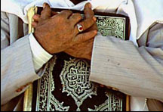
A'amaal for Laylatul Qadr
اعمال للَيْلَةُ الْقَدْرِ
Please DO NOT
place the
Holy Quran
on the floor.

Slide 243
A'amaal for Laylatul Qadr
اعمال للَيْلَةُ الْقَدْرِ
As there are no further Salaat, Brothers are requested to move as far forward as possible.

Slide 244
أَمَّنْ يُجيبُ الْمُضْطَرَّ إِذا دَعاهُ وَ يَكْشِفُ السُّوءَ {27:62}
A'amaal for Laylatul Qadr
اعمال للَيْلَةُ الْقَدْرِ
Du`á E Shifa Mareez
O, Who listens to the distressed when he calls on Him, and Who relieves his suffering (27:62)
Amman yujeebu almudtarra itha daAAahu wayakshifu alssooa

Slide 245
A'amaal for Laylatul Qadr
اعمال للَيْلَةُ الْقَدْرِ
Recommended general acts for “laylat al-qadr”
  Take a new Ghusl other than the first one, during the last hours of the night.
  Recite Surahs of ‘Ankabūt (No. 29), al-Rūm (No. 30) (Imam al-Sadiq (a.s) is reported to have said, “Anyone who recites these two Surahs at this night will be included with the people of Paradise.”) and Surah of al-Dukhān (No. 44).
  It is recommended to repeat Surah of al-Qadr (No. 97) One thousand times.
  This night is inextricably linked to the Imam of our time (A) Recite this Special Salaat of Imam (It is composed of 2 Rak'ats, each with Sūrat al-Fātiḥah, until one reaches verse: 5: "Iyyaka naA'budu wa iyyaka nastaA'een", then one repeats this verse 100 times, then completes the Surah. After Sūrat al-Fātiḥah, Sūrat al-Ikhlāṣ is recited once. The second Rak'ah is done in the same manner. After salaat, recited Dua Faraj.) & Dua from Sahifa Mahdi.
  Please visit : http://www.duas.org/23Ramadhanaamal.htm for more information.

Slide 246

Please recite
Sūrat al-Fātiḥah for
ALL MARHUMEEN
اعمال للَيْلَةُ الْقَدْرِ
A'amaal for Laylatul Qadr
For any errors / comments please write to: duas.org@gmail.com
Kindly recite Sūrat al-Fātiḥah for Marhumeen of all those who have worked towards making this small work possible.

