Slide 1
دعاء الأفتتاح‎‎‎‎
Dua’a al-Iftitah
(with Arabic text and English Translation and Transliteration)
For any errors / comments please write to: duas.org@gmail.com
Kindly recite Sūrat al-Fātiḥah for Marhumeen of all those who have worked towards making this small work possible.

Slide 2
Merits of Dua’a al-Iftitah
Dua’a al-Iftitah was taught by the Twelfth Imam Mehdi (A.S) to recite every night during the holy month Ramadan. The Du'a is excellent for moulding man's attitude towards his Creator, as it discusses many aspects of the wretchedness of the human being, and the grace of Allāh (SWT). The Dua can be divided into two parts: 1) Man's relationship with Allāh (SWT) & 2) Divine leaders.

Slide 3
اَللَّهُمَّ صَلِّ عَلَى مُحَمَّدٍ وَ آلِ مُحَمَّد
دعاء الأفتتاح
Dua’a al-Iftitah
O' Allāh send Your blessings on Muhammad
and the family of Muhammad.
allahumma salli `ala muhammadin wa ali muhammadin

Slide 4
بِسْمِ اللَّهِ الرَّحْمَٰنِ الرَّحِيمِ
دعاء الأفتتاح
Dua’a al-Iftitah
In the Name of Allāh,
the All-beneficent, the All-merciful.
bi-smi llahi r-rahmani r-rahimi

Slide 5
اللّهُمَّ إنِّي أَفْتَتِحُ الثَّنَاءَ بِحَمْدِكَ
دعاء الأفتتاح
Dua’a al-Iftitah
O Allāh: I begin the glorification of You with praising You:
allahumma inni aftatihuth-thana`a bihamdik

Slide 6
وَأَنْتَ مُسَدِّدٌ لِلصَّوَابِ بِمَنِّكَ
دعاء الأفتتاح
Dua’a al-Iftitah
And You always guide us to the right out of Your favoring upon us.
wa anta musaddidun lis-sawabi bimannik

Slide 7
وَأَيْقَنْتُ أَنَّكَ أَنْتَ أَرْحَمُ الرَّاحِمِينَ فِي مَوْضِعِ الْعَفْوِ وَالرَّحْمَةِ
دعاء الأفتتاح
Dua’a al-Iftitah
And I am certain that You are the most Merciful of all those who show mercy in situations of pardon and mercy
wa ayqantu annaka anta arhamur-rahimina fi maqdi’il-‘afwi war-rahmah

Slide 8
وَأَشَدُّ الْمُعَاقِبِينَ فِي مَوْضِعِ النَّكَالِ وَالنِّقِمَةِ
دعاء الأفتتاح
Dua’a al-Iftitah
But You are the very exacting in situations of giving exemplary punishment and chastisement (to the wrongdoers),
wa ashaddul-mu’aqibina fi mawdi’in-nakali wan-naqimah

Slide 9
وَأَعْظَمُ الْمُتَجَبِّرِينَ فِي مَوْضِعِ الْكِبْرِيَاءِ وَالْعَظَمَةِ.
دعاء الأفتتاح
Dua’a al-Iftitah
And You are the greatest Omnipotent in the domain of absolute power and might.
wa a’zamul-mutajabbirina fi mawdi’il-kibriya`i wal-‘azamah

Slide 10
اللّهُمَّ أَذِنْتَ لِي فِي دُعَائِكَ وَمَسْأَلَتِكَ
دعاء الأفتتاح
Dua’a al-Iftitah
O Allāh: You have permitted me to pray and beseech You.
allahumma adhinta li fi du’a`ika wamas`alatik

Slide 11
فَاسْمَعْ يَا سَمِيعُ مِدْحَتِي
دعاء الأفتتاح
Dua’a al-Iftitah
So, listen, O the All-hearer, to my words of praise,
fasma’ ya sami’u mid-hati

Slide 12
وَأَجِبْ يَا رَحِيمُ دَعْوَتِي
دعاء الأفتتاح
Dua’a al-Iftitah
And please reply my prayer; O the All-merciful.
wa ajib ya rahimu da’wati

Slide 13
وَأَقِلْ يَا غَفُورُ عَثْرَتِي
دعاء الأفتتاح
Dua’a al-Iftitah
And please overlook my slips; O the Oft-Forgiving.
wa aqil ya ghafuru ‘athrati

Slide 14
فَكَمْ يَا إلهِي مِنْ كُرْبَةٍ قَدْ فَرَّجْتَهَا
دعاء الأفتتاح
Dua’a al-Iftitah
You, O my God, have relieved so many of my grief's,
fakam ya ilahi min kurbatin qad farrajtaha

Slide 15
وَهُمُومٍ قَدْ كَشَفْتَهَا
دعاء الأفتتاح
Dua’a al-Iftitah
And You have dispelled so many of my sorrows
wahumumin qad kashaftaha

Slide 16
وَعَثْرَةٍ قَدْ أَقَلْتَهَا
دعاء الأفتتاح
Dua’a al-Iftitah
And You have overlooked so many of my slips,
wa ‘athratin qad aqaltaha

Slide 17
وَرَحْمَةٍ قَدْ نَشَرْتَهَا
دعاء الأفتتاح
Dua’a al-Iftitah
And You have spread over me many of Your mercies
warahmatin qad nashartaha

Slide 18
وَحَلْقَةِ بَلاءٍ قَدْ فَكَكْتَهَا؟
دعاء الأفتتاح
Dua’a al-Iftitah
And You have unlocked so many of rings of misfortunes (in which I was detained).
wahalaqati bala`in qad fakaktaha

Slide 19
الْحَمْدُ لِلّهِ الَّذِي لَمْ يَتَّخِذْ صَاحِبَةً وَلا وَلَداً
دعاء الأفتتاح
Dua’a al-Iftitah
All praise be to Allāh Who has not betaken wife or son,
al-hamdu lilllahil-ladhi lam yattakhidh sahibatan wa la walada

Slide 20
وَلَمْ يَكُنْ لَهُ شَرِيكٌ فِي الْمُلْكِ
دعاء الأفتتاح
Dua’a al-Iftitah
And Who has no partner in the sovereignty,
walam yakun lahu sharikun fil-mulk

Slide 21
وَلَمْ يَكُنْ لَهُ وَلِيٌّ مِنَ الذُّلِّ وَكَبِّرْهُ تَكْبِيراً.
دعاء الأفتتاح
Dua’a al-Iftitah
nor has He any protecting friend through dependence. And Magnify Him with all magnificence.
walam yakun lahu waliyyun minadh-dhulli wakabbirhu takbira

Slide 22
الله أكبر
دعاء الأفتتاح
Dua’a al-Iftitah
Allāh is [the] greatest!
Allahu Akbar

Slide 23
الْحَمْدُ لِلّهِ بِجَمِيعِ مَحَامِدِهِ كُلِّهَا عَلَى جَمِيعِ نِعَمِهِ كُلِّهَا.
دعاء الأفتتاح
Dua’a al-Iftitah
All praise be to Allāh with full gratitude for all His bounties.
al-hamdu lillahi bijami’i mahamidihi kulliha ‘ala jami’i ni’amihi kulliha

Slide 24
الْحَمْدُ لِلّهِ الَّذِي لا مُضَادَّ لَهُ فِي مُلْكِهِ
دعاء الأفتتاح
Dua’a al-Iftitah
All praise be to Allāh Who has no opposition in His rule,
al-hamdu lilllahil-ladhi la mudadda lahu fi mulkih

Slide 25
وَلا مُنَازِعَ لَهُ فِي أَمْرِهِ.
دعاء الأفتتاح
Dua’a al-Iftitah
nor there is any challenge to His commands.
wala munazi’a lahu fi amrih

Slide 26
الْحَمْدُ لِلّهِ الَّذِي لا شَرِيكَ لَهُ فِي خَلْقِهِ
دعاء الأفتتاح
Dua’a al-Iftitah
All praise be to Allāh Who has no counsel to meddle with His operation of creation,
al-hamdu lilllahil-ladhi la sharika lahu fi khalqih

Slide 27
وَلا شَبِيهَ لَهُ فِي عَظَمَتِهِ.
دعاء الأفتتاح
Dua’a al-Iftitah
nor there is anything similar to Him in His greatness.
wala shabiha lahu fi ‘azamatihi

Slide 28
الْحَمْدُ لِلّهِ الْفَاشِي فِي الْخَلْقِ أَمْرُهُ وَحَمْدُهُ
دعاء الأفتتاح
Dua’a al-Iftitah
All praise be to Allāh Whose commandments are active in the creation and the praising of Whom is incumbent.
al-hamdu lillahil-fashi fil-khalqi amruhu wahamduh

Slide 29
الظَّاهِرِ بِالْكَرَمِ مَجْدُهُ
دعاء الأفتتاح
Dua’a al-Iftitah
His glory is evident through His kindness,
az-zahiri bil-karami maj-duh

Slide 30
الْبَاسِطِ بِالْجُودِ يَدَهُ
دعاء الأفتتاح
Dua’a al-Iftitah
His distinct overflowing generosity is freely available,
al-basiti bil-judi yadah

Slide 31
الَّذِي لا تَنْقُصُ خَزَائِنُهُ
دعاء الأفتتاح
Dua’a al-Iftitah
His unlimited bestowals do not exhaust,
alladhi la tanqusu khaza`inuh

Slide 32
وَلا تَزِيدُهُ كَثْرَةُ الْعَطَاءِ إلاَّ جُوداً وَكَرَماً
دعاء الأفتتاح
Dua’a al-Iftitah
and He does not swell the numerous benefits except because of generosity and kindness.
wala taziduhu kathratul-‘ata`i illa judan wakarama

Slide 33
إنَّهُ هُوَ الْعَزِيزُ الْوَهَّابُ.
دعاء الأفتتاح
Dua’a al-Iftitah
Verily He is Mighty, Generous.
innahu huwal-‘azizul-wahhab

Slide 34
اللّهُمَّ إنِّي أَسْأَلُكَ قَلِيلاً مِنْ كَثِيرٍ
دعاء الأفتتاح
Dua’a al-Iftitah
O Allāh, I ask for some from much,
allahumma inni as`aluka qalilan min kathir

Slide 35
مَعَ حَاجَةٍ بِي إلَيْهِ عَظِيمَةٍ
دعاء الأفتتاح
Dua’a al-Iftitah
in the midst of my many needs for which I entirely depend on You,
ma’a hajatin bi ilayhi ‘azimah

Slide 36
وَغِنَاكَ عَنْهُ قَدِيمٌ وَهُوَ عِنْدِي كَثِيرٌ
دعاء الأفتتاح
Dua’a al-Iftitah
and You since eternity, are able to do without them, but for me it is a titanic effort
waghinaka ‘anhu qadimun wahuwa ‘indi kathir

Slide 37
وَهُوَ عَلَيْكَ سَهْلٌ يَسِيرٌ.
دعاء الأفتتاح
Dua’a al-Iftitah
and for You it is very easy and simple.
wahuwa ‘alayka sahlun yasir

Slide 38
اللّهُمَّ إنَّ عَفْوَكَ عَنْ ذَنْبِي
دعاء الأفتتاح
Dua’a al-Iftitah
O Allāh, truly, as You pardon my sins,
allahumma inna ‘afwaka ‘an dhanbi

Slide 39
وَتَجَاوُزَكَ عَنْ خَطِيئَتِي
دعاء الأفتتاح
Dua’a al-Iftitah
And You overlook my mistakes;
watajawuzaka ‘an khati`ati

Slide 40
وَصَفْحَكَ عَنْ ظُلْمِي
دعاء الأفتتاح
Dua’a al-Iftitah
And You take a lenient view of my disorderly conduct,
wasafhaka ‘an zulmi

Slide 41
وَسِتْرَكَ عَلَى قَبِيحِ عَمَلِي
دعاء الأفتتاح
Dua’a al-Iftitah
And You cover up my foul actions,
wasitraka ‘ala qabihi ‘amali

Slide 42
وَحِلْمَكَ عَنْ كَثِيرِ جُرْمِي عِنْدَ مَا كَانَ مِنْ خَطَإي وَعَمْدِي
دعاء الأفتتاح
Dua’a al-Iftitah
And You show consideration in spite of my many transgressions committed willfully or negligently,
wahilmaka ‘an kathiri jurmi ‘ind ma kana min khata`i wa ‘amdi

Slide 43
أَطْمَعَنِي فِي أَنْ أَسْأَلَكَ مَا لا أَسْتَوْجِبُهُ مِنْكَ الَّذِي رَزَقْتَنِي مِنْ رَحْمَتِكَ
دعاء الأفتتاح
Dua’a al-Iftitah
All that tempted me to ask for that which I do not deserve, from You, on account of Your mercy, that You may give me the daily bread;
atma’ani fi an as`alaka ma la astawjibuhu minkal-ladhi razaqtani min rahmatik

Slide 44
وَأَرَيْتَنِي مِنْ قُدْرَتِكَ
دعاء الأفتتاح
Dua’a al-Iftitah
And You may provide with that which is suitable for me, through Your control;
wa araytani min qudratik

Slide 45
وَعَرَّفْتَنِي مِنْ إجَابَتِكَ
دعاء الأفتتاح
Dua’a al-Iftitah
And You may distinguish me with favorable reply to my requests.
wa ‘arraftani min ijabatik

Slide 46
فَصِرْتُ أَدْعُوكَ آمِناً
دعاء الأفتتاح
Dua’a al-Iftitah
So, I persist in calling out, believing in You,
fasirtun ad-‘uka aminan

Slide 47
وَأَسْأَلُكَ مُسْتَأْنِساً لا خَائِفاً وَلا وَجِلاً
دعاء الأفتتاح
Dua’a al-Iftitah
and I invoke You, talking familiarly, not afraid, nor shy,
wa as`aluka musta`nisan la kha`ifan wala wajila

Slide 48
مُدِلاً عَلَيْكَ فِيمَا قَصَدْتُ فِيهِ إلَيْكَ
دعاء الأفتتاح
Dua’a al-Iftitah
but assured of Your love and kindness whenever I turn to You.
mudillan ‘alayka fi ma qadhadtu fihi ilayk

Slide 49
فَإنْ أَبْطَأ عَنِّي عَتَبْتُ بِجَهْلِي عَلَيْكَ
دعاء الأفتتاح
Dua’a al-Iftitah
A temporary setback and I, out of ignorance, begin to despair,
fa`in abta`a ‘anni ‘atabtu bijahli ‘alayk

Slide 50
وَلَعَلَّ الَّذِي أَبْطَأَ عَنِّي هُوَ خَيْرٌ لِي لِعِلْمِكَ بِعَاقِبَةِ الأُمُورِ
دعاء الأفتتاح
Dua’a al-Iftitah
although perhaps slowing down may be a blessing in disguise, because You alone knows (all) the consequences.
wala’allal-ladhi abta`a ‘anni huwa khayrun li li-‘ilmika bi-‘aqibatil umur

Slide 51
فَلَمْ أَرَ مَوْلَىً كَرِيماً أَصْبَرَ عَلَى عَبْدٍ لَئِيمٍ مِنْكَ عَلَيَّ
دعاء الأفتتاح
Dua’a al-Iftitah
I do not know a generous Master who is more accommodating to the dissatisfied servants than You are to me.
falam ara mawlan kariman asbara ‘ala ‘abdin la`imin minka ‘alayya ya rabb

Slide 52
يَارَبِّ إنَّكَ تَدْعُونِي فَأُوَلِّي عَنْكَ
دعاء الأفتتاح
Dua’a al-Iftitah
O Lord! You give an invitation but I turn down,
innaka tad-‘uni fa-uwalliya ‘ank

Slide 53
وَتَتَحَبَّبُ إلَيَّ فأَتَبَغَّضُ إلَيْكَ
دعاء الأفتتاح
Dua’a al-Iftitah
And You become familiar with me but I do not care for You,
watatahabbabu ilayya fa-atabaghghadu ilayk

Slide 54
وَتَتَوَدَّدُ إلَيَّ فَلا أَقْبَلُ مِنْكَ
دعاء الأفتتاح
Dua’a al-Iftitah
And You show affection to me but I do not correspond to You
watatawaddadu ilayya fala aqbalu mink

Slide 55
كَأَنَّ لِيَ التَّطَوُّلَ عَلَيْكَ
دعاء الأفتتاح
Dua’a al-Iftitah
as if You are overreaching me!
ka`anna liyat-tatawwula ‘alayk

Slide 56
فَلَمْ يَمْنَعْكَ ذلِكَ مِنَ الرَّحْمَةِ لِي وَالإحْسَانِ إلَيَّ
دعاء الأفتتاح
Dua’a al-Iftitah
Yet You do not abstain from having mercy upon me and doing favors to me
falam yamna’ka dhalika minar-rahmati li wal-ihsani ilayy

Slide 57
وَالتَّفَضُّلِ عَلَيَّ بِجُودِكَ وَكَرَمِكَ
دعاء الأفتتاح
Dua’a al-Iftitah
and blessing me out of Your magnanimity and generosity,
wat-tafadduli ‘alayya bijudika wakaramik

Slide 58
فَارْحَمْ عَبْدَكَ الْجَاهِلَ وَجُدْ عَلَيْهِ بِفَضْلِ إحْسَانِكَ
دعاء الأفتتاح
Dua’a al-Iftitah
So, (please) have mercy on Your ignorant servant and bestow upon him with the favors of Your beneficence
farham ‘abdakal-jahila wajud ‘alayhi bifadli ihsanik

Slide 59
إنَّكَ جَوَادٌ كَرِيمٌ.
دعاء الأفتتاح
Dua’a al-Iftitah
Verily, You are Generous and Kind.
innaka jawadun karim

Slide 60
الْحَمْدُ لِلّهِ مَالِكِ الْمُلْكِ
دعاء الأفتتاح
Dua’a al-Iftitah
All praise be to Allāh: the owner of the sovereignty,
al-hamdu lillahi malikil-mulk

Slide 61
مُجْرِي الْفُلْكِ
دعاء الأفتتاح
Dua’a al-Iftitah
Who sets the course of skies and the stars,
mujril-fulk

Slide 62
مُسَخِّرِ الرِّيَاحِ
دعاء الأفتتاح
Dua’a al-Iftitah
Who controls the winds,
musakhkhirir-riyah

Slide 63
فَالِقِ الإصْبَاحِ
دعاء الأفتتاح
Dua’a al-Iftitah
Who causes the day break,
faliqil-isbah

Slide 64
دَيَّانِ الدِّينِ
دعاء الأفتتاح
Dua’a al-Iftitah
and Who administers the authority:
dayyanid-din

Slide 65
رَبِّ الْعَالَمِينَ.
دعاء الأفتتاح
Dua’a al-Iftitah
the Lord of the worlds.
rabbil-‘alamin

Slide 66
الْحَمْدُ لِلّهِ عَلَى حِلْمِهِ بَعْدَ عِلْمِهِ
دعاء الأفتتاح
Dua’a al-Iftitah
All praise be to Allāh for His indulgence although He has full acquaintance with all things.
al-hamdu lillahi ‘ala hilmihi ba’da ‘ilmih

Slide 67
وَالْحَمْدُ لِلّهِ عَلَى عَفْوِهِ بَعْدَ قُدْرَتِهِ
دعاء الأفتتاح
Dua’a al-Iftitah
All praise be to Allāh for His amnesty although He has full power over all things.
wal-hamdu lillahi ‘ala ‘afwihi ba’da qudratih

Slide 68
وَالْحَمْدُ لِلّهِ عَلَى طُولِ أَنَاتِهِ فِي غَضَبِهِ
دعاء الأفتتاح
Dua’a al-Iftitah
All praise be to Allāh for the respite that He allows in spite of provocation.
wal-hamdu lillahi ‘ala tuli anatihi fi ghadabih

Slide 69
وَهُوَ قَادِرٌ عَلَى مَا يُرِيدُ.
دعاء الأفتتاح
Dua’a al-Iftitah
He is able to do whatever He wills.
wahuwa qadirn ‘ala ma yurid

Slide 70
الْحَمْدُ لِلّهِ خَالِقِ الْخَلْقِ
دعاء الأفتتاح
Dua’a al-Iftitah
All praise be to Allāh, the Creator of all the created beings,
al-hamdu lillahi khaliqil-khalq

Slide 71
بَاسِطِ الرِّزْقِ
دعاء الأفتتاح
Dua’a al-Iftitah
Who makes the sustenance freely available,
basitir-rizq

Slide 72
فَالِقِ الإصْبَاحِ
دعاء الأفتتاح
Dua’a al-Iftitah
Who starts the day,
faliqil-isbah

Slide 73
ذِي الْجَلالِ وَالإكْرَامِ وَالْفَضْلِ وَالإنْعَامِ
دعاء الأفتتاح
Dua’a al-Iftitah
Who is the Owner of glory, might, favours, and bounties,
dhil-jalali wal-ikrami wal-fadli wal-in’am

Slide 74
الَّذِي بَعُدَ فَلا يُرَى
دعاء الأفتتاح
Dua’a al-Iftitah
And Who is so far away that none can ever see Him,
alladhi ba’uda fala yura

Slide 75
وَقَرُبَ فَشَهِدَ النَّجْوَى
دعاء الأفتتاح
Dua’a al-Iftitah
And, in the same time, He is so near that He is fully aware of even the whispering secrets.
waqaruba fashahidan-najwa

Slide 76
تَبَارَكَ وَتَعَالَى.
دعاء الأفتتاح
Dua’a al-Iftitah
Blessed and Exalted be He.
tabaraka wata’ala

Slide 77
الْحَمْدُ لِلّهِ الَّذِي لَيْسَ لَهُ مُنَازِعٌ يُعَادِلُهُ
دعاء الأفتتاح
Dua’a al-Iftitah
All praise be to Allāh Who has no equal to challenge Him,
al-hamdu lillahil-ladhi laysa lahu munazi’un yu’adiluh

Slide 78
وَلا شَبِيهٌ يُشَاكِلُهُ
دعاء الأفتتاح
Dua’a al-Iftitah
nor is there an image comparable to Him,
wala shabihun yushakiluh

Slide 79
وَلا ظَهِيرٌ يُعَاضِدُهُ
دعاء الأفتتاح
Dua’a al-Iftitah
nor is there a helper to assist Him.
wala zahirun yu’adiduh

Slide 80
قَهَرَ بِعِزَّتِهِ الأَعِزَّاءَ
دعاء الأفتتاح
Dua’a al-Iftitah
He tames the powerful by (His) force,
qahara bi’izzatihil-a’izza`

Slide 81
وَتَوَاضَعَ لِعَظَمَتِهِ الْعُظَمَاءُ
دعاء الأفتتاح
Dua’a al-Iftitah
and disgraced are the great ones before His Greatness,
watawada’a li-‘azamatihil-‘uzama`

Slide 82
فَبَلَغَ بِقُدْرَتِهِ مَا يَشَاءُ.
دعاء الأفتتاح
Dua’a al-Iftitah
so He, through His power, fulfills that which He wills.
fabalagha biqudratihi ma yasha`

Slide 83
الْحَمْدُ لِلّهِ الَّذِي يُجِيبُنِي حِينَ أُنَادِيهِ
دعاء الأفتتاح
Dua’a al-Iftitah
All praise be to Allāh Who gives answer to me whenever I call Him;
al-hamdu lillahil-ladhi yujibuni hina unadih

Slide 84
وَيَسْتُرُ عَلَيَّ كُلَّ عَوْرَةٍ وَأَنَا أَعْصِيهِ
دعاء الأفتتاح
Dua’a al-Iftitah
And He covers up my shortcomings, yet I disobey Him;
wayasturu ‘alayya kulla ‘awratin wa-ana a’sih

Slide 85
وَيُعَظِّمُ النِّعْمَةَ عَلَيَّ فَلا أُجَازِيهِ
دعاء الأفتتاح
Dua’a al-Iftitah
And He gives me the largest part of the bounties, yet I do not show his gratitude.
wayu’azzimun-ni’mata ‘alayya fala ujazih

Slide 86
فَكَمْ مِنْ مَوْهِبَةٍ هَنِيئَةٍ قَدْ أَعْطَانِي
دعاء الأفتتاح
Dua’a al-Iftitah
Many a auspicious favors had He given me;
fakam min mawhibatin hani`atin qad a’tani

Slide 87
وَعَظِيمَةٍ مَخُوفَةٍ قَدْ كَفَانِي
دعاء الأفتتاح
Dua’a al-Iftitah
And many a terrible dangers had He turned off,
wa’azimatin makhufatin qad kafani

Slide 88
وَبَهْجَةٍ مُونِقَةٍ قَدْ أَرَانِي؟
دعاء الأفتتاح
Dua’a al-Iftitah
And many a blossoming joys had He made available for me,
wabahjatin muniqatin qad arani

Slide 89
فَأُثْنِي عَلَيْهِ حَامِداً
دعاء الأفتتاح
Dua’a al-Iftitah
Therefore, I sing His praises and recite His glorifications.
fa-uthni ‘alayhi hamida

Slide 90
وَأَذْكُرُهُ مُسَبِّحاً.
دعاء الأفتتاح
Dua’a al-Iftitah
And mention Him with exaltation.
wa-adhkuruhu musabbiha

Slide 91
الْحَمْدُ لِلّهِ الَّذِي لا يُهْتَكُ حِجَابُهُ
دعاء الأفتتاح
Dua’a al-Iftitah
All praise be to Allāh Whose screen cannot be penetrated
al-hamdu lillahil-ladhi la yuhtaku hijabuh

Slide 92
وَلا يُغْلَقُ بَابُهُ
دعاء الأفتتاح
Dua’a al-Iftitah
And Whose door is not blocked;
wala yughlaqu babuh

Slide 93
وَلا يُرَدُّ سَائِلُهُ
دعاء الأفتتاح
Dua’a al-Iftitah
And Whose beseecher is not rejected;
wala yuraddu sa`ilhu

Slide 94
وَلا يُخَيَّبُ آمِلُهُ.
دعاء الأفتتاح
Dua’a al-Iftitah
And one who hopes Him is not disappointed.
wala yukhayyabu amiluh

Slide 95
الْحَمْدُ لِلّهِ الَّذِي يُؤْمِنُ الْخَائِفِينَ
دعاء الأفتتاح
Dua’a al-Iftitah
All praise be to Allāh Who secures the frightened ones,
al-hamdu lillahil-ladhi yu`minul-kha`ifin

Slide 96
وَيُنَجِّي الصَّالِحِينَ
دعاء الأفتتاح
Dua’a al-Iftitah
Who comes to the help of the upright ones,
wayunajjis-salihin

Slide 97
وَيَرْفَعُ الْمُسْتَضْعَفِينَ
دعاء الأفتتاح
Dua’a al-Iftitah
Who promotes the cause of the weak ones,
wayarfa’ul-mustad-‘afin

Slide 98
وَيَضَعُ الْمُسْتَكْبِرِينَ
دعاء الأفتتاح
Dua’a al-Iftitah
annihilates the autocrats,
wayada’ul-mustakbirin

Slide 99
وَيُهْلِكُ مُلُوكاً وَيَسْتَخْلِفُ آخَرِينَ؛
دعاء الأفتتاح
Dua’a al-Iftitah
Who destroys rulers and appoints others instead.
wayuhliku mulukan wayastakhlifu akharin

Slide 100
وَالْحَمْدُ لِلّهِ قَاصِمِ الْجَبَّارِينَ
دعاء الأفتتاح
Dua’a al-Iftitah
All praise be to Allāh; the Eradicator of the tyrants,
wal-hamdu lillahi qasimil-jabbarin

Slide 101
مُبِيرِ الظَّالِمِينَ
دعاء الأفتتاح
Dua’a al-Iftitah
The Terminator of the unjust ones,
mubiriz-zalimin

Slide 102
مُدْرِكِ الْهَارِبِينَ
دعاء الأفتتاح
Dua’a al-Iftitah
The Catcher of the fugitives,
mudrikil-haribin

Slide 103
نَكَالِ الظَّالِمِينَ
دعاء الأفتتاح
Dua’a al-Iftitah
The Punisher of the unjust ones,
nakaliz-zalimin

Slide 104
صَرِيخِ الْمُسْتَصْرِخِينَ
دعاء الأفتتاح
Dua’a al-Iftitah
The aide of the seekers of aid,
sarikhil-mustasrikhin

Slide 105
مَوْضِعِ حَاجَاتِ الطَّالِبِينَ
دعاء الأفتتاح
Dua’a al-Iftitah
The Settler of the needs of the beseechers,
mawdi’i hajatit-talibin

Slide 106
مُعْتَمَدِ الْمُؤْمِنِينَ.
دعاء الأفتتاح
Dua’a al-Iftitah
And the support of the faithful believers.
mu’tamadil-mu`minin

Slide 107
الْحَمْدُ لِلّهِ الَّذِي مِنْ خَشْيَتِهِ تَرْعُدُ السَّمَاءُ وَسُكَّانُهَا
دعاء الأفتتاح
Dua’a al-Iftitah
All praise be to Allāh! In His awe-inspiring fear the heavens and its dwellers tremble and shiver,
al-hamdu lillahil-ladhi min khashyatihi tar-‘udus-sama`u wasukkanuha

Slide 108
وَتَرْجُفُ الأَرْضُ وَعُمَّارُهَا
دعاء الأفتتاح
Dua’a al-Iftitah
And the earth and its inhabitants shake and quiver,
watarjuful-ardu wa-‘ummaruha

Slide 109
وَتَمُوجُ الْبِحَارُ وَمَنْ يَسْبَحُ فِي غَمَرَاتِهَا
دعاء الأفتتاح
Dua’a al-Iftitah
And the oceans and all that which float and swim in their waters flow together in excitement and tumult.
watamujul-biharu waman yasbahu fi ghamaratiha

Slide 110
الْحَمْدُ لِلّهِ الَّذِي هَدَانَا لِهذَا وَمَا كُنَّا لِنَهْتَدِيَ لَوْلا أَنْ هَدَانَا اللّهُ.
دعاء الأفتتاح
Dua’a al-Iftitah
All praise be to Allāh Who has guided us to this. We could not truly have been led aright if Allāh had not guided us.
al-hamdu lillahil-ladhi hadana lihadha wama kunna linahtadiya lawla an hadanal-lah

Slide 111
الْحَمْدُ لِلّهِ الَّذِي يَخْلُقُ وَلَمْ يُخْلَقْ
دعاء الأفتتاح
Dua’a al-Iftitah
All praise be to Allāh Who creates but He is not created;
al-hamdu lillahil-ladhi yakhluqu walam yukhlaq

Slide 112
وَيَرْزُقُ وَلا يُرْزَقُ
دعاء الأفتتاح
Dua’a al-Iftitah
And He gives subsistence but He needs no provisions;
wayarzuqu wala yurzaq

Slide 113
وَيُطْعِمُ وَلا يُطْعَمُ
دعاء الأفتتاح
Dua’a al-Iftitah
And He gives food to eat but He takes no nourishment,
wayut-‘imu wala yut-‘am

Slide 114
وَيُمِيتُ الأَحْيَاءَ
دعاء الأفتتاح
Dua’a al-Iftitah
And He makes the living dead
wayumitul-ahya`

Slide 115
وَيُحْيِي الْمَوْتَى
دعاء الأفتتاح
Dua’a al-Iftitah
And He brings the dead to life,
wayuhyil-mawta

Slide 116
وَهُوَ حَيٌّ لا يَمُوتُ
دعاء الأفتتاح
Dua’a al-Iftitah
But He is the Ever living, there is no death for Him,
wahuwa hayyun la yamut

Slide 117
بِيَدِهِ الْخَيْرُ
دعاء الأفتتاح
Dua’a al-Iftitah
in His hands is all the good,
biyadihil-khayr

Slide 118
وَهُوَ عَلَى كُلِّ شَيْءٍ قَدِيرٌ.
دعاء الأفتتاح
Dua’a al-Iftitah
and He is able to do all things.
wahuwa ‘ala kulli shay`in qadir

Slide 119
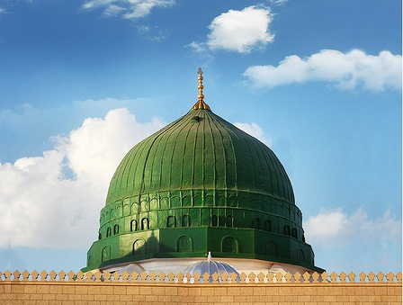
اللّهُمَّ صَلِّ عَلَى مُحَمَّدٍ عَبْدِكَ وَرَسُولِكَ
دعاء الأفتتاح
Dua’a al-Iftitah
O Allāh: (please do) send blessings on Muhammad, Your servant and Messenger,
allahumma salli ‘ala muhammadin ‘abdika warasulik

Slide 120
وَأَمِينِكَ وَصَفِيِّكَ وَحَبِيبِكَ
دعاء الأفتتاح
Dua’a al-Iftitah
And Your confidant, friend, and beloved intimate,
wa-aminika wasafiyyika wahabibik

Slide 121
وَخِيَرَتِكَ مِنْ خَلْقِكَ
دعاء الأفتتاح
Dua’a al-Iftitah
And the choicest of Your created beings,
wakhiyaratika min khalqik

Slide 122
وَحَافِظِ سِرِّكَ
دعاء الأفتتاح
Dua’a al-Iftitah
And the bearer of Your sacraments,
wahafizi sirrik

Slide 123
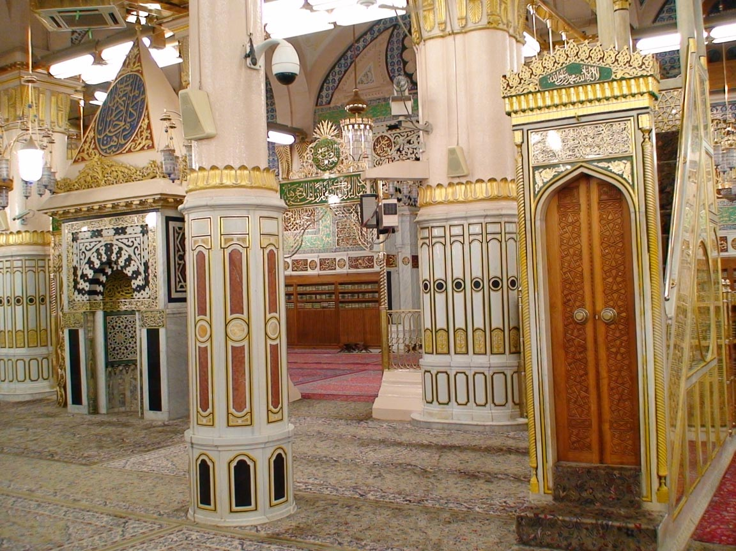
وَمُبَلِّغِ رِسَالاتِكَ
دعاء الأفتتاح
Dua’a al-Iftitah
And the quotient of Your Messengers,
wamuballighi risalatik

Slide 124
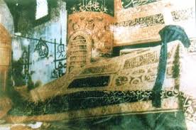
دعاء الأفتتاح
Dua’a al-Iftitah
أَفْضَلَ وَأَحْسَنَ وَأَجْمَلَ
With the most superior, the most exquisite, the most handsomer,
afdala wa-ahsana wa-ajmal

Slide 125
دعاء الأفتتاح
Dua’a al-Iftitah
وَأَكْمَلَ وَأَزْكَى وَأَنْمَى
the most perfect, the most upright, the most prospering,
wa-akmala wa-azka wa-anma

Slide 126
وَأَطْيَبَ وَأَطْهَرَ وَأَسْنَى
دعاء الأفتتاح
Dua’a al-Iftitah
the most pleasant, the most thoroughly purified, the most sublime;
wa-atyaba wa-athara wa-asna

Slide 127
وَأَكْثَرَ مَا صَلَّيْتَ وَبَارَكْتَ
دعاء الأفتتاح
Dua’a al-Iftitah
The most and the best blessings, advantages,
wa-akthara ma sallayta wabarakta

Slide 128
وَتَرَحَّمْتَ وَتَحَنَّنْتَ
دعاء الأفتتاح
Dua’a al-Iftitah
mercies, affections
watarahhamta watahannanta

Slide 129
وَسَلَّمْتَ عَلَى أَحَدٍ مِنْ عِبَادِكَ وَأَنْبِيَائِكَ
دعاء الأفتتاح
Dua’a al-Iftitah
And salutations that You have ever made available to anyone of Your servants and Prophets,
wasallamta ‘ala ahadin min ‘ibadika wa-anbiya`ik

Slide 130
وَرُسُلِكَ وَصِفْوَتِكَ وَأَهْلِ الْكَرَامَةِ عَلَيْكَ مِنْ خَلْقِكَ.
دعاء الأفتتاح
Dua’a al-Iftitah
And Messengers and choicest people and those honored by You from among Your created beings.
warusulika wasafwatika wa-ahlil-karamati ‘alayka min khalqik

Slide 131
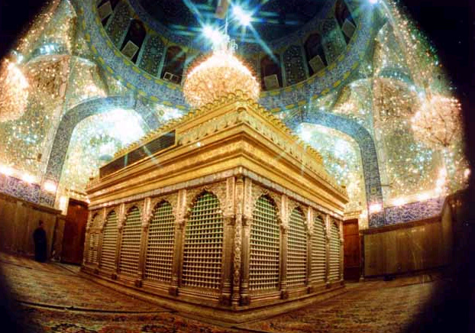
دعاء الأفتتاح
Dua’a al-Iftitah
اللّهُمَّ وَصَلِّ عَلَى عَلِيٍّ أَمِيرِ الْمُؤْمِنِينَ
O Allāh: (please do) send blessings on `Ali, the Commander of the Believers,
allahumma wasalli ‘ala ‘aliyyin amiril-mu`minin

Slide 132
دعاء الأفتتاح
Dua’a al-Iftitah
وَوَصِيِّ رَسُولِ رَبِّ الْعَالَمِينَ
And the successor of the Messenger of the Lord of the worlds:
wawasiyyi rasuli rabbil-‘alamin

Slide 133
دعاء الأفتتاح
Dua’a al-Iftitah
عَبْدِكَ وَوَلِيِّكَ وَأَخِي رَسُولِكَ
Your servant, Your beloved representative, and the brother of Your Messenger,
‘abdika wawaliyyika wa-akhi rasulik

Slide 134
وَحُجَّتِكَ عَلَى خَلْقِكَ
دعاء الأفتتاح
Dua’a al-Iftitah
and Your decisive argument over the mankind,
wahujjatika ‘ala khalqik

Slide 135
وَآيَتِكَ الْكُبْرَى
دعاء الأفتتاح
Dua’a al-Iftitah
And Your most important sign,
wa-ayatikal-kubra

Slide 136
وَالنَّبَأَ الْعَظِيمِ
دعاء الأفتتاح
Dua’a al-Iftitah
And the great news (from You).
wan-naba`il-‘azim

Slide 137
وَصَلِّ عَلَى الصِّدِّيقَةِ الطَّاهِرَةِ
دعاء الأفتتاح
Dua’a al-Iftitah
And (please do) send blessings on the truthful, pure Lady,
wasalli ‘alas-siddiqatit-tahirah

Slide 138
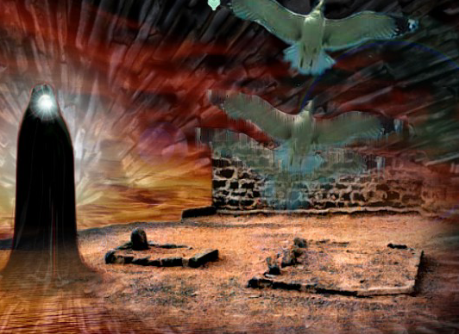
دعاء الأفتتاح
Dua’a al-Iftitah
فَاطِمَةَ سَيِّدَةِ نِسَاءِ الْعَالَمِينَ
Fatimah: the Doyenne of the women of the world.
fatimata sayyidati nisa`il-‘alamin

Slide 139
وَصَلِّ عَلَى سِبْطَيِ الرَّحْمَةِ
دعاء الأفتتاح
Dua’a al-Iftitah
And (please do) send blessings on the sons of ‘the mercy to the worlds’
wasalli ‘ala sibtayir-rahmah

Slide 140
وَإمَامَيِ الْهُدَى
دعاء الأفتتاح
Dua’a al-Iftitah
And the two leaders of true guidance,
wa-imamayil-huda

Slide 141
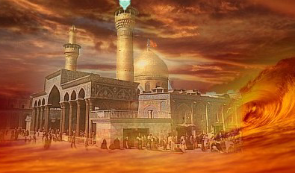
دعاء الأفتتاح
Dua’a al-Iftitah
الْحَسَنِ وَالْحُسَيْنِ
Al-Hasan and al-Husayn,
al-hasani wal-husayn

Slide 142
سَيِّدَيْ شَبَابِ أَهْلِ الْجَنَّةِ
دعاء الأفتتاح
Dua’a al-Iftitah
the two Chiefs of the dwellers of Paradise.
sayyiday shababi ahlil-jannah

Slide 143
وَصَلِّ عَلَى أَئِمَّةِ الْمُسْلِمِينَ:
دعاء الأفتتاح
Dua’a al-Iftitah
And (please do) send blessings on the leaders of the Muslims,
wasalli ‘ala a`immatil-muslimin

Slide 144
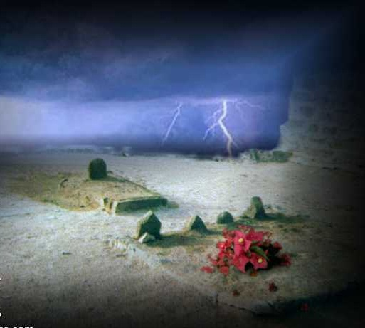
دعاء الأفتتاح
Dua’a al-Iftitah
عَلِيِّ بْنِ الْحُسَيْنِ
`Ali bin al-Husayn,
‘aliyyibnil-husayn

Slide 145
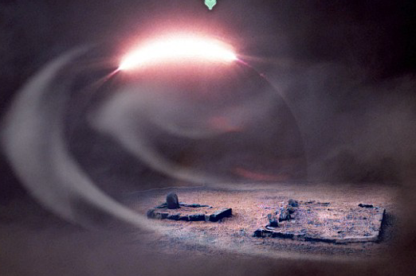
دعاء الأفتتاح
Dua’a al-Iftitah
وَمُحَمَّدِ بْنِ عَلِيٍّ
Muhammad bin `Ali,
wa muhammadibni ‘aliyy

Slide 146
دعاء الأفتتاح
Dua’a al-Iftitah
وَجَعْفَرِ بْنِ مُحَمَّدٍ
Ja`far bin Muhammad,
wa ja’faribni muhammad

Slide 147
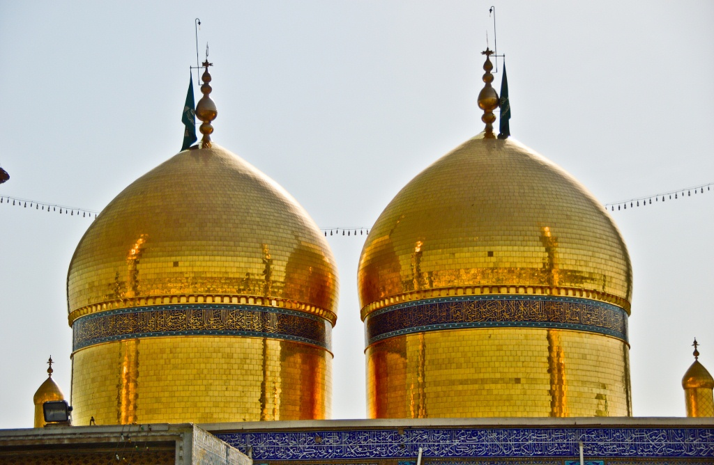
دعاء الأفتتاح
Dua’a al-Iftitah
وَمُوسَى بْنِ جَعْفَرٍ
Musa bin Ja`far,
wa musabni ja’far

Slide 148
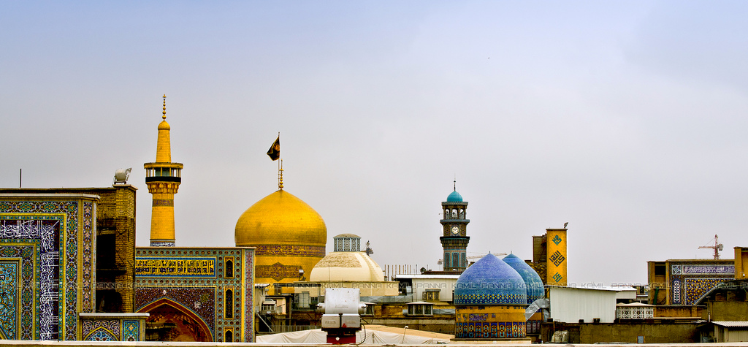
دعاء الأفتتاح
Dua’a al-Iftitah
وَعَلِيِّ بْنِ مُوسَى
`Ali bin Musa,
wa ’aliyyibni musa

Slide 149
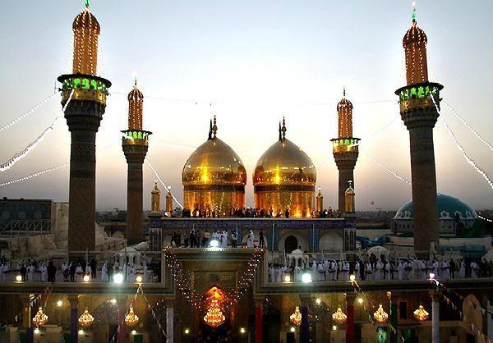
دعاء الأفتتاح
Dua’a al-Iftitah
وَمُحَمَّدِ بْنِ عَلِيٍّ
Muhammad bin `Ali,
wamuhammadibni ‘aliyy

Slide 150
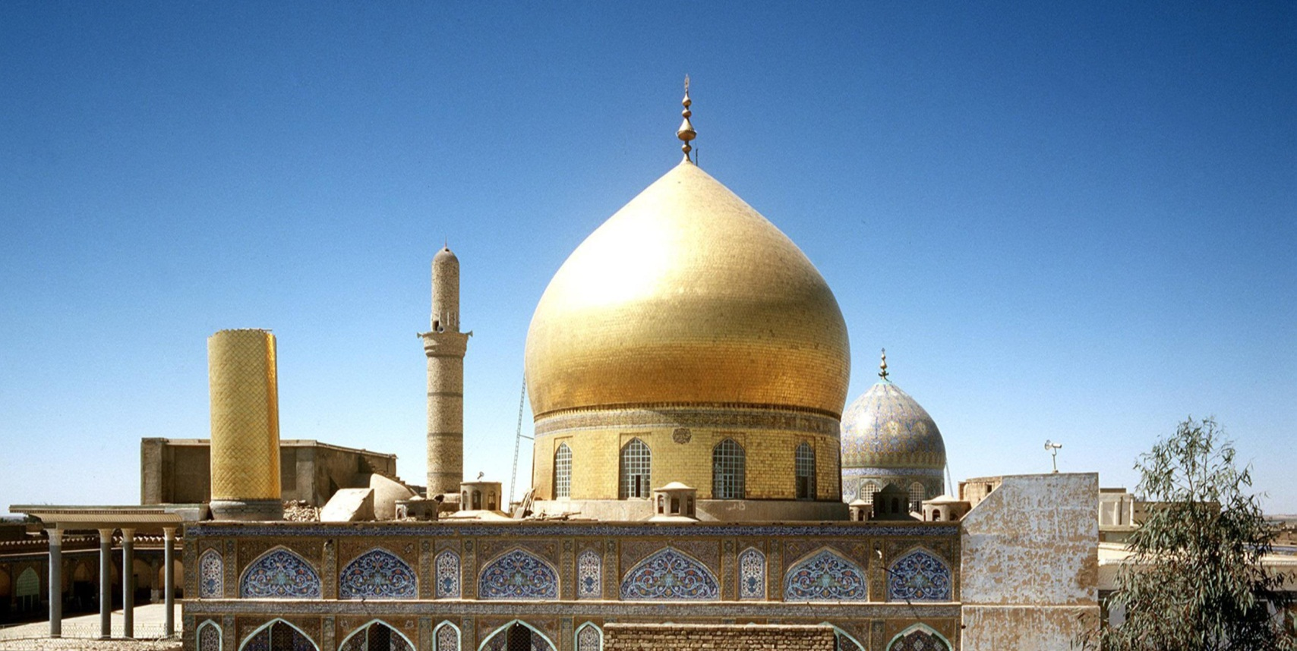
دعاء الأفتتاح
Dua’a al-Iftitah
وَعَلِيِّ بْنِ مُحَمَّدٍ
`Ali bin Muhammad,
wa ‘aliyyibni muhammad

Slide 151
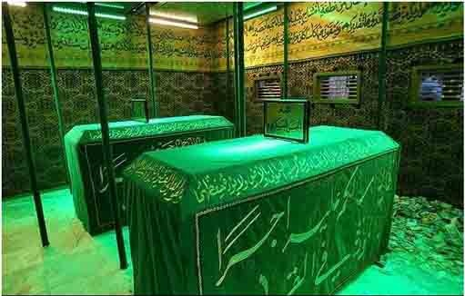
دعاء الأفتتاح
Dua’a al-Iftitah
وَالْحَسَنِ بْنِ عَلِيٍّ
Al-Hasan bin `Ali,
wal-hasanibni ‘aliyy

Slide 152
دعاء الأفتتاح
Dua’a al-Iftitah
وَالْخَلَفِ الْهَادِي الْمَهْدِيِّ
and the successor, the guide, and the rightly guided
wal-khalafil-hadil-mahdiyy

Slide 153
حُجَجِكَ عَلَى عِبَادِكَ
دعاء الأفتتاح
Dua’a al-Iftitah
(Those Imams are) Your decisive arguments over Your servants,
hujajika ‘ala ‘ibadik

Slide 154
وَأُمَنَائِكَ فِي بِلادِكَ
دعاء الأفتتاح
Dua’a al-Iftitah
Your trustworthy confidants in Your lands—
wa-umana`ika fi biladik

Slide 155
صَلاةً كَثِيرَةً دَائِمَةً.
دعاء الأفتتاح
Dua’a al-Iftitah
Blessings that are numerous and non-stop.
salatan kathiratan da`imah

Slide 156
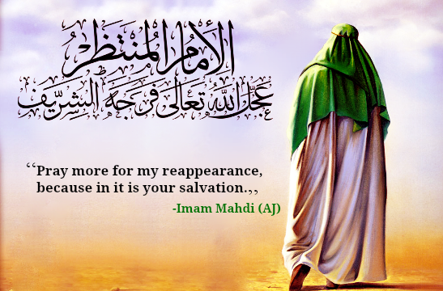
دعاء الأفتتاح
Dua’a al-Iftitah
اللّهُمَّ وَصَلِّ عَلَى وَليِّ أَمْرِكَ
O Allāh: (please do) send blessings on the custodian of Your commandments,
allahumma wasalli ‘ala waliyyi amrik

Slide 157
دعاء الأفتتاح
Dua’a al-Iftitah
الْقَائِمِ الْمُؤَمَّلِ
The vigilant guardian, the reliable patron,
al-qa`imil-mu`ammal

Slide 158
دعاء الأفتتاح
Dua’a al-Iftitah
وَالْعَدْلِ الْمُنْتَظَرِ
And the awaited justice.
wal’adlil-muntazar

Slide 159
دعاء الأفتتاح
Dua’a al-Iftitah
وَحُفَّهُ بِمَلائِكَتِكَ الْمُقَرَّبِينَ
And (please) surround him with Your favorite Angels,
wahuffahu bimala`ikatikal-muqarrabin

Slide 160
دعاء الأفتتاح
Dua’a al-Iftitah
وَأَيِّدْهُ بِرُوحِ الْقُدُسِ
And assist him with the Holy Spirit.
wa-ayyid-hu biruhil-qudus

Slide 161
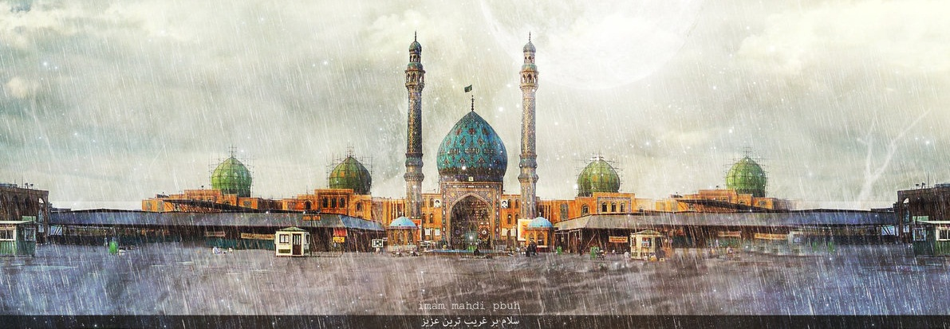
دعاء الأفتتاح
Dua’a al-Iftitah
يَارَبَّ الْعَالَمِينَ.
O the Lord of the worlds.
ya rabbal-‘alamin

Slide 162
اللّهُمَّ اجْعَلْهُ الدَّاعِيَ إلَى كِتَابِكَ وَالْقَائِمَ بِدِينِكَ
دعاء الأفتتاح
Dua’a al-Iftitah
O Allāh: (please) choose him to be the caller to Your Book and the for establisher of Your religion,
allahummaj-‘alhud-da’iya ila kitabik wal-qa`ima bidinik

Slide 163
اسْتَخْلِفْهُ فِي الأَرْضِ كَمَا اسْتَخْلَفْتَ الَّذِينَ مِنْ قَبْلِهِ
دعاء الأفتتاح
Dua’a al-Iftitah
and make him succeed in the earth as You caused those who were before him to succeed,
istakhlifhu fil-ardi kamas-takhlaftal-ladhina min qablih

Slide 164
مَكِّنْ لَهُ دِينَهُ الَّذِي ارْتَضَيْتَهُ لَهُ
دعاء الأفتتاح
Dua’a al-Iftitah
and establish for him his faith which You have approved for him
makkin lahu dinahul-ladhir-tadaytahu lah

Slide 165
أَبْدِلْهُ مِنْ بَعْدِ خَوْفِهِ أَمْناً
دعاء الأفتتاح
Dua’a al-Iftitah
And give him in exchange safety after the fear.
abdilhu min ba’di khawfihi amna

Slide 166
يَعْبُدُكَ لا يُشْرِكُ بِكَ شَيْئاً.
دعاء الأفتتاح
Dua’a al-Iftitah
He serves You. He ascribes nothing as partner to You.
ya’buduka ya yushriku bika shay`a

Slide 167
اللّهُمَّ أَعِزَّهُ وَأَعْزِزْ بِهِ
دعاء الأفتتاح
Dua’a al-Iftitah
O Allāh: (please) give him power and authority, and through him strengthen the people,
allahumma a’ziz-hu wa a’ziz bih

Slide 168
وَانْصُرْهُ وَانْتَصِرْ بِهِ
دعاء الأفتتاح
Dua’a al-Iftitah
And give him the necessary assistance, and through him support the people,
wansurhu wantasir bih

Slide 169
وَانْصُرْهُ نَصْراً عَزِيزاً
دعاء الأفتتاح
Dua’a al-Iftitah
And help him with a mighty help
wansurhu nasran ‘aziza

Slide 170
وَافْتَحْ لَهُ فَتْحاً يَسِيراً
دعاء الأفتتاح
Dua’a al-Iftitah
And make him prevail over all with easiness
waftah lahu fat-han yasira

Slide 171
وَاجْعَلْ لَهُ مِنْ لَدُنْكَ سُلْطَاناً نَصِيراً.
دعاء الأفتتاح
Dua’a al-Iftitah
And delegate him Your controlling authority.
waj-‘al lahu min ladunka sultanan nasira

Slide 172
اللّهُمَّ أَظْهِرْ بِهِ دِينَكَ وَسُنَّةَ نَبِيِّكَ
دعاء الأفتتاح
Dua’a al-Iftitah
O Allāh: (please) give currency to Your religion and to Your Prophet’s traditions through him
allahumma az-hir bihi dinaka wasunnata nabiyyik

Slide 173
حَتَّى لا يَسْتَخْفِيَ بِشَيْءٍ مِنَ الْحَقِّ مَخَافَةَ أَحَدٍ مِنَ الْخَلْقِ.
دعاء الأفتتاح
Dua’a al-Iftitah
So that nothing which is just and genuine is kept concealed from anyone of the human beings.
hatta la yastakhfi bishay`in minal-haqqi makhafata ahadin minal-khalq

Slide 174
اللّهُمَّ إنَّا نَرْغَبُ إلَيْكَ فِي دَوْلَةٍ كَرِيمَةٍ
دعاء الأفتتاح
Dua’a al-Iftitah
O Allāh: we ardently desire that You confer upon us a respectful government
allahumma inna narghabu ilayka fi dawlatin karimah

Slide 175
تُعِزُّ بِهَا الإسْلامَ وَأَهْلَهُ
دعاء الأفتتاح
Dua’a al-Iftitah
Through which You may reactivate Islam and stimulate its followers,
tu’izzu bihal-islama wa-ahlah

Slide 176
وَتُذِلُّ بِهَا النِّفَاقَ وَأَهْلَهُ
دعاء الأفتتاح
Dua’a al-Iftitah
and humble and humiliate the imposters and their double-dealing shams,
watudhillu bihan-nifaqa wa-ahlah

Slide 177
وَتَجْعَلُنَا فِيهَا مِنَ الدُّعَاةِ إلَى طَاعَتِكَ وَالْقَادَةِ إلَى سَبِيلِكَ
دعاء الأفتتاح
Dua’a al-Iftitah
and include us among those who invite people to the obedience to You and lead them to Your approved path,
wataj-‘aluna fiha minad-du’ati ila ta’atika wal-qadati ila sabilik

Slide 178
وَتَرْزُقُنَا بِهَا كَرَامَةَ الدُّنْيَا وَالآخِرَةِ.
دعاء الأفتتاح
Dua’a al-Iftitah
and give us the good of this world and the world to come.
watarzuquna biha karamatad-dunya wal-akhirah

Slide 179
اللّهُمَّ مَا عَرَّفْتَنَا مِنَ الْحَقِّ فَحَمِّلْنَاهُ
دعاء الأفتتاح
Dua’a al-Iftitah
O Allāh: let us bear out and hold up that which You make known to us as the truth,
allahumma ma ‘arraftana minal-haqqi fahammilnah

Slide 180
وَمَا قَصُرْنَا عَنْهُ فَبَلِّغْنَاهُ.
دعاء الأفتتاح
Dua’a al-Iftitah
and let us be fully aware of that which we fall short of doing.
wama qasurna ‘anhu faballighnah

Slide 181
اللّهُمَّ الْمُمْ بِه شَعَثَنَا
دعاء الأفتتاح
Dua’a al-Iftitah
O Allāh: through him, set in order our disorder;
allahummal-mum bihi sha’athana

Slide 182
وَاشْعَبْ بِهِ صَدْعَنَا
دعاء الأفتتاح
Dua’a al-Iftitah
gather and unite our flock;
wash-‘ib bihi sad-‘ana

Slide 183
وَارْتُقْ بِهِ فَتْقَنَا
دعاء الأفتتاح
Dua’a al-Iftitah
stitch together our ripped open separation;
wartuq bihi fatqana

Slide 184
وَكَثِّرْ بِهِ قِلَّتَنَا
دعاء الأفتتاح
Dua’a al-Iftitah
turn our want and poverty into enough,
wakaththir bihi qillatana

Slide 185
وَأَعْزِزْ بِهِ ذِلَّتَنَا
دعاء الأفتتاح
Dua’a al-Iftitah
lift us up from our degradation;
wa-a’ziz bihi dhillatana

Slide 186
وَأَغْنِ بِهِ عَائِلَنَا
دعاء الأفتتاح
Dua’a al-Iftitah
free us from our misery,
wa-aghni bihi ‘a`ilana

Slide 187
وَاقْضِ بِهِ عَنْ مُغْرَمِنَا
دعاء الأفتتاح
Dua’a al-Iftitah
pull us out from our debts,
waqdi bihi ‘an mughramina

Slide 188
وَاجْبُرْ بِهِ فَقْرَنَا
دعاء الأفتتاح
Dua’a al-Iftitah
Set up our poverty
wajbur bihi faqrana

Slide 189
وَسُدَّ بِهِ خَلَّتَنَا
دعاء الأفتتاح
Dua’a al-Iftitah
fill the gap created by confusion among us;
wasudda bihi khallatana

Slide 190
وَيَسِّرْ بِهِ عُسْرَنَا
دعاء الأفتتاح
Dua’a al-Iftitah
let our difficulties be easy to deal with;
wayassir bihi ‘usrana

Slide 191
وَبَيِّضْ بِهِ وُجُوهَنَا
دعاء الأفتتاح
Dua’a al-Iftitah
refine our substance and style,
wabayyid bihi wujuhana

Slide 192
وَفُكَّ بِهِ أَسْرَنَا
دعاء الأفتتاح
Dua’a al-Iftitah
untie our ropes and straps;
wafukka bihi asrana

Slide 193
وَأَنْجِحْ بِهِ طَلِبَتَنَا
دعاء الأفتتاح
Dua’a al-Iftitah
let our efforts succeed well and secure success;
wa-anjih bihi talibatana

Slide 194
وَأَنْجِزْ بِهِ مَوَاعِيدَنَا
دعاء الأفتتاح
Dua’a al-Iftitah
make us fulfill our promises;
wa-anjiz bihi mawa’idana

Slide 195
وَاسْتَجِبْ بِهِ دَعْوَتَنَا
دعاء الأفتتاح
Dua’a al-Iftitah
give answer to our prayers;
wastajib bihi da’watana

Slide 196
وَأَعْطِنَا بِهِ سُؤْلَنَا
دعاء الأفتتاح
Dua’a al-Iftitah
listen to our requests;
wa-a’tina bihi su`lana

Slide 197
وَبَلِّغْنَا بِهِ مِنَ الدُّنْيَا وَالآخِرَةِ آمَالَنَا
دعاء الأفتتاح
Dua’a al-Iftitah
cause us to obtain the good of this world and the Hereafter;
waballighna bihi minad-dunya wal-akhirati amalana

Slide 198
وَأَعْطِنَا بِهِ فَوْقَ رَغْبَتِنَا
دعاء الأفتتاح
Dua’a al-Iftitah
give us much and more than our expectations
wa-a’tina bihi fawqa raghbatina

Slide 199
يَا خَيْرَ الْمَسْؤُولِينَ وَأَوْسَعَ الْمُعْطِينَ
دعاء الأفتتاح
Dua’a al-Iftitah
O the Best of givers and bestowers;
ya khayral-mas`ulina wa-awsa’al-mu’tin

Slide 200
اشْفِ بِهِ صُدُورَنَا
دعاء الأفتتاح
Dua’a al-Iftitah
and cleanse our hearts,
ishfi bihi sudurana

Slide 201
وَأَذْهِبْ بِهِ غَيْظَ قُلُوبِنَا
دعاء الأفتتاح
Dua’a al-Iftitah
unburden our emotions from hate and anger,
wa-adh-hib bihi ghayza qulubina

Slide 202
وَاهْدِنَا بِهِ لِمَا اخْتُلِفَ فِيهِ مِنَ الْحَقِّ بِإذْنِكَ
دعاء الأفتتاح
Dua’a al-Iftitah
and in the event of dispute in the matter of truth show us the right path,
wahdina bihi limakhtulifa fihi minal-haqqi bi-id'nik

Slide 203
إنَّكَ تَهْدِي مَنْ تَشَاءُ إلَى صِرَاطٍ مُسْتَقِيمٍ
دعاء الأفتتاح
Dua’a al-Iftitah
verily You guides whosoever You wills to the Right Path.
innaka tahdi man tasha`u ila siratin mustaqim

Slide 204
وَانْصُرْنَا بِهِ عَلَى عَدُوِّكَ وَعَدُوِّنَا
دعاء الأفتتاح
Dua’a al-Iftitah
Let us, through him, get the better of Your enemies and our opponents,
wansurna bihi ‘ala ‘aduwwina wa ‘aduwwik

Slide 205
إلهَ الْحَقِّ آمِينَ.
دعاء الأفتتاح
Dua’a al-Iftitah
O the true God: Be it so!
ilahal-haqqi amin

Slide 206
اللّهُمَّ إنَّا نَشْكُو إلَيْكَ
دعاء الأفتتاح
Dua’a al-Iftitah
O Allāh: we complain to You
allahumma inna nashku ilayka

Slide 207
فَقْدَ نَبِيِّنَا صَلَوَاتُكَ عَلَيْهِ وَآلِهِ
دعاء الأفتتاح
Dua’a al-Iftitah
About the departure of our Prophet —Your blessings be on him and on his Household—
faqda nabiyyin salawatuka ‘alayhi wa-alih

Slide 208
وَغَيْبَةَ وَلِيِّنَا
دعاء الأفتتاح
Dua’a al-Iftitah
And about the absence of our leader,
waghaybata waliyyina

Slide 209
وَكَثْرَةَ عَدُوِّنَا
دعاء الأفتتاح
Dua’a al-Iftitah
And about the big numbers of our enemies,
wakathrata ‘aduwwina

Slide 210
وَقِلَّةَ عَدَدِنَا
دعاء الأفتتاح
Dua’a al-Iftitah
And about our few number,
waqillata ‘adadina

Slide 211
وَشِدَّةَ الْفِتَنِ بِنَا
دعاء الأفتتاح
Dua’a al-Iftitah
And about widespread disorder,
washiddatal-fitani bina

Slide 212
وَتَظَاهُرَ الزَّمَانِ عَلَيْنَا
دعاء الأفتتاح
Dua’a al-Iftitah
and about vicissitudes of time against us.
watazahuraz-zamani ‘alayna

Slide 213
فَصَلِّ عَلَى مُحَمَّدٍ وَآلِهِ
دعاء الأفتتاح
Dua’a al-Iftitah
So, (please do) send blessings on Muhammad and on his Household
fasalli ‘ala muhamadin wa alih

Slide 214
وَأَعِنَّا عَلَى ذلِكَ بِفَتْحٍ مِنْكَ تُعَجِّلُهُ
دعاء الأفتتاح
Dua’a al-Iftitah
And help us overcome all that through victory from You that You expedite
wa-a’inna ‘ala dhalika bifat-hin minka tu’ajjiluh

Slide 215
وَبِضُرٍّ تَكْشِفُهُ
دعاء الأفتتاح
Dua’a al-Iftitah
And through relieving us from our injuries
wabidurrin takshifuh

Slide 216
وَنَصْرٍ تُعِزُّهُ
دعاء الأفتتاح
Dua’a al-Iftitah
And through Your help that You confirm
wanasrin tu’izzuh

Slide 217
وَسُلْطَانِ حَقٍّ تُظْهِرُهُ
دعاء الأفتتاح
Dua’a al-Iftitah
And through bringing in the rule of justice and fair play,
wasultani haqqin tuz-hiruh

Slide 218
وَرَحْمَةٍ مِنْكَ تُجَلِّلُنَاهَا
دعاء الأفتتاح
Dua’a al-Iftitah
And through mercy that You expand over us
warahmatin minka tujallilunaha

Slide 219
وَعَافِيَةٍ مِنْكَ تُلْبِسُنَاهَا
دعاء الأفتتاح
Dua’a al-Iftitah
And through good health that You cover us with,
wa ‘afiyatin minka tulbisunaha

Slide 220
بِرَحْمَتِكَ يَا أَرْحَمَ الرَّاحِمِينَ.
دعاء الأفتتاح
Dua’a al-Iftitah
Out of Your mercy, O the most Merciful of all those who show mercy.
birahmatika ya arhamar-rahimin

Slide 221
اَللَّهُمَّ صَلِّ عَلَى مُحَمَّدٍ وَ آلِ مُحَمَّد
دعاء الأفتتاح
Dua’a al-Iftitah
O' Allāh send Your blessings on Muhammad
and the family of Muhammad.
allahumma salli `ala muhammadin wa ali muhammadin

Slide 222
Please recite Sūrat al-Fātiḥah for ALL MARHUMEEN
دعاء الأفتتاح‎‎‎‎
Dua’a al-Iftitah
For any errors / comments please write to: duas.org@gmail.com
Kindly recite Sūrat al-Fātiḥah for Marhumeen of all those who have worked towards making this small work possible.

