Slide 1
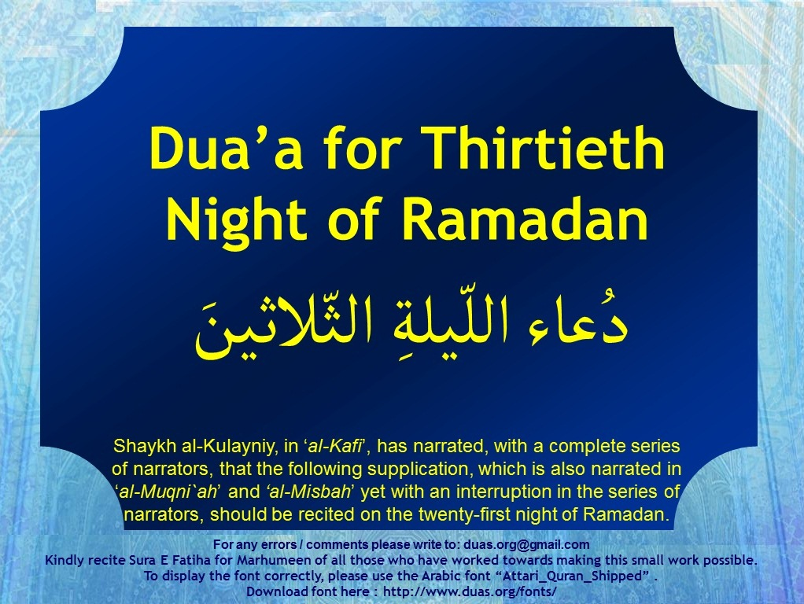



Slide 2
اَللَّهُمَّ صَلِّ عَلَى مُحَمَّدٍ وَ آلِ ممُحَمّدٍ
دُعاء اللّيلةِ الثّلاثينَ
Dua’a for Thirtieth Night of Ramadan
O' Allāh send Your blessings on Muhammad
and the family of Muhammad.
allahumma salli `ala muhammadin wa ali muhammadin

Slide 3
بِسْمِ اللَّهِ الرَّحْمَٰنِ الرَّحِيمِ
دُعاء اللّيلةِ الثّلاثينَ
Dua’a for Thirtieth Night of Ramadan
In the Name of Allāh,
the All-beneficent, the All-merciful.
bi-smi llahi r-rahmani r-rahimi

Slide 4
الحَمْدُ لِلّهِ كَمَا يَنْبَغِي لِكَرَمِ وَجْهِهِ وَعِزّ جَلالِهِ وَكَمَا هُوَ أَهْلُهُ
دُعاء اللّيلةِ الثّلاثينَ
Dua’a for Thirtieth Night of Ramadan
All praise be to Allah as is suiting the nobility of His Face and the mighty of His Majesty and as it befits Him.
alhamdu lillahi kama yanbaghy likarami wajhihi wa `izzi jalalihi wa kama huwa ahluhu

Slide 5
يَا قُدّوسُ يَا نُورُ
دُعاء اللّيلةِ الثّلاثينَ
Dua’a for Thirtieth Night of Ramadan
O the All-holy; O the Light;
ya quddusu ya nuru

Slide 6
يَا نُورَ القُدْسِ
دُعاء اللّيلةِ الثّلاثينَ
Dua’a for Thirtieth Night of Ramadan
O the Light of holiness;
ya nura alqudsi

Slide 7
يَا سُبّوحُ يَا مُنْتَهَى التّسْبِيحِ
دُعاء اللّيلةِ الثّلاثينَ
Dua’a for Thirtieth Night of Ramadan
O the Glorified; O the ultimate goal of glorification;
ya subbuhu ya muntaha alttasbihi

Slide 8
يَا رَحْمَانُ يَا فَاعِلَ الرّحْمَةِ
دُعاء اللّيلةِ الثّلاثينَ
Dua’a for Thirtieth Night of Ramadan
O the All-beneficent; O the Doer of mercy;
ya rahmanu ya fa`ila alrrahmati

Slide 9
يَا اللّهُ يَا عَلِيمُ
دُعاء اللّيلةِ الثّلاثينَ
Dua’a for Thirtieth Night of Ramadan
O Allah; O the All-knowing;
ya allahu ya `alimu

Slide 10
يَا كَبِيرُ يَا اللّهُ
دُعاء اللّيلةِ الثّلاثينَ
Dua’a for Thirtieth Night of Ramadan
O the All-big; O Allah;
ya kabiru ya allahu

Slide 11
يَا لَطِيفُ يَا جَلِيلُ
دُعاء اللّيلةِ الثّلاثينَ
Dua’a for Thirtieth Night of Ramadan
O the All-aware; O the All-majestic;
ya latifu ya jalilu

Slide 12
يَا اللّهُ يَا سَمِيعُ يَا بَصِيرُ
دُعاء اللّيلةِ الثّلاثينَ
Dua’a for Thirtieth Night of Ramadan
O Allah; O the All-hearing; O the All-seeing
ya allahu ya sami`u ya basiru

Slide 13
يَا اللّهُ يَا اللّهُ يَا اللّهُ
دُعاء اللّيلةِ الثّلاثينَ
Dua’a for Thirtieth Night of Ramadan
O Allah; O Allah; O Allah;
ya allahu ya allahu ya allahu

Slide 14
لَكَ الأَسْمَاءُ الحُسْنَى
دُعاء اللّيلةِ الثّلاثينَ
Dua’a for Thirtieth Night of Ramadan
To You are the Most Excellent Names,
laka alasma‘u alhusna

Slide 15
وَالأَمْثَالُ العُلْيَا
دُعاء اللّيلةِ الثّلاثينَ
Dua’a for Thirtieth Night of Ramadan
And the most elevated examples,
wal-amthalu al`ulia

Slide 16
وَالكِبْرِيَاءُ وَالآلاءُ
دُعاء اللّيلةِ الثّلاثينَ
Dua’a for Thirtieth Night of Ramadan
And greatness and bounties.
wal-kibrya‘u wal-ala‘u

Slide 17
أَسْأَلُكَ أَنْ تُصَلّيَ عَلَى مُحَمّدٍ وَآلِ مُحَمّدٍ
دُعاء اللّيلةِ الثّلاثينَ
Dua’a for Thirtieth Night of Ramadan
I beseech You to bless Muhammad and the Household of Muhammad,
as’aluka an tusalliya `ala muhammadin wa ali muhammadin

Slide 18
وَأَنْ تَجْعَلَ اسْمِي فِي هذِهِ اللّيْلَةِ فِي السّعَدَاءِ
دُعاء اللّيلةِ الثّلاثينَ
Dua’a for Thirtieth Night of Ramadan
And to include my name with the list of the happiest ones,
wa an taj`ala asmy fi hadhihi allaylati fi alssu`ada‘i

Slide 19
وَرُوحِي مَعَ الشّهَدَاءِ
دُعاء اللّيلةِ الثّلاثينَ
Dua’a for Thirtieth Night of Ramadan
And to add my soul to the martyrs,
wa ruhy ma`a alshshuhada‘i

Slide 20
وَإِحْسَانِي فِي عِلّيّينَ
دُعاء اللّيلةِ الثّلاثينَ
Dua’a for Thirtieth Night of Ramadan
And record my good deeds in the most exalted rank
wa ihsany fi `illiyyina

Slide 21
وَإِسَاءَتِي مَغْفُورَةً
دُعاء اللّيلةِ الثّلاثينَ
Dua’a for Thirtieth Night of Ramadan
And to decide my offense to be forgiven,
wa isa‘aty maghfuratan

Slide 22
وَأَنْ تَهَبَ لِي يَقِيناً تُبَاشِرُ بِهِ قَلْبِي
دُعاء اللّيلةِ الثّلاثينَ
Dua’a for Thirtieth Night of Ramadan
And to grant me certitude that fills in my heart
wa an tahaba li yaqinan tubashiru bihi qalbi

Slide 23
وَإِيمَاناً يُذْهِبُ الشّكّ عَنّي
دُعاء اللّيلةِ الثّلاثينَ
Dua’a for Thirtieth Night of Ramadan
and a faith which drives doubt away from me
wa ‘imanan yudhhibu alshshkk `anni

Slide 24
وَتُرْضِيَنِي بِمَا قَسَمْتَ لِي
دُعاء اللّيلةِ الثّلاثينَ
Dua’a for Thirtieth Night of Ramadan
And to make me feel satisfied with that which You decide for me
wa turdiyany bima qasamta li

Slide 25
وَآتِنَا فِي الدّنْيَا حَسَنَةً
دُعاء اللّيلةِ الثّلاثينَ
Dua’a for Thirtieth Night of Ramadan
And (please) grant us reward in this world
wa atina fi alddunya hasanatan

Slide 26
وَفِي الآخِرَةِ حَسَنَةً
دُعاء اللّيلةِ الثّلاثينَ
Dua’a for Thirtieth Night of Ramadan
And reward in the Hereafter,
wa fi alakhirati hasanatan

Slide 27
وَقِنَا عَذَابَ النَّارِ الحَرِيقِ
دُعاء اللّيلةِ الثّلاثينَ
Dua’a for Thirtieth Night of Ramadan
And save us from the torment of the buring Fire,
wa qina `adhaba alnnari alhariqi

Slide 28
وَارْزُقْنِي فِيهَا ذِكْرَكَ وَشُكْرَكَ وَالرّغْبَةَ إِلَيْكَ
دُعاء اللّيلةِ الثّلاثينَ
Dua’a for Thirtieth Night of Ramadan
And (also) confer upon us at this night Your mentioning, thanking You, and desiring for You,
warzuqny fiha dhikraka wa shukraka wal-rraghbata ilayka

Slide 29
وَالإِنَابَةَ وَالتّوْفِيقَ لِمَا وَفّقْتَ لَهُ مُحَمّداً وَآلَ مُحَمّدٍ
دُعاء اللّيلةِ الثّلاثينَ
Dua’a for Thirtieth Night of Ramadan
And turning to You, and success to that to which You led Muhammad and the Household of Muhammad,
wal-inabata wal-ttawfiqa lima waffaqta lahu muhammadan wa ala muhammadin

Slide 30
عَلَيْهِ وَعَلَيْهِمُ السّلامُ.
دُعاء اللّيلةِ الثّلاثينَ
Dua’a for Thirtieth Night of Ramadan
peace be upon him and them.
`alayhi wa `alayhimu alssalamu

Slide 31
اَللَّهُمَّ صَلِّ عَلَى مُحَمَّدٍ وَ آلِ ممُحَمّدٍ
دُعاء اللّيلةِ الثّلاثينَ
Dua’a for Thirtieth Night of Ramadan
O' Allāh send Your blessings on Muhammad
and the family of Muhammad.
allahumma salli `ala muhammadin wa ali muhammadin

Slide 32
Please recite
Sūrat al-Fātiḥah for
ALL MARHUMEEN
Dua’a for Thirtieth Night of Ramadan
دُعاء اللّيلةِ الثّلاثينَ
For any errors / comments please write to: duas.org@gmail.com
Kindly recite Sura E Fatiha for Marhumeen of all those who have worked towards making this small work possible.

