Slide 1
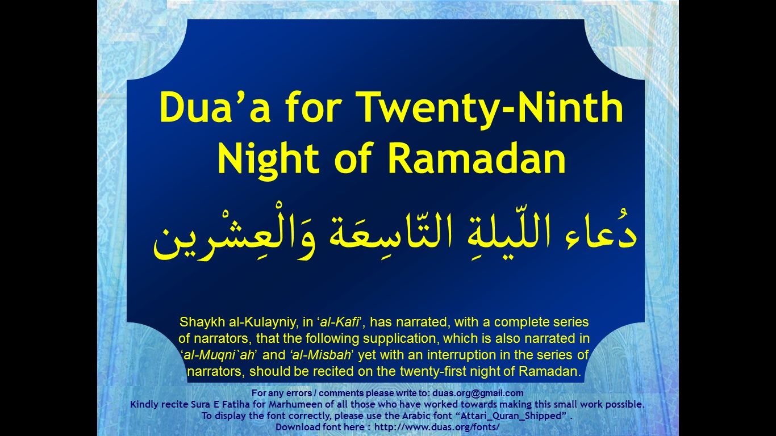



Slide 2
اَللَّهُمَّ صَلِّ عَلَى مُحَمَّدٍ وَ آلِ ممُحَمّدٍ
دُعاء اللّيلةِ التّاسِعَة وَالْعِشْرين
Dua’a for Twenty-Ninth Night of Ramadan
O' Allāh send Your blessings on Muhammad
and the family of Muhammad.
allahumma salli `ala muhammadin wa ali muhammadin

Slide 3
بِسْمِ اللَّهِ الرَّحْمَٰنِ الرَّحِيمِ
دُعاء اللّيلةِ التّاسِعَة وَالْعِشْرين
Dua’a for Twenty-Ninth Night of Ramadan
In the Name of Allāh,
the All-beneficent, the All-merciful.
bi-smi llahi r-rahmani r-rahimi

Slide 4
يَا مُكَوّرَ اللّيْلِ عَلَى النّهَارِ
دُعاء اللّيلةِ التّاسِعَة وَالْعِشْرين
Dua’a for Twenty-Ninth Night of Ramadan
O He Who makes the night overlap the day
ya mukawwira allayli `ala alnnahari

Slide 5
وَمُكَوّرَ النّهَارِ عَلَى اللّيْلِ
دُعاء اللّيلةِ التّاسِعَة وَالْعِشْرين
Dua’a for Twenty-Ninth Night of Ramadan
And makes the day overlap the night;
wa mukawwira alnnahari `ala allayli

Slide 6
يَا عَلِيمُ يَا حَكِيمُ
دُعاء اللّيلةِ التّاسِعَة وَالْعِشْرين
Dua’a for Twenty-Ninth Night of Ramadan
O the All-knowing; O the All-wise;
ya `alimu ya hakimu

Slide 7
يَارَبّ الأَرْبَابِ
دُعاء اللّيلةِ التّاسِعَة وَالْعِشْرين
Dua’a for Twenty-Ninth Night of Ramadan
O the Lord of lords;
ya rabba al-arbabi

Slide 8
وَسَيّدَ السَّادَاتِ
دُعاء اللّيلةِ التّاسِعَة وَالْعِشْرين
Dua’a for Twenty-Ninth Night of Ramadan
And the Master of masters;
wa sayyida alssadati

Slide 9
لا إِلهَ إِلاَّ أَنْتَ
دُعاء اللّيلةِ التّاسِعَة وَالْعِشْرين
Dua’a for Twenty-Ninth Night of Ramadan
There is no god save You.
la ilaha illa anta

Slide 10
يَا أَقْرَبَ إِلَيّ مِنْ حَبْلِ الوَرِيدِ
دُعاء اللّيلةِ التّاسِعَة وَالْعِشْرين
Dua’a for Twenty-Ninth Night of Ramadan
You are nearer to me than my life-vein.
ya aqraba ilayya min habli alwaridi

Slide 11
يَا اللّهُ يَا اللّهُ يَا اللّهُ
دُعاء اللّيلةِ التّاسِعَة وَالْعِشْرين
Dua’a for Twenty-Ninth Night of Ramadan
O Allah; O Allah; O Allah;
ya allahu ya allahu ya allahu

Slide 12
لَكَ الأَسْمَاءُ الحُسْنَى
دُعاء اللّيلةِ التّاسِعَة وَالْعِشْرين
Dua’a for Twenty-Ninth Night of Ramadan
To You are the Most Excellent Names,
laka alasma‘u alhusna

Slide 13
وَالأَمْثَالُ العُلْيَا
دُعاء اللّيلةِ التّاسِعَة وَالْعِشْرين
Dua’a for Twenty-Ninth Night of Ramadan
And the most elevated examples,
wal-amthalu al`ulia

Slide 14
وَالكِبْرِيَاءُ وَالآلاءُ
دُعاء اللّيلةِ التّاسِعَة وَالْعِشْرين
Dua’a for Twenty-Ninth Night of Ramadan
And greatness and bounties.
wal-kibrya‘u wal-ala‘u

Slide 15
أَسْأَلُكَ أَنْ تُصَلّيَ عَلَى مُحَمّدٍ وَآلِ مُحَمّدٍ
دُعاء اللّيلةِ التّاسِعَة وَالْعِشْرين
Dua’a for Twenty-Ninth Night of Ramadan
I beseech You to bless Muhammad and the Household of Muhammad,
as’aluka an tusalliya `ala muhammadin wa ali muhammadin

Slide 16
وَأَنْ تَجْعَلَ اسْمِي فِي هذِهِ اللّيْلَةِ فِي السّعَدَاءِ
دُعاء اللّيلةِ التّاسِعَة وَالْعِشْرين
Dua’a for Twenty-Ninth Night of Ramadan
And to include my name with the list of the happiest ones,
wa an taj`ala asmy fi hadhihi allaylati fi alssu`ada‘i

Slide 17
وَرُوحِي مَعَ الشّهَدَاءِ
دُعاء اللّيلةِ التّاسِعَة وَالْعِشْرين
Dua’a for Twenty-Ninth Night of Ramadan
And to add my soul to the martyrs,
wa ruhy ma`a alshshuhada‘i

Slide 18
وَإِحْسَانِي فِي عِلّيّينَ
دُعاء اللّيلةِ التّاسِعَة وَالْعِشْرين
Dua’a for Twenty-Ninth Night of Ramadan
And record my good deeds in the most exalted rank
wa ihsany fi `illiyyina

Slide 19
وَإِسَاءَتِي مَغْفُورَةً
دُعاء اللّيلةِ التّاسِعَة وَالْعِشْرين
Dua’a for Twenty-Ninth Night of Ramadan
And to decide my offense to be forgiven,
wa isa‘aty maghfuratan

Slide 20
وَأَنْ تَهَبَ لِي يَقِيناً تُبَاشِرُ بِهِ قَلْبِي
دُعاء اللّيلةِ التّاسِعَة وَالْعِشْرين
Dua’a for Twenty-Ninth Night of Ramadan
And to grant me certitude that fills in my heart
wa an tahaba li yaqinan tubashiru bihi qalbi

Slide 21
وَإِيمَاناً يُذْهِبُ الشّكّ عَنّي
دُعاء اللّيلةِ التّاسِعَة وَالْعِشْرين
Dua’a for Twenty-Ninth Night of Ramadan
and a faith which drives doubt away from me
wa ‘imanan yudhhibu alshshkk `anni

Slide 22
وَتُرْضِيَنِي بِمَا قَسَمْتَ لِي
دُعاء اللّيلةِ التّاسِعَة وَالْعِشْرين
Dua’a for Twenty-Ninth Night of Ramadan
And to make me feel satisfied with that which You decide for me
wa turdiyany bima qasamta li

Slide 23
وَآتِنَا فِي الدّنْيَا حَسَنَةً
دُعاء اللّيلةِ التّاسِعَة وَالْعِشْرين
Dua’a for Twenty-Ninth Night of Ramadan
And (please) grant us reward in this world
wa atina fi alddunya hasanatan

Slide 24
وَفِي الآخِرَةِ حَسَنَةً
دُعاء اللّيلةِ التّاسِعَة وَالْعِشْرين
Dua’a for Twenty-Ninth Night of Ramadan
And reward in the Hereafter,
wa fi alakhirati hasanatan

Slide 25
وَقِنَا عَذَابَ النَّارِ الحَرِيقِ
دُعاء اللّيلةِ التّاسِعَة وَالْعِشْرين
Dua’a for Twenty-Ninth Night of Ramadan
And save us from the torment of the buring Fire,
wa qina `adhaba alnnari alhariqi

Slide 26
وَارْزُقْنِي فِيهَا ذِكْرَكَ وَشُكْرَكَ وَالرّغْبَةَ إِلَيْكَ
دُعاء اللّيلةِ التّاسِعَة وَالْعِشْرين
Dua’a for Twenty-Ninth Night of Ramadan
And (also) confer upon us at this night Your mentioning, thanking You, and desiring for You,
warzuqny fiha dhikraka wa shukraka wal-rraghbata ilayka

Slide 27
وَالإِنَابَةَ وَالتّوْفِيقَ لِمَا وَفّقْتَ لَهُ مُحَمّداً وَآلَ مُحَمّدٍ
دُعاء اللّيلةِ التّاسِعَة وَالْعِشْرين
Dua’a for Twenty-Ninth Night of Ramadan
And turning to You, and success to that to which You led Muhammad and the Household of Muhammad,
wal-inabata wal-ttawfiqa lima waffaqta lahu muhammadan wa ala muhammadin

Slide 28
عَلَيْهِ وَعَلَيْهِمُ السّلامُ.
دُعاء اللّيلةِ التّاسِعَة وَالْعِشْرين
Dua’a for Twenty-Ninth Night of Ramadan
peace be upon him and them.
`alayhi wa `alayhimu alssalamu

Slide 29
اَللَّهُمَّ صَلِّ عَلَى مُحَمَّدٍ وَ آلِ ممُحَمّدٍ
دُعاء اللّيلةِ التّاسِعَة وَالْعِشْرين
Dua’a for Twenty-Ninth Night of Ramadan
O' Allāh send Your blessings on Muhammad
and the family of Muhammad.
allahumma salli `ala muhammadin wa ali muhammadin

Slide 30
Please recite
Sūrat al-Fātiḥah for
ALL MARHUMEEN
Dua’a for Twenty-Ninth Night of Ramadan
دُعاء اللّيلةِ التّاسِعَة وَالْعِشْرين
For any errors / comments please write to: duas.org@gmail.com
Kindly recite Sura E Fatiha for Marhumeen of all those who have worked towards making this small work possible.

