Slide 1
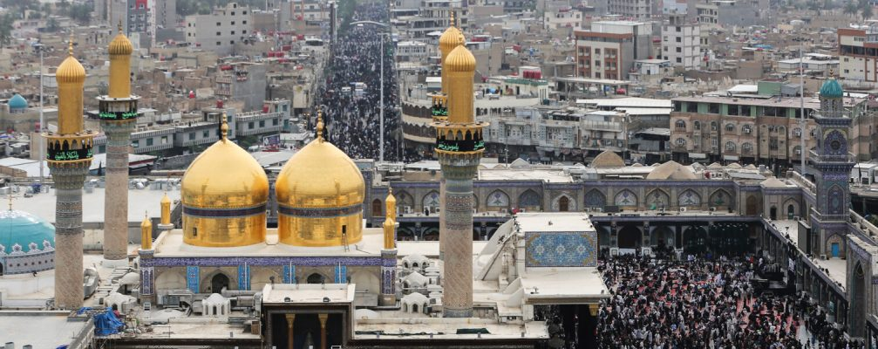
Tawassul – Short Ziyarah of Imam Mohammed Taqi Jawad (as)
For any errors / comments please write to: duas.org@gmail.com
Kindly recite Sura E Fatiha for Marhumeen of all those who have worked towards making this small work possible.
To display the font correctly, please use the Arabic font “Attari_Quran_Shipped” .
Download font here : http://www.duas.org/fonts/

Slide 2
TAWASSUL

Slide 3
اَللَّهُمَّ صَلِّ عَلَىٰ مُحَمَّدٍ وَآلِ مُحَمَّدٍ
O' Allah send Your blessings on Muhammad
and the family of Muhammad.

Slide 4
يَا ابَا جَعْفَرٍ يَا مُحَمَّدُ بْنَ عَلِيٍّ
ايُّهَا ٱلتَّقِيُّ ٱلْجَوَادُ يَا بْنَ رَسُولِ ٱللَّهِ
O Abu Ja’far, O Muhammad,
son of ‘Ali, O generous, Taqi’ and pious one,
O descendant of the Messenger of Allah

Slide 5
يَا حُجَّةَ ٱللَّهِ عَلَىٰ خَلْقِهِ
يَا سَيِّدَنَا وَمَوْلاَنَا
O decisive argument of Allah over mankind,
O our chief, O our master

Slide 6
إِنَّا تَوَجَّهْنَا وَٱسْتَشْفَعْنَا
وَتَوَسَّلْنَا بِكَ إِلَىٰ ٱللَّهِ
We turn towards Allah with your help,
seek thy intercession and advocacy before Allah

Slide 7
وَقَدَّمْنَاكَ بَيْنَ يَدَيْ حَاجَاتِنَا
We call upon you before [mentioning] our requests [to Allah]

Slide 8
يَا وَجِيهاً عِنْدَ ٱللَّهِ
إِشْفَعْ لَنَا عِنْدَ ٱللَّهِ
O intimate of Allah,
Stand by us when Allah sits in judgement over us.

Slide 9
SHORT – ZIYARAT

Slide 10
اَلسَّلاَمُ عَلَيْكَ يَا وَلِيَّ ٱللَّهِ
اَلسَّلاَمُ عَلَيْكَ يَا حُجَّةَ ٱللَّهِ
Peace be upon you, O intimate servant of Allah.
Peace be upon you, O Allah’s argument.

Slide 11
اَلسَّلاَمُ عَلَيْكَ يَا نُورَ ٱللَّهِ فِي ظُلُمَاتِ ٱلارْضِ اَلسَّلاَمُ عَلَيْكَ يَا بْنَ رَسُولِ ٱللَّهِ
Peace be upon you, O Allah’s light in the darkness of the earth.
Peace be upon you, O son of Allah’s Messenger.

Slide 12
اَلسَّلاَمُ عَلَيْكَ وَعَلَىٰ آبَائِكَ
اَلسَّلاَمُ عَلَيْكَ وَعَلَىٰ ابْنَائِكَ
اَلسَّلاَمُ عَلَيْكَ وَعَلَىٰ اوْلِيَائِكَ
Peace be upon you and upon your fathers.
Peace be upon you and upon your descendants.
Peace be upon you and upon your loyalists.

Slide 13
اشْهَدُ انَّكَ قَدْ اقَمْتَ ٱلصَّلاَةَ وَآتَيْتَ ٱلزَّكَاةَ وَامَرْتَ بِٱلْمَعْرُوفِ وَنَهَيْتَ عَنِ ٱلْمُنْكَرِ وَتَلَوْتَ ٱلْكِتَابَ حَقَّ تِلاَوَتِهِ
I bear witness that you performed the prayers, defrayed the poor-rate, enjoined the right, forbade the wrong,
recited the Book as it should be recited

Slide 14
وَجَاهَدْتَ فِي ٱللَّهِ حَقَّ جِهَادِهِ
وَصَبَرْتَ عَلَىٰ ٱلاذَىٰ فِي جَنْبِهِ
حَتَّىٰ اتَاكَ ٱلْيَقِينُ
strove for Allah as exactly as striving should be,
and endured harm for His sake
until death came upon you.

Slide 15
اتَيْتُكَ زَائِراً عَارِفاً بِحَقِّكَ
مُوَالِياً لِاَوْلِيَائِكَ مُعَادِياً لِاَعْدَائِكَ
فَٱشْفَعْ لِي عِنْدَ رَبِّكَ
I have come to you, visiting you, recognizing your right,
declaring loyalty to your loyalists, and incurring the animosity of your enemies;
so, (please) intercede for me with Your Lord.

Slide 16
اَللَّهُمَّ صَلِّ عَلَىٰ مُحَمَّدٍ وَآلِ مُحَمَّدٍ
O' Allah send Your blessings on Muhammad
and the family of Muhammad.

