Slide 1
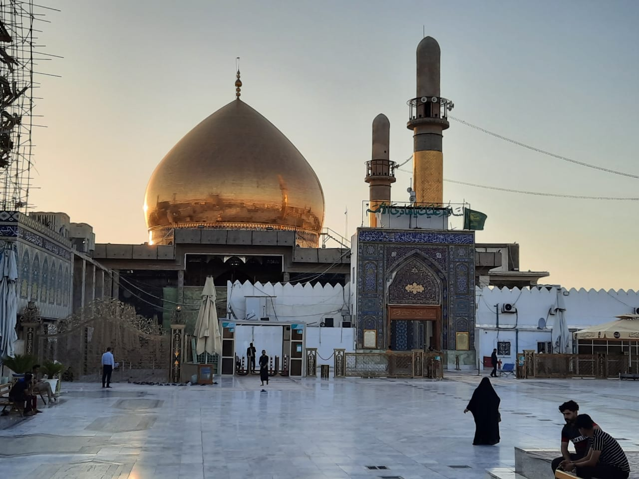

Tawassul -Short Ziyarah 10th Imam
Imam Ali Naqi (as)
For any errors / comments please write to: duas.org@gmail.com
Kindly recite Sura E Fatiha for Marhumeen of all those who have worked towards making this small work possible.
To display the font correctly, please use the Arabic font “Attari_Quran_Shipped” .
Download font here : http://www.duas.org/fonts/

Slide 2
TAWASSUL

Slide 3
اَللَّهُمَّ صَلِّ عَلَىٰ مُحَمَّدٍ وَآلِ مُحَمَّدٍ
O' Allah send Your blessings on Muhammad
and the family of Muhammad.

Slide 4
يَا ابَا ٱلْحَسَنِ يَا عَلِيُّ بْنَ مُحَمَّدٍ
ايُّهَا ٱلْهَادِي ٱلنَّقِيُّ
يَا بْنَ رَسُولِ ٱللَّهِ
O Abal Hasan, O ‘Ali, son of ‘Muhammad,
O guide (Hadi) and pure one (Naqi),
O descendant of the Messenger of Allah

Slide 5
يَا حُجَّةَ ٱللَّهِ عَلَىٰ خَلْقِهِ
يَا سَيِّدَنَا وَمَوْلاَنَا
O decisive argument of Allah over mankind,
O our chief, O our master

Slide 6
إِنَّا تَوَجَّهْنَا وَٱسْتَشْفَعْنَا
وَتَوَسَّلْنَا بِكَ إِلَىٰ ٱللَّهِ
We turn towards Allah with your help,
seek thy intercession and advocacy before Allah

Slide 7
وَقَدَّمْنَاكَ بَيْنَ يَدَيْ حَاجَاتِنَا
We call upon you before [mentioning] our requests [to Allah]

Slide 8
يَا وَجِيهاً عِنْدَ ٱللَّهِ
إِشْفَعْ لَنَا عِنْدَ ٱللَّهِ
O intimate of Allah,
Stand by us when Allah sits in judgement over us.

Slide 9
SHORT – ZIYARAT

Slide 10
اَلسَّلاَمُ عَلَيْكَ يَا ابَا ٱلْحَسَنِ عَلِيُّ بْنَ مُحَمَّدٍ
Peace be upon you,
O Abul-Hasan,`Ali the son of Muhammad

Slide 11
ٱلزَّكِيُّ ٱلرَّاشِدُ ٱلنُّورُ ٱلثَّاقِبُ
وَرَحْمَةُ ٱللَّهِ وَبَرَكَاتُهُ
the pious, right-directing, and brightly shining light.
Allah’s mercy and blessings be upon you.

Slide 12
اَلسَّلاَمُ عَلَيْكَ يَا صَفِيَّ ٱللَّهِ
اَلسَّلاَمُ عَلَيْكَ يَا سِرَّ ٱللَّهِ
Peace be upon you, O sincerely attached friend of Allah.
Peace be upon you, O confidant of Allah.

Slide 13
اَلسَّلاَمُ عَلَيْكَ يَا حَبْلَ ٱللَّهِ
اَلسَّلاَمُ عَلَيْكَ يَا آلَ ٱللَّهِ
Peace be upon you, O rope of Allah.
Peace be upon you, O household of Allah.

Slide 14
اَلسَّلاَمُ عَلَيْكَ يَا خِيَرةَ ٱللَّهِ
اَلسَّلاَمُ عَلَيْكَ يَا صَفْوَةَ ٱللَّهِ
Peace be upon you, O select of Allah.
Peace be upon you, O choice of Allah.

Slide 15
اَلسَّلاَمُ عَلَيْكَ يَا امِينَ ٱللَّهِ
اَلسَّلاَمُ عَلَيْكَ يَا حَقَّ ٱللَّهِ
Peace be upon you, O trustee of Allah.
Peace be upon you, O proof of Allah.

Slide 16
انِّي وَلِيٌّ لِمَنْ وَالاَكُمْ
وَعَدُوٌّ لِمَنْ عَادَاكُمْ
I do show loyalty to your loyalists,
I show enmity towards your enemies,
,

Slide 17
و مُؤْمِنٌ بِسِرِّكُمْ وَعَلاَنِيَتِكُمْ
واوَّلِكُمْ وَآخِرِكُمْ
I believe in all of the invisible and the visible,
and the first and the last of you.

Slide 18
بِابِي انْتَ وَامِّي
وَٱلسَّلاَمُ عَلَيْكَ وَرَحْمَةُ ٱللَّهِ وَبَرَكَاتُهُ
May Allah accept my father and mother as ransoms for you.
Peace and Allah’s mercy and blessings be upon you.

Slide 19
اَللَّهُمَّ صَلِّ عَلَىٰ مُحَمَّدٍ وَآلِ مُحَمَّدٍ
O' Allah send Your blessings on Muhammad
and the family of Muhammad.

Slide 20



