Slide 1

اعمال للَيْلَةُ الْقَدْرِ
A'amaal for
Laylatul Qadr
(Arabic text with English Translation and Transliteration)
For any errors / comments please write to: duas.org@gmail.com
Kindly recite Sūrat al-Fātiḥah for Marhumeen of all those who have worked towards making this small work possible.

Slide 2
A'amaal for Laylatul Qadr
اعمال للَيْلَةُ الْقَدْرِ
Merits
Some Ahadith indicate that the fate of every believer for the coming year is decreed on this night.
That is why the Du`as for this night ask for special favors in the decree for the year

Slide 3
A'amaal for Laylatul Qadr
اعمال للَيْلَةُ الْقَدْرِ
Merits
It is reported that whoever keeps awake on the nights of Qadr shall have his/her sins forgiven even if they equal the number of the stars in the heavens.

Slide 4
A'amaal for Laylatul Qadr
اعمال للَيْلَةُ الْقَدْرِ
Merits
Among the nights of Ramadhan is one special night, which is better than a thousand months (HQ, 97:3).
Good deeds performed on that single night are more to those performed over a thousand months.
It is the Night of Power (Laylatul Qadr), when the Qur'an was revealed.

Slide 5
A'amaal for Laylatul Qadr
اعمال للَيْلَةُ الْقَدْرِ
Merits
Laylatul Qadr is the night, which is the best night among the nights of the whole year. The “A'amaal” (religious performances) of this night are better than the A'amaal of 1000 months. In this night the divine Annual Decree is passed. The Angels and Roohul Ameen (A highly dignified Angel) descend on this earth, in that night. These call on the Imam of the time (A), and what is ordained (by Allāh (SWT)) for everybody is presented before the Imam (A).
Allama Majlisi (r.a) says, “It is better to take a bath before sunset so that the night prayers may be performed after bath”. .

Slide 6
A'amaal for Laylatul Qadr
اعمال للَيْلَةُ الْقَدْرِ
Recommended general acts for “laylat al-qadr”
  Take a Ghusl preferably near sunset time (wudhu also required) and Give/pre arrange for Sadqah/Charity tonight.
  Recite two Rak`ah Salaat, in every Rak`ah recite Sura-al-Hamd, and Sura Ikhlaas seven times.(for seeking protection against sinning for the seven organs ) After finishing Salat recite 70 times: أَسْتَغْفِرُ اللّهَ وَأَتُوبُ إلَيْهِ
  It is reported from the Prophet (s) that by the time the reciter will rise from his place Allāh (swt) will have forgiven him and his parents. Try to first be really repentant for serious mistakes done, sincerely ask for forgiveness either by: (a) recalling 70 different sins OR (b) feeling remorseful for 10 sins of the 7 main organs: eyes, ears, tongue, hands, mouth, stomach + private parts OR (c) some particular sins that you may have committed repeatedly OR (d) recalling the variety of punishments of different sins and finally resolve NOT TO Repeat them in the future. The Holy Prophet has promised “Whoever performs this act will surely be forgiven by the Almighty even before here rises from his place".

Slide 7
A'amaal for Laylatul Qadr
اعمال للَيْلَةُ الْقَدْرِ
Recite Two Rak`ah Salaat: in every Rak`ah recite Surah al-Fatihah and and Surah al-Tawhid / Ikhlaas seven times, after Salaat recite the following:

Slide 8
A'amaal for Laylatul Qadr
اعمال للَيْلَةُ الْقَدْرِ
Recite 70 times
أَسْتَغْفِرُ اللّهَ وَأَتُوبُ إلَيْهِ.
I seek the forgiveness of Allāh, my Lord, and I repent before Him.
astaghfiru allaha wa atubu ilayhi

Slide 9
A'amaal for Laylatul Qadr
اعمال للَيْلَةُ الْقَدْرِ
Recite 100 times
أَسْتَغْفِرُ اللّهَ رَبِّي وَأَتُوبُ إلَيْهِ
I seek the forgiveness of Allāh, my Lord, and I repent before Him.
astaghfiru allaha rabbi wa atubu ilayhi

Slide 10
A'amaal for Laylatul Qadr
اعمال للَيْلَةُ الْقَدْرِ
Recite 100 times
اللّهُمّ الْعَنْ قَتَلَةَ أَمِيرِ الْمُؤْمِنِينَ
(عليه السلام)
O Allāh : (please do) remove your blessings from the killers of the Commander of the Believers - Amir al-Mu'minin (Peace be upon him).
allahumma al`an qatalata amiri almu´minina (alayhi as-salām)

Slide 11
A'amaal for Laylatul Qadr
اعمال للَيْلَةُ الْقَدْرِ
Please open the
Holy Qur'an
and recite the following:
When opening the Qur’an and praying for your needs with the intercession of the Qur’an, realize that while the Qur’an is a cure for spiritual illness, it only benefits the pious ones and the evil doers are deprived of its illumination. Thus increase the chances for Qur’an intercession to work on your behalf by earnestly following the rulings of the Qur’an.

Slide 12
اَللَّهُمَّ صَلِّ عَلَى مُحَمَّدٍ وَ آلِ مُحَمَّد
A'amaal for Laylatul Qadr
اعمال للَيْلَةُ الْقَدْرِ
O' Allāh send Your blessings on Muhammad
and the family of Muhammad.
allahumma salli `ala muhammadin wa ali muhammadin

Slide 13
بِسْمِ ٱللَّـهِ ٱلرَّحْمَـٰنِ ٱلرَّحِيمِ
A'amaal for Laylatul Qadr
اعمال للَيْلَةُ الْقَدْرِ
In the Name of Allāh,
the All-beneficent, the All-merciful.
bi-smi llahi r-rahmani r-rahimi

Slide 14
اللّهُمّ إِنّي أَسْأَلُكَ بِكِتَابِكَ المُنْزَلِ وَمَا فِيهِ
A'amaal for Laylatul Qadr
اعمال للَيْلَةُ الْقَدْرِ
O Allāh: I beseech You in the name of Your revealed Book and that which is in it,
allahumma inni as’aluka bikitabika almunzali wa ma fihi

Slide 15
وَفِيهِ اسْمُكَ الأَكْبَرُ وَأَسْمَاؤُكَ الحُسْنَى
A'amaal for Laylatul Qadr
اعمال للَيْلَةُ الْقَدْرِ
and Your Great Name and Your (Other) beautiful names are in it,
wa fihi asmuka al-akbaru wa-asmau ‘uka alhusna

Slide 16
وَمَا يُخَافُ وَيُرْجَى
A'amaal for Laylatul Qadr
اعمال للَيْلَةُ الْقَدْرِ
and in it there is that which warns and gives hope.
wa ma yukhafu wa yurja

Slide 17
أَنْ تَجْعَلَنِي مِنْ عُتَقَائِكَ مِنَ النَّارِ.
A'amaal for Laylatul Qadr
اعمال للَيْلَةُ الْقَدْرِ
That You may include me among those who have been set free from the Hellfire.
an taj`alany min `utaqa’ika mina alnnari

Slide 18


Slide 19
A'amaal for Laylatul Qadr
اعمال للَيْلَةُ الْقَدْرِ
Please place the
Holy Qur'an
on the head and recite the following:
While placing the Qur’an on the head, remind yourself that true salvation can only be achieved by always keeping the rules of Qur’an ahead of us to follow. The fact that we put the Qur’an on our head is a sign of respect and reverence. We beseech Allāh (SWT) by the thaqalayn - the speaking and the silent Qur'an. - Holy Qur'an (39:56) Pray for Aql/Intelligence to be Kamil ( complete) ,it is Kashe (submits) to Qur’an & acquires Noor ( light) from it.

Slide 20
اَللَّهُمَّ صَلِّ عَلَى مُحَمَّدٍ وَ آلِ مُحَمَّد
A'amaal for Laylatul Qadr
اعمال للَيْلَةُ الْقَدْرِ
O' Allāh send Your blessings on Muhammad
and the family of Muhammad.
allahumma salli `ala muhammadin wa ali muhammadin

Slide 21
بِسْمِ ٱللَّـهِ ٱلرَّحْمَـٰنِ ٱلرَّحِيمِ
A'amaal for Laylatul Qadr
اعمال للَيْلَةُ الْقَدْرِ
In the Name of Allāh,
the All-beneficent, the All-merciful.
bi-smi llahi r-rahmani r-rahimi

Slide 22
اللّهُمّ بِحَقّ هذَا القُرْآنِ
A'amaal for Laylatul Qadr
اعمال للَيْلَةُ الْقَدْرِ
O Allāh: for the sake of this (Holy) Qur'an,
allahumma bihaqqi hadha alqur’ani

Slide 23
وَبِحَقّ مَنْ أَرْسَلْتَهُ بِهِ
A'amaal for Laylatul Qadr
اعمال للَيْلَةُ الْقَدْرِ
and for the sake of that person through whom You sent it,
wa bihaqqi man arsaltahu bihi

Slide 24
وَبِحَقّ كُلّ مُؤْمِنٍ مَدَحْتَهُ فِيهِ
A'amaal for Laylatul Qadr
اعمال للَيْلَةُ الْقَدْرِ
and for the sake of those believers who have been praised therein,
wa bihaqqi kulli mu’minin madahtahu fihi

Slide 25
وَبِحَقّكَ عَلَيْهِمْ
A'amaal for Laylatul Qadr
اعمال للَيْلَةُ الْقَدْرِ
and in the name of Your obligation to them,
wa bihaqqka `alayhim

Slide 26
فَلا أَحَدَ أَعْرَفُ بِحَقّكَ مِنْكَ.
A'amaal for Laylatul Qadr
اعمال للَيْلَةُ الْقَدْرِ
no one is aware of Your obligation more than You.
fala ahada a`rafu bihaqqka minka

Slide 27
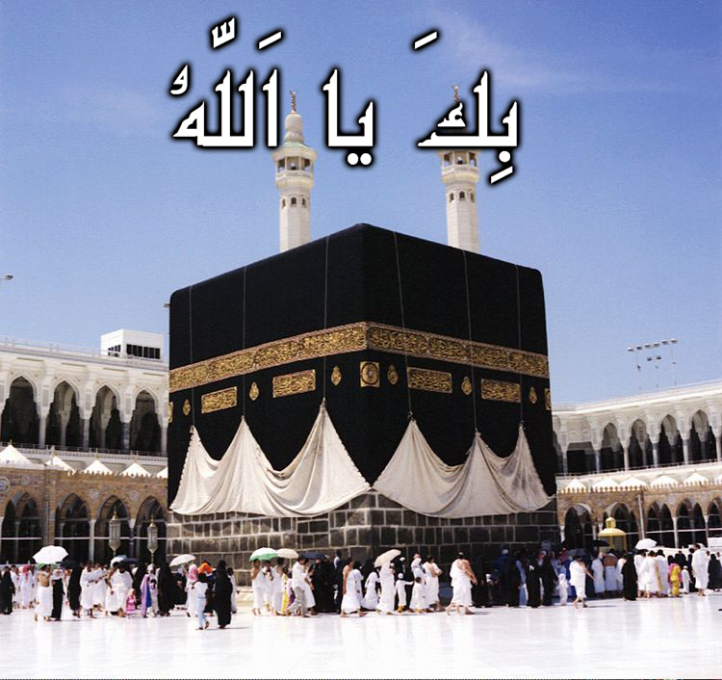
A'amaal for Laylatul Qadr
اعمال للَيْلَةُ الْقَدْرِ
Recite 10 Times

Slide 28
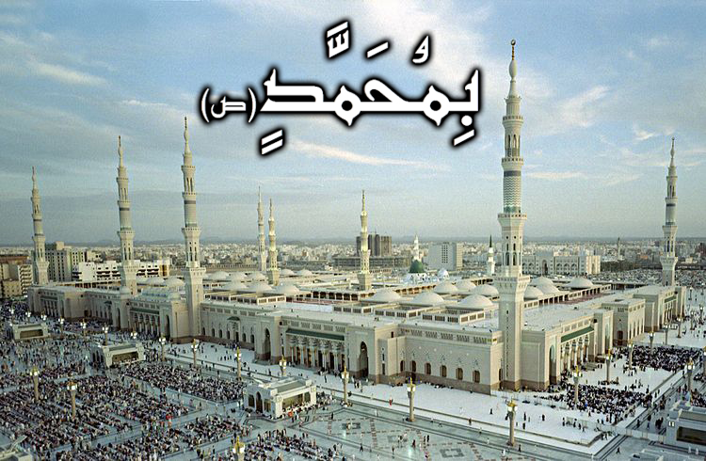
A
A'amaal for Laylatul Qadr
اعمال للَيْلَةُ الْقَدْرِ
Recite 10 Times
Quick Facts:
Name: Muhammed (S)
Titles: Al Mustafa, As Saadiq (The Truthful), Al Ameen (The Trusted)
Kuniyah: Abul Qassim
Father: Abdallah bin Abdul Muttalib
Mother: Amina Bint Wahab
Birthday: 17 Rabee’ Al Awaal, 570 AC (Year of the Elephant) in Makkah
Death: 28 Safar, 11 AH in Medina
E
T

Slide 29
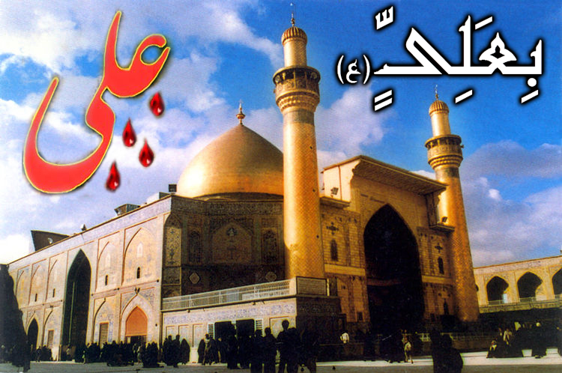
A
A'amaal for Laylatul Qadr
اعمال للَيْلَةُ الْقَدْرِ
Recite 10 Times
Quick Facts:
Name: Ali (A)
Titles: Murtadha, Ameer ul Mu’mineen (King of the Believers), Abu Turaab, Asad Ullah (The lion of Allah)
Kuniyah: Abul Hassan
Father: Abu Talib
Mother: Fatemah Bint Asad
Birthday: 13 Rajab – 23 Years before Hijra, inside the Holy Ka’baa in Makkah
Death: 21 Ramadhan, 40 AH in Kufa
E
T

Slide 30

A'amaal for Laylatul Qadr
اعمال للَيْلَةُ الْقَدْرِ
Recite 10 Times
Quick Facts:
Name: Fatemah (A)
Titles: Zahra (Radiant), Zakiyyah (Pure), Radhiyyah (Satisfied), Tahera (Chaste), Ummul Aimmah (Mother of Imams) & Umme Abiha (Mother of her Father)
Father: Prophet Muhammed (S)
Mother: Bibi Khadijah Bint Khuwailid
Birthday: 20 Jamaadil Aakhar in Makkah
Death: 14 Jamaadil Awwal, 11 AH in Medina

Slide 31
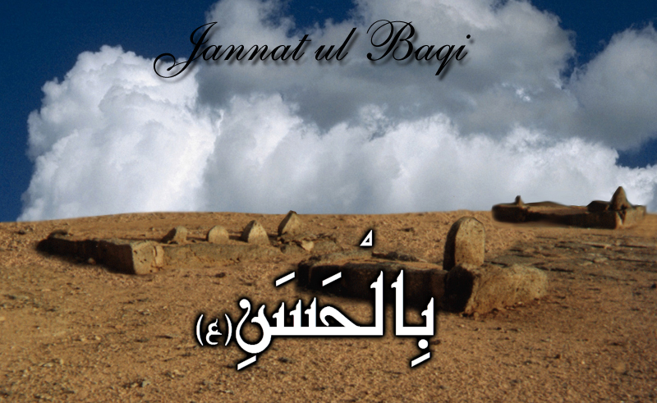
A'amaal for Laylatul Qadr
اعمال للَيْلَةُ الْقَدْرِ
Recite 10 Times
Quick Facts:
Name: Hassan (A)
Title: Al Mujtaba (The Chosen One)
Kuniyah: Abu Muhammed
Father: Imam Ali (A)
Mother: Bibi Fatemah (A)
Birthday: 15 Ramadhan, 3 AH, Medina
Death: 7 Safar, 50 AH, Medina

Slide 32
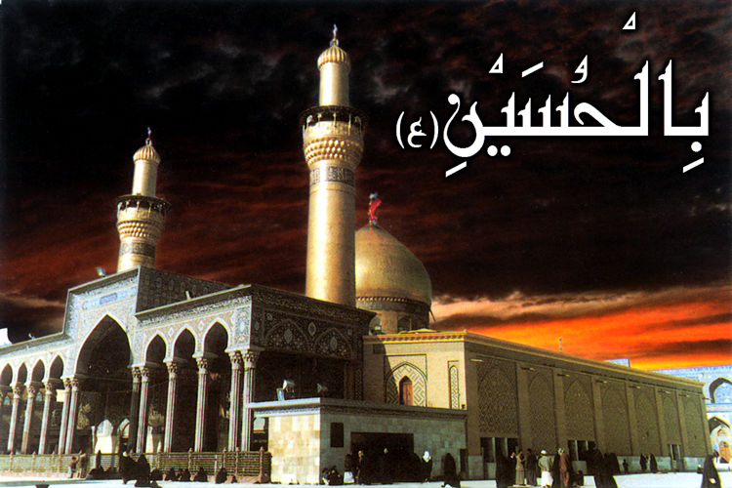
A'amaal for Laylatul Qadr
اعمال للَيْلَةُ الْقَدْرِ
Recite 10 Times
Quick Facts:
Name: Hussain (A)
Title: Sayyid ash Shuhada (Leader of Martyrs)
Kuniyah: Aba Abdillah
Father: Imam Ali (A)
Mother: Bibi Fatemah (A)
Birthday: 3 Sha’baan, 4 AH in Medina
Death: Ashura, 10 Muharram, 61 AH in Kerbala

Slide 33

A'amaal for Laylatul Qadr
اعمال للَيْلَةُ الْقَدْرِ
Recite 10 Times
Quick Facts:
Name: Ali (A)
Titles: Zain ul Abideen (Beauty of the Worshippers), Sajjad (The Prostrating), Syed us Saajideen (Leader of those who Prostrate)
Kuniyah: Abu Muhammed
Father: Imam Hussain (A)
Mother: Bibi Shahr Banu
Birthday: 5 Sha’baan, 38 AH in Medina
Death: 25 Muharram, 95 AH in Medina

Slide 34
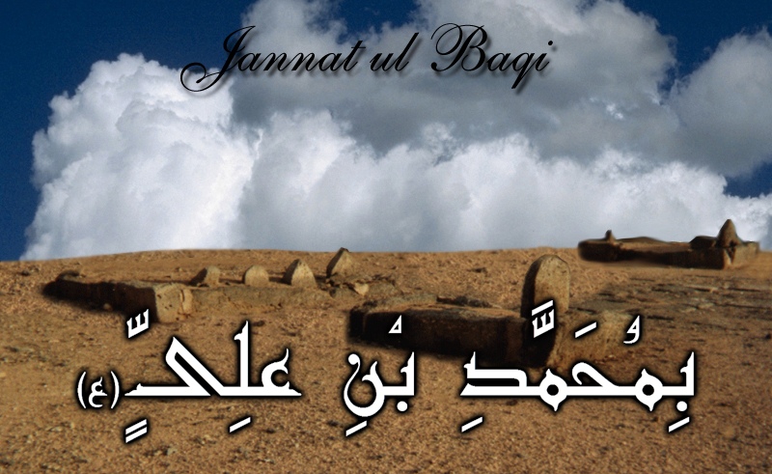
A'amaal for Laylatul Qadr
اعمال للَيْلَةُ الْقَدْرِ
Recite 10 Times
Quick Facts:
Name: Muhammed (A)
Titles: Baqir, Hadi (Guide)
Kuniyah: Abu Ja’far
Father: Imam Ali Bin Hussain (A)
Mother: Fatemah Bint Hassan (Daughter of Imam Hassan (A))
Birthday: 1 Rajab – 57 AH in Medina
Death: 7 Dhul Hijjah, 114 AH in Medina

Slide 35
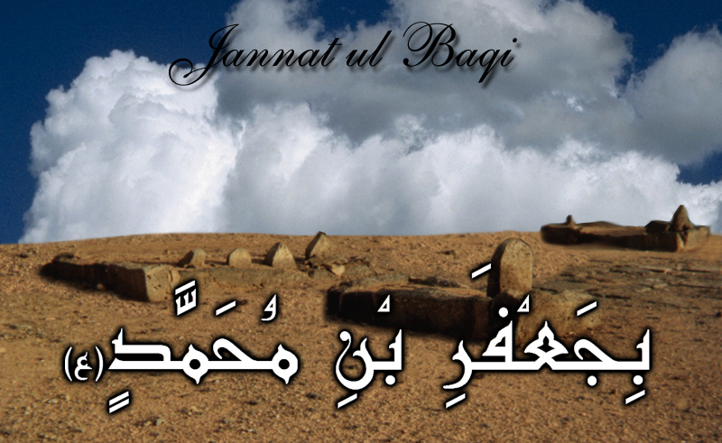
A'amaal for Laylatul Qadr
اعمال للَيْلَةُ الْقَدْرِ
Recite 10 Times
Quick Facts:
Name: Ja’far (A)
Titles: Fadhil (Excellent), Khashiful Haqaiq (Revealer of Mysteries), Sadiq (Truthful)
Kuniyah: Aba Abdillah
Father: Imam Muhammed Al Baqir (A)
Mother: Fatemah
Birthday: 17 Rabee’ al Awwal, 82 AH in Medina
Death: 25 Shawwal, 148 AH in Medina

Slide 36
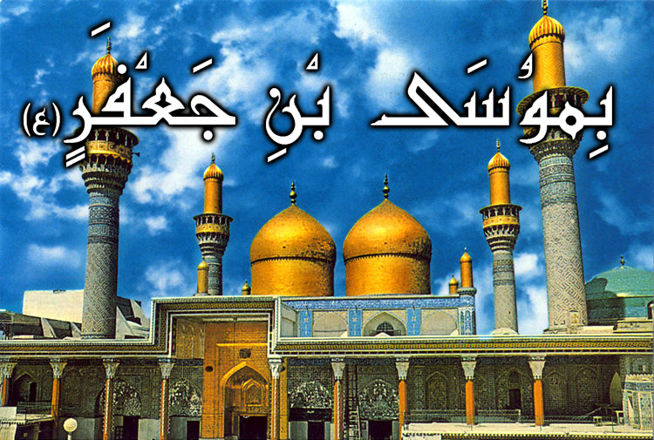
A'amaal for Laylatul Qadr
اعمال للَيْلَةُ الْقَدْرِ
Recite 10 Times
Quick Facts:
Name: Musa (A)
Titles: Al Kaadhim, Bab Al Hawaaij (Door of Wishes), Faquih
Kuniyah: Abu Ibrahim
Father: Imam Ja’far bin Muhammed (A)
Mother: Hamida Al Barbaria
Birthday: 7 Safar, 128 AH in Abwa (Between Makkah & Medina)
Death: 25 Rajab, 183 AH in Baghdad

Slide 37
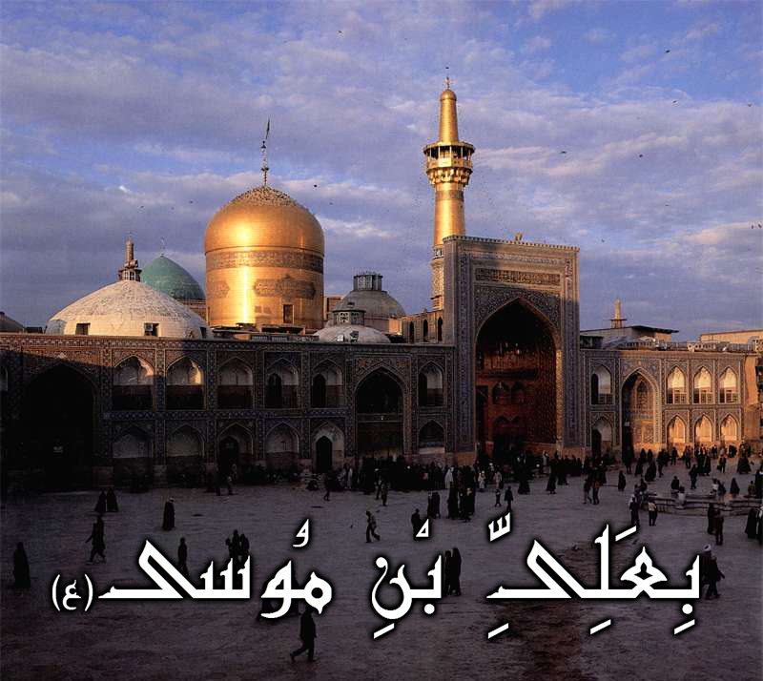
A'amaal for Laylatul Qadr
اعمال للَيْلَةُ الْقَدْرِ
Recite 10 Times
Quick Facts:
Name: Ali (A)
Titles: Ar Redha, Ghareeb Al Ghuraba
Kuniyah: Abul Hassan
Father: Imam Musa bin Ja’far (A)
Mother: Najma
Birthday: 11 Dhul Qa’dah, 148 AH in Medina
Death: 29 Safar, 203 AH in Mashad

Slide 38
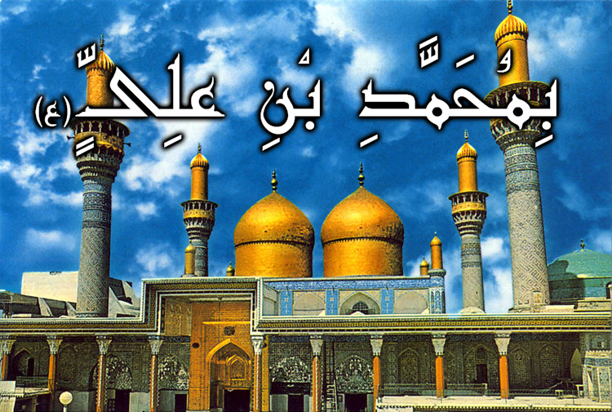
A'amaal for Laylatul Qadr
اعمال للَيْلَةُ الْقَدْرِ
Recite 10 Times
Quick Facts:
Name: Muhammed (A)
Titles: At Taqi, Al Jawaad
Kuniyah: Abul Ja’far
Father: Imam Ali bin Musa (A)
Mother: Sabika (Also known as Khaizaroon)
Birthday: 10 Rajab, 195 AH in Medina
Death: 29 Dhul Qa’dah, 220 AH in Baghdad

Slide 39
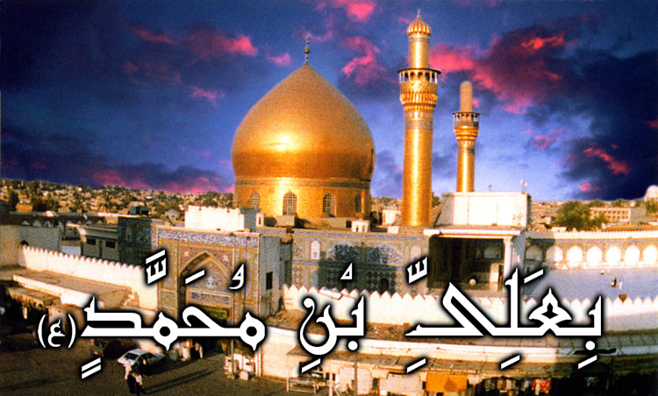
A'amaal for Laylatul Qadr
اعمال للَيْلَةُ الْقَدْرِ
Recite 10 Times
Quick Facts:
Name: Ali (A)
Titles: An Naqi, Al Hadi (The Guide)
Kuniyah: Abul Hassan
Father: Imam Muhammed bin Ali (A)
Mother: Sumana
Birthday: 15 Dhul Hijjah, 212 AH in Surba (Suburb of Medina)
Death: 3 Rajab, 254 AH in Samarra

Slide 40
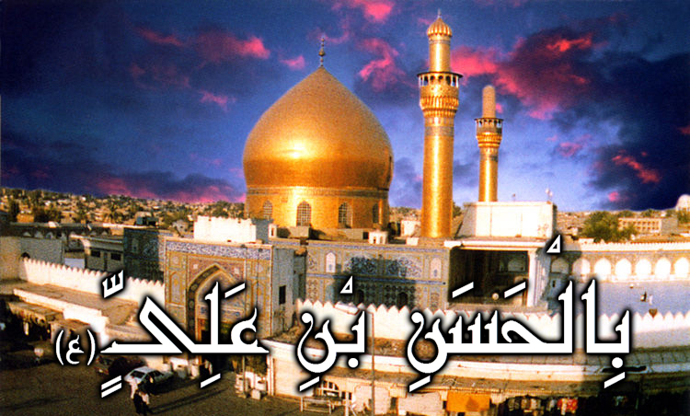
A'amaal for Laylatul Qadr
اعمال للَيْلَةُ الْقَدْرِ
Recite 10 Times
Quick Facts:
Name: Hassan (A)
Title: Al Askary
Kuniyah: Abu Muhammed
Father: Imam Ali bin Muhammed (A)
Mother: Saleel (Also known as Hudaitha)
Birthday: 10 Rabee’ Al Aakhar, 232 AH in Medina
Death: 8 Rabee’ Al Awwal, 260 AH in Samarra

Slide 41

A'amaal for Laylatul Qadr
اعمال للَيْلَةُ الْقَدْرِ
Recite 10 Times
Quick Facts:
Name: Muhammed (A)
Titles: Mahdi (The Guided One), Hujjah (The proof of Allah), Al Muntazar (One who awaits the order of Allah), Al Muntazir (The one who is awaited), Saahib Az Zamaan (Master of the Age), Al Qaaim (The steadfast)
Kuniyah: Abul Qassim
Father: Imam Hassan bin Ali (A)
Mother: Malika (Also known as Narjis)
Birthday: 15 Sha’baan, 255 AH

Slide 43
A'amaal for Laylatul Qadr
اعمال للَيْلَةُ الْقَدْرِ
Short Du’a for the night of Qadr
اللّهُمّ إِنّي أَمْسَيْتُ لَكَ عَبْداً دَاخِراً
allahumma inni amsaytu laka `abdan dakhiran
Mentioning this du`a, Shaykh Kaf`ami has related that Imam Ali ibn al-Husayn (A) recited this du`a during these nights while standing (qiyam), bowing (rukou`) and performing prostration (sajdah).

Slide 44
اَللَّهُمَّ صَلِّ عَلَى مُحَمَّدٍ وَ آلِ مُحَمَّد
A'amaal for Laylatul Qadr
اعمال للَيْلَةُ الْقَدْرِ
O' Allāh send Your blessings on Muhammad
and the family of Muhammad.
allahumma salli `ala muhammadin wa ali muhammadin

Slide 45
بِسْمِ ٱللَّـهِ ٱلرَّحْمَـٰنِ ٱلرَّحِيمِ
A'amaal for Laylatul Qadr
اعمال للَيْلَةُ الْقَدْرِ
In the Name of Allāh,
the All-beneficent, the All-merciful.
bi-smi llahi r-rahmani r-rahimi

Slide 46
اللّهُمّ إِنّي أَمْسَيْتُ لَكَ عَبْداً دَاخِراً
A'amaal for Laylatul Qadr
اعمال للَيْلَةُ الْقَدْرِ
O Allāh: surely, I am at this evening Your passive slave;
allahumma inni amsaytu laka `abdan dakhiran

Slide 47
لا أَمْلِكُ لِنَفْسِي نَفْعاً وَلا ضَرّاً
A'amaal for Laylatul Qadr
اعمال للَيْلَةُ الْقَدْرِ
I have no control of hurt or good to myself,
la amliku linafsy naf`an wa la darran

Slide 48
وَلا أَصْرِفُ عَنْهَا سُوءً
A'amaal for Laylatul Qadr
اعمال للَيْلَةُ الْقَدْرِ
And I cannot drive back any evil from myself,
wa la asrifu `anha su‘an

Slide 49
أَشْهَدُ بِذلِكَ عَلَى نَفْسِي
A'amaal for Laylatul Qadr
اعمال للَيْلَةُ الْقَدْرِ
I testify to so against myself,
ash-hadu bidhalika `ala nafsi

Slide 50
وَأَعْتَرِفُ لَكَ بِضَعْفِ قُوّتِي
A'amaal for Laylatul Qadr
اعمال للَيْلَةُ الْقَدْرِ
And to You do I confess of my powerlessness
wa a`tarifu laka bida`fi quwwati

Slide 51
وَقِلّةِ حِيلَتِي
A'amaal for Laylatul Qadr
اعمال للَيْلَةُ الْقَدْرِ
And my feebleness
wa qillati hilati

Slide 52
فَصَلّ عَلَى مُحَمّدٍ وَآلِ مُحَمّدٍ
A'amaal for Laylatul Qadr
اعمال للَيْلَةُ الْقَدْرِ
So, (please do) send blessings upon Muhammad and the Household of Muhammad,
fasall `ala muhammadin wa ali muhammadin

Slide 53
وَأَنْجِزْ لِي مَا وَعَدْتَنِي
A'amaal for Laylatul Qadr
اعمال للَيْلَةُ الْقَدْرِ
And fulfill that of which You have promised me,
wa anjiz li ma wa`adtany

Slide 54
وَجَمِيعَ المُؤْمِنِينَ وَالمُؤْمِنَاتِ
A'amaal for Laylatul Qadr
اعمال للَيْلَةُ الْقَدْرِ
As well as all the believing men and women,
wa jami`a almu'minina wal-mu'minati

Slide 55
مِنَ المَغْفِرَةِ فِي هذِهِ اللّيْلَةِ
A'amaal for Laylatul Qadr
اعمال للَيْلَةُ الْقَدْرِ
That is Your forgiveness at this night.
mina almaghfirati fi hadhihi allaylati

Slide 56
وَأَتْمِمْ عَلَيّ مَا آتَيْتَنِي
A'amaal for Laylatul Qadr
اعمال للَيْلَةُ الْقَدْرِ
And accomplish that which You have conferred upon me,
wa atmim `alayya ma ataytany

Slide 57
فَإِنّي عَبْدُكَ المِسكِينُ المُسْتَكِينُ
A'amaal for Laylatul Qadr
اعمال للَيْلَةُ الْقَدْرِ
For I am Your slave—the poor, the humble,
fa’inni `abduka almiskinu almustakinu

Slide 58
الضّعِيفُ الفَقِيرُ المَهِينُ.
A'amaal for Laylatul Qadr
اعمال للَيْلَةُ الْقَدْرِ
The weak, the needy, the humiliated.
aldda`ifu alfaqiru almahinu

Slide 59
اللّهُمّ لا تَجْعَلْنِي نَاسِياً لِذِكْرِكَ فِيمَا أَوْلَيْتَنِي
A'amaal for Laylatul Qadr
اعمال للَيْلَةُ الْقَدْرِ
O Allāh: (please) do not make me negligent of the mention of You as regards that which You have bestowed upon me,
allahumma la taj`alny nasiyan lidhikrika fima awlaytani

Slide 60
وَلا غَافِلاً لإحْسَانِكَ فِيمَا أَعْطَيْتَنِي
A'amaal for Laylatul Qadr
اعمال للَيْلَةُ الْقَدْرِ
And do not make me inadvertent to Your favors to me as regards that which You have given me,
wa la ghafilan liihsanika fima a`taytani

Slide 61
وَلا آيِساً مِنْ إِجَابَتِكَ وَإِنْ أَبْطَأَتْ عَنّي
A'amaal for Laylatul Qadr
اعمال للَيْلَةُ الْقَدْرِ
And do not make me despair of Your responding to me, even if such response is postponed,
wa la ayisan min ijabatika wa in abtat `anni

Slide 62
فِي سَرَّاءَ أَوْ ضَرَّاءَ
A'amaal for Laylatul Qadr
اعمال للَيْلَةُ الْقَدْرِ
Whether I be in prosperity or adversity
fi sarra‘a aw darra‘a

Slide 63
أَوْ شِدّةٍ أَوْ رَخَاءٍ
A'amaal for Laylatul Qadr
اعمال للَيْلَةُ الْقَدْرِ
Or hardship or comfort
aw shiddatin aw rakha‘in

Slide 64
أَوْ عَافِيَةٍ أَوْ بَلاءٍ
A'amaal for Laylatul Qadr
اعمال للَيْلَةُ الْقَدْرِ
Or well-being or ordeal,
aw `afiyatin aw bala‘in

Slide 65
أَوْ بُؤْسٍ أَوْ نَعْمَاءَ
A'amaal for Laylatul Qadr
اعمال للَيْلَةُ الْقَدْرِ
Or misery or bliss.
aw bu'sin aw na`ma‘a

Slide 66
إِنّكَ سَمِيعُ الدّعَاءِ.
A'amaal for Laylatul Qadr
اعمال للَيْلَةُ الْقَدْرِ
Verily, You are the Hearer of prayers.
innaka sami`u alddu`a‘i

Slide 67
فَلا أَحَدَ أَعْرَفُ بِحَقّكَ مِنْكَ.
A'amaal for Laylatul Qadr
اعمال للَيْلَةُ الْقَدْرِ
no one is aware of Your obligation more than You.
fala ahada a`rafu bihaqqka minka

Slide 68
A'amaal for Laylatul Qadr
اعمال للَيْلَةُ الْقَدْرِ
Short recommended Du’a for the night of Qadr
اللّهُمّ اجْعَلْ فِيمَا تَقْضِي وَتُقَدّرُ
allahumma aj`al fima taqdy wa tuqaddiru
Shaykh Kaf`ami in al-Misbah has written that it was the du`a of Imam Mahdi (A).

Slide 69
اَللَّهُمَّ صَلِّ عَلَى مُحَمَّدٍ وَ آلِ مُحَمَّد
A'amaal for Laylatul Qadr
اعمال للَيْلَةُ الْقَدْرِ
O' Allāh send Your blessings on Muhammad
and the family of Muhammad.
allahumma salli `ala muhammadin wa ali muhammadin

Slide 70
بِسْمِ ٱللَّـهِ ٱلرَّحْمَـٰنِ ٱلرَّحِيمِ
A'amaal for Laylatul Qadr
اعمال للَيْلَةُ الْقَدْرِ
In the Name of Allāh,
the All-beneficent, the All-merciful.
bi-smi llahi r-rahmani r-rahimi

Slide 71
اللّهُمّ اجْعَلْ فِيمَا تَقْضِي وَتُقَدّرُ
A'amaal for Laylatul Qadr
اعمال للَيْلَةُ الْقَدْرِ
O Allāh: at the time of taking decisions
allahumma aj`al fima taqdy wa tuqaddiru

Slide 72
مِنَ الأَمْرِ الْمَحْتُومِ
A'amaal for Laylatul Qadr
اعمال للَيْلَةُ الْقَدْرِ
That are inevitable
mina al-amri almahtumi

Slide 73
وَفِيمَا تَفْرُقُ مِنَ الأَمْرِ الْحَكِيمِ فِي لَيْلَةِ الْقَدْرِ
A'amaal for Laylatul Qadr
اعمال للَيْلَةُ الْقَدْرِ
and rendering possible things and events decisively, in the night of Qadr,
wa fima tafruqu mina al-amri alhakimi fi laylati alqadri

Slide 74
في الْقَضَاءِ الّذِي لا يُرَدّ وَلا يُبَدّلُ
A'amaal for Laylatul Qadr
اعمال للَيْلَةُ الْقَدْرِ
In the decisions that are neither retreated nor altered—
fi al-qadha`il-ladhi la yuraddu wala yubaddal

Slide 75
أَنْ تَجْعَلَنِي مِنْ حُجَّاجِ بَيْتِكَ الْحَرَامِ
A'amaal for Laylatul Qadr
اعمال للَيْلَةُ الْقَدْرِ
write my name in the list of those pilgrims of Your ‘Sacred House’
an taj`alany min hujjaji baytika alharami

Slide 76
الْمَبْرُورِ حَجّهُمُ
A'amaal for Laylatul Qadr
اعمال للَيْلَةُ الْقَدْرِ
whose pilgrimage receive Your approval,
almabruri hajjhumu

Slide 77
الْمَشْكُورِ سَعْيُهُمُ
A'amaal for Laylatul Qadr
اعمال للَيْلَةُ الْقَدْرِ
whose efforts are appreciated,
almashkuri sa`yuhumu

Slide 78
الْمَغْفُورِ ذُنُوبُهُمُ
A'amaal for Laylatul Qadr
اعمال للَيْلَةُ الْقَدْرِ
whose sins are forgiven,
almaghfuri dhunubuhum

Slide 79
الْمُكَفّرِ عَنْهُمْ سَيّئَاتُهُمْ
A'amaal for Laylatul Qadr
اعمال للَيْلَةُ الْقَدْرِ
and whose offenses are pardoned by You,
al-mukaffari `anhum sayyi`atuhum

Slide 80
وَاجْعَلْ فِيما تَقْضي وَتُقَدّرُ
A'amaal for Laylatul Qadr
اعمال للَيْلَةُ الْقَدْرِ
And decide from among the decisions that You make,
waj`al fama taqdi wa tuqaddiru

Slide 81
أَنْ تُطِيلَ عُمْرِي
A'amaal for Laylatul Qadr
اعمال للَيْلَةُ الْقَدْرِ
that You make possible for me long life
an tutila `umri

Slide 82
وَتُوَسّعَ عَلَيّ فِي رِزْقِي…
A'amaal for Laylatul Qadr
اعمال للَيْلَةُ الْقَدْرِ
And to grant me enough means of livelihood… . (ask for your Hajaat here)
wa tuwassi`a `alayya fi rizqi…

Slide 83
A'amaal for Laylatul Qadr
اعمال للَيْلَةُ الْقَدْرِ
Short recommended Du’a for the night of Qadr
اَللَّهُمَّ ٱرْزُقْنَا تَوْفِيقَ ٱلطَّاعَةِ
allahumma irzuqna tawfiqa altta`ati
Shaykh Kaf`ami in al-Misbah has written that it was the du`a of Imam Mahdi (A).

Slide 84
اَللَّهُمَّ صَلِّ عَلَى مُحَمَّدٍ وَ آلِ مُحَمَّد
A'amaal for Laylatul Qadr
اعمال للَيْلَةُ الْقَدْرِ
O' Allāh send Your blessings on Muhammad
and the family of Muhammad.
allahumma salli `ala muhammadin wa ali muhammadin

Slide 85
بِسْمِ ٱللَّـهِ ٱلرَّحْمَـٰنِ ٱلرَّحِيمِ
A'amaal for Laylatul Qadr
اعمال للَيْلَةُ الْقَدْرِ
In the Name of Allāh,
the All-beneficent, the All-merciful.
bi-smi llahi r-rahmani r-rahimi

Slide 86
اَللَّهُمَّ ٱرْزُقْنَا تَوْفِيقَ ٱلطَّاعَةِ
A'amaal for Laylatul Qadr
اعمال للَيْلَةُ الْقَدْرِ
O Allāh, (please do) grant us success to obey (You),
allahumma irzuqna tawfiqa altta`ati

Slide 87
وَبُعْدَ ٱلْمَعْصِيَةِ
A'amaal for Laylatul Qadr
اعمال للَيْلَةُ الْقَدْرِ
remoteness from disobedience (to You),
wa bu`da alma`siyati

Slide 88
وَصِدْقَ ٱلنِّيّةِ
A'amaal for Laylatul Qadr
اعمال للَيْلَةُ الْقَدْرِ
true intention,
wa sidqa alnniyyati

Slide 89
وَعِرْفَانَ ٱلْحُرْمَةِ
A'amaal for Laylatul Qadr
اعمال للَيْلَةُ الْقَدْرِ
and identification of sanctity.
wa `irfana alhurmati

Slide 90
وَاكْرِمْنَا بِٱلْهُدَىٰ وَٱلاِسْتِقَامَةِ
A'amaal for Laylatul Qadr
اعمال للَيْلَةُ الْقَدْرِ
(Please do) honor us with true guidance and straightforwardness,
wa akrimna bilhuda wal-istiqamati

Slide 91
وَسَدِّدْ الْسِنَتَنَا بِٱلصَّوَابِ وَٱلْحِكْمَةِ
A'amaal for Laylatul Qadr
اعمال للَيْلَةُ الْقَدْرِ
dedicate our tongues to truth and wisdom,
wa saddid alsinatana bilssawabi walhikmati

Slide 92
وَٱمْلَا قُلُوبَنَا بِٱلْعِلْمِ وَٱلْمَعْرِفَةِ
A'amaal for Laylatul Qadr
اعمال للَيْلَةُ الْقَدْرِ
fill our hearts with knowledge and learning,
wamla' qulubana bil`ilmi walma`rifati

Slide 93
وَطَهِّرْ بُطُونَنَا مِنَ ٱلْحَرَامِ وَٱلشُّبْهَةِ
A'amaal for Laylatul Qadr
اعمال للَيْلَةُ الْقَدْرِ
purify our stomachs from illegally and suspiciously gotten food,
wa tahhir butunana mina alharami walshshubhati

Slide 94
وَٱكْفُفْ ايْدِيَنَا عَنِ ٱلظُّلْمِ وَٱلسَّرِقَةِ
A'amaal for Laylatul Qadr
اعمال للَيْلَةُ الْقَدْرِ
withhold our hands from oppression and larceny,
wakfuf aydiyana `an alzzulmi walssariqati

Slide 95
وَٱغْضُضْ ابْصَارَنَا عَنِ ٱلْفُجُورِ وَٱلْخِيَانَةِ
A'amaal for Laylatul Qadr
اعمال للَيْلَةُ الْقَدْرِ
turn our sights away from licentiousness and treachery,
waghdud absarana `an alfujuri walkhiyanati

Slide 96
وَٱسْدُدْ اسْمَاعَنَا عَنِ ٱللَّغْوِ وَٱلْغِيبَةِ
A'amaal for Laylatul Qadr
اعمال للَيْلَةُ الْقَدْرِ
and block our hearings against vainness and backbiting,
wasdud asma`ana `an allaghwi walghibati

Slide 97
وَتَفَضَّلْ عَلَىٰ عُلَمَائِنَا بِٱلزُّهْدِ وَٱلنَّصِيحَةِ
A'amaal for Laylatul Qadr
اعمال للَيْلَةُ الْقَدْرِ
confer upon our scholars with asceticism and advice,
wa tafaddal `ala `ulama'ina bilzzuhdi walnnasihati

Slide 98
وَعَلَىٰ ٱلْمُتَعَلِّمِينَ بِٱلْجُهْدِ وَٱلرَّغْبَةِ
A'amaal for Laylatul Qadr
اعمال للَيْلَةُ الْقَدْرِ
upon the learners with hard work and desire (to learning),
wa `ala almuta`allimina biljuhdi walrraghbati

Slide 99
وَعَلَىٰ ٱلْمُسْتَمِعِينَ بِٱلاِتِّبَاعِ وَٱلْمَوْعِظَةِ
A'amaal for Laylatul Qadr
اعمال للَيْلَةُ الْقَدْرِ
upon the listeners with following and learning (lessons),
wa `ala almustami`ina bil-ittiba`i walmaw`izati

Slide 100
وَعَلَىٰ مَرْضَىٰ ٱلْمُسْلِمِينَ بِٱلشِّفَاءِ وَٱلرَّاحَةِ
A'amaal for Laylatul Qadr
اعمال للَيْلَةُ الْقَدْرِ
upon the Muslim patients with cure and comfort,
wa `ala marda almuslimina bilshshafa'i walrrahati

Slide 101
وَعَلَىٰ مَوْتَاهُمْ بِٱلرَّافَةِ وَٱلرَّحْمَةِ
A'amaal for Laylatul Qadr
اعمال للَيْلَةُ الْقَدْرِ
upon the dead Muslims with kindness and mercy,
wa `ala mawtahum bilrra'fati walrrahmati

Slide 102
وَعَلَىٰ مَشَايِخِنَا بِٱلْوَقَارِ وَٱلسَّكِينَةِ
A'amaal for Laylatul Qadr
اعمال للَيْلَةُ الْقَدْرِ
upon our aged people with somberness and gentleness,
wa `ala mashayikhina bilwaqari walssakinati

Slide 103
وَعَلَىٰ ٱلشَّبَابِ بِٱلإِنَابَةِ وَٱلتَّوْبَةِ
A'amaal for Laylatul Qadr
اعمال للَيْلَةُ الْقَدْرِ
upon the youths with turning (to You) and repentance,
wa `ala alshshababi bil-inabati walttawbati

Slide 104
وَعَلَىٰ ٱلنِّسَاءِ بِٱلْحَيَاءِ وَٱلْعِفَّةِ
A'amaal for Laylatul Qadr
اعمال للَيْلَةُ الْقَدْرِ
upon the women with shyness and chastity,
wa `ala alnnisa'i bilhaya'i wal`iffati

Slide 105
وَعَلَىٰ ٱلاغْنِيَاءِ بِٱلتَّوَاضُعِ وَٱلسَّعَةِ
A'amaal for Laylatul Qadr
اعمال للَيْلَةُ الْقَدْرِ
upon the rich with modesty and ample giving,
wa `ala al-aghniya'i bilttawadu`i walssa`ati

Slide 106
وَعَلَىٰ ٱلْفُقَرَاءِ بِٱلصَّبْرِ وَٱلْقَنَاعَةِ
A'amaal for Laylatul Qadr
اعمال للَيْلَةُ الْقَدْرِ
upon the poor with patience and satisfaction,
wa `ala alfuqara'i bilssabri walqana`ati

Slide 107
وَعَلَىٰ ٱلْغُزَاةِ بِٱلنَّصْرِ وَٱلْغَلَبَةِ
A'amaal for Laylatul Qadr
اعمال للَيْلَةُ الْقَدْرِ
upon the warriors with triumph and supremacy,
wa `ala alghuzati bilnnasri walghalabati

Slide 108
وَعَلَىٰ ٱلاسَرَاءِ بِٱلْخَلاَصِ وَٱلرَّاحَةِ
A'amaal for Laylatul Qadr
اعمال للَيْلَةُ الْقَدْرِ
upon the prisoners with release and comfort,
wa `ala al-usara'i bilkhalasi walrrahati

Slide 109
وَعَلَىٰ ٱلامَرَاءِ بِٱلْعَدْلِ وَٱلشَّفَقَةِ
A'amaal for Laylatul Qadr
اعمال للَيْلَةُ الْقَدْرِ
upon the rulers with justice and sympathy,
wa `ala al-umara'i bil`adli walshshafaqati

Slide 110
وَعَلَىٰ ٱلرَّعِيَّةِ بِٱلإِنْصَافِ وَحُسْنِ ٱلسِّيرَةِ
A'amaal for Laylatul Qadr
اعمال للَيْلَةُ الْقَدْرِ
and upon the subjects with impartiality and good behavior.
wa `ala alrra`iyyati bil-insafi wa husni alssirati

Slide 111
وَبَارِكْ لِلْحُجَّاجِ وَالزُّوَّارِ فِي ٱلزَّادِ وَٱلنَّفَقَةِ
A'amaal for Laylatul Qadr
اعمال للَيْلَةُ الْقَدْرِ
(Please do) bless the pilgrims to Mecca and the visitors (of the tombs of the saints) with provision and expenditure,
wa barik lilhujjaji walzzuwwari fi alzzadi walnnafaqati

Slide 112
وَٱقْضِ مَا اوْجَبْتَ عَلَيْهِمْ مِنَ ٱلْحَجِّ وَٱلْعُمْرَةِ
A'amaal for Laylatul Qadr
اعمال للَيْلَةُ الْقَدْرِ
and help them settle the Hajj and `Umrah that You have made incumbent upon them,
waqdi ma awjabta `alayhim min alhajj wal`umrati

Slide 113
بِفَضْلِكَ وَرَحْمَتِكَ يَا ارْحَمَ ٱلرَّاحِمِينَ
A'amaal for Laylatul Qadr
اعمال للَيْلَةُ الْقَدْرِ
in the name of Your grace and mercy, O most merciful of all those who show mercy!
bifadlika wa rahmatika ya arhama alrrahimina

Slide 114
اَللَّهُمَّ صَلِّ عَلَى مُحَمَّدٍ وَ آلِ مُحَمَّد
A'amaal for Laylatul Qadr
اعمال للَيْلَةُ الْقَدْرِ
O' Allāh send Your blessings on Muhammad
and the family of Muhammad.
allahumma salli `ala muhammadin wa ali muhammadin

Slide 115
A'amaal for Laylatul Qadr
اعمال للَيْلَةُ الْقَدْرِ
Short recommended Du’a for the night of Qadr
يَا ذَا الّذِي كَانَ قَبْلَ كُلّ شَيْءٍ
ya dhalladhy kana qabla kulli shay‘in

Slide 116
اَللَّهُمَّ صَلِّ عَلَى مُحَمَّدٍ وَ آلِ مُحَمَّد
A'amaal for Laylatul Qadr
اعمال للَيْلَةُ الْقَدْرِ
O' Allāh send Your blessings on Muhammad
and the family of Muhammad.
allahumma salli `ala muhammadin wa ali muhammadin

Slide 117
بِسْمِ ٱللَّـهِ ٱلرَّحْمَـٰنِ ٱلرَّحِيمِ
A'amaal for Laylatul Qadr
اعمال للَيْلَةُ الْقَدْرِ
In the Name of Allāh,
the All-beneficent, the All-merciful.
bi-smi llahi r-rahmani r-rahimi

Slide 118
يَا ذَا الّذِي كَانَ قَبْلَ كُلّ شَيْءٍ
A'amaal for Laylatul Qadr
اعمال للَيْلَةُ الْقَدْرِ
O He Who has been always there before all things,
ya dhalladhy kana qabla kulli shay‘in

Slide 119
ثُمّ خَلَقَ كُلّ شَيْءٍ
A'amaal for Laylatul Qadr
اعمال للَيْلَةُ الْقَدْرِ
And He then created all things,
thumma khalaqa kulla shay‘in

Slide 120
ثُمّ يَبْقَى وَيَفْنَى كُلّ شَيْءٍ
A'amaal for Laylatul Qadr
اعمال للَيْلَةُ الْقَدْرِ
And He then stays while all things vanish.
thumm yabqa wa yafna kullu shay‘in

Slide 121
يَا ذَا الّذِي لَيْسَ كَمِثْلِهِ شَيْءٌ
A'amaal for Laylatul Qadr
اعمال للَيْلَةُ الْقَدْرِ
O He Whose like in not found at all
ya dhalladhy laysa kamithlihi shay‘un

Slide 122
وَيَا ذَا الّذِي لَيْسَ فِي السّمَاوَاتِ العُلَى
A'amaal for Laylatul Qadr
اعمال للَيْلَةُ الْقَدْرِ
O He; neither in the highest heavens,
wa ya dhalladhy laysa fi alssamawati al`ula

Slide 123
وَلا فِي الأَرَضِينَ السّفْلَى
A'amaal for Laylatul Qadr
اعمال للَيْلَةُ الْقَدْرِ
Nor in the lowest layers of the earth
wa la fi alaradina alssufla

Slide 124
وَلا فَوْقَهُنّ وَلا تَحْتَهُنّ وَلا بَيْنَهُنّ إلهٌ يُعْبَدُ غَيْرُهُ
A'amaal for Laylatul Qadr
اعمال للَيْلَةُ الْقَدْرِ
Nor above them, nor beneath them, nor there is between them any god that is worshipped save Him.
wa la fawqahunna wa la tahtahunna wa la baynahunna ilhun yu`badu ghayruhu

Slide 125
لَكَ الحَمْدُ حَمْداً لا يَقْوَى عَلَى إحْصَائِهِ إلاَّ أَنْتَ
A'amaal for Laylatul Qadr
اعمال للَيْلَةُ الْقَدْرِ
To You be the praise that none can count save You,
laka alhamdu hamdan la yaqwa `ala ihsa’ihi illa anta

Slide 126
فَصَلّ عَلَى مُحَمّدٍ وَآلِ مُحَمّدٍ
A'amaal for Laylatul Qadr
اعمال للَيْلَةُ الْقَدْرِ
So, please bless Muhammad and the Household of Muhammad
fasalli `ala muhammadin wa ali muhammadin

Slide 127
صَلاةً لا يَقْوَى عَلَى إحْصَائِهَا إلاَّ أَنْتَ.
A'amaal for Laylatul Qadr
اعمال للَيْلَةُ الْقَدْرِ
with the blessings that none can count save You.
salatan la yaqwa `ala ihsa’iha illa anta

Slide 128
اَللَّهُمَّ صَلِّ عَلَى مُحَمَّدٍ وَ آلِ مُحَمَّد
A'amaal for Laylatul Qadr
اعمال للَيْلَةُ الْقَدْرِ
O' Allāh send Your blessings on Muhammad
and the family of Muhammad.
allahumma salli `ala muhammadin wa ali muhammadin

Slide 129
A'amaal for Laylatul Qadr
اعمال للَيْلَةُ الْقَدْرِ
Du’a for the 21st night of Ramadan
يَا مُولِجَ اللّيْلِ فِي النّهَارِ
ya mulija allayli fi alnnahari
Shaykh al-Kulayni, in ‘al-Kafi’, has narrated, that the following supplication, which is also narrated in ‘al-Muqni`ah’ and ‘al-Misbah’,should be recited at the twenty-first night of Ramadan:

Slide 130
اَللَّهُمَّ صَلِّ عَلَى مُحَمَّدٍ وَ آلِ مُحَمَّد
A'amaal for Laylatul Qadr
اعمال للَيْلَةُ الْقَدْرِ
O' Allāh send Your blessings on Muhammad
and the family of Muhammad.
allahumma salli `ala muhammadin wa ali muhammadin

Slide 131
بِسْمِ ٱللَّـهِ ٱلرَّحْمَـٰنِ ٱلرَّحِيمِ
A'amaal for Laylatul Qadr
اعمال للَيْلَةُ الْقَدْرِ
In the Name of Allāh,
the All-beneficent, the All-merciful.
bi-smi llahi r-rahmani r-rahimi

Slide 132
يَا مُولِجَ اللّيْلِ فِي النّهَارِ
A'amaal for Laylatul Qadr
اعمال للَيْلَةُ الْقَدْرِ
O He Who causes the night to enter into the day
ya mulija allayli fi alnnahari

Slide 133
وَمُولِجَ النّهَارِ فِي اللّيْلِ
A'amaal for Laylatul Qadr
اعمال للَيْلَةُ الْقَدْرِ
And causes the day to enter into the night,
wa mulija alnnahari fi allayli

Slide 134
وَ مُخْرِجَ الحَيّ مِنَ المَيّتِ
A'amaal for Laylatul Qadr
اعمال للَيْلَةُ الْقَدْرِ
And brings forth the living from the dead
wa mukhrija alhayy mina almayyti

Slide 135
وَمُخْرِجَ المَيّتِ مِنَ الحَيّ
A'amaal for Laylatul Qadr
اعمال للَيْلَةُ الْقَدْرِ
And brings forth the dead from the living,
wa mukhrija almayyti mina alhayy

Slide 136
يَا رَازِقَ مَنْ يَشَاءُ بِغَيْرِ حِسَابٍ
A'amaal for Laylatul Qadr
اعمال للَيْلَةُ الْقَدْرِ
And He Who gives sustenance to whomever He please without measure:
ya raziqa man yasha‘u bighayri hisabin

Slide 137
يَا اللّهُ يَا رَحْمَانُ
A'amaal for Laylatul Qadr
اعمال للَيْلَةُ الْقَدْرِ
O Allāh; O the All-beneficent;
ya allahu ya rahmanu

Slide 138
يَا اللّهُ يَا رَحِيمُ
A'amaal for Laylatul Qadr
اعمال للَيْلَةُ الْقَدْرِ
O Allāh; O the All-merciful;
ya allahu ya rahimu

Slide 139
يَا اللّهُ يَا اللّهُ يَا اللّهُ
A'amaal for Laylatul Qadr
اعمال للَيْلَةُ الْقَدْرِ
O Allāh; O Allāh; O Allāh;
ya allahu ya allahu ya allahu

Slide 140
لَكَ الأَسْمَاءُ الحُسْنَى
A'amaal for Laylatul Qadr
اعمال للَيْلَةُ الْقَدْرِ
To You are the Most Excellent Names,
laka alasma‘u alhusna

Slide 141
وَالأَمْثَالُ العُلْيَا
A'amaal for Laylatul Qadr
اعمال للَيْلَةُ الْقَدْرِ
And the most elevated examples,
wal-amthalu al`ulia

Slide 142
وَالكِبْرِيَاءُ وَالآلاءُ
A'amaal for Laylatul Qadr
اعمال للَيْلَةُ الْقَدْرِ
And greatness and bounties.
wal-kibrya‘u wal-ala‘u

Slide 143
أَسْأَلُكَ أَنْ تُصَلّيَ عَلَى مُحَمّدٍ وَآلِ مُحَمّدٍ
A'amaal for Laylatul Qadr
اعمال للَيْلَةُ الْقَدْرِ
I beseech You to bless Muhammad and the Household of Muhammad,
as’aluka an tu¥alliya `ala muhammadin wa ali muhammadin

Slide 144
وَأَنْ تَجْعَلَ اسْمِي فِي هذِهِ اللّيْلَةِ فِي السّعَدَاءِ
A'amaal for Laylatul Qadr
اعمال للَيْلَةُ الْقَدْرِ
And to include my name with the list of the happiest ones,
wa an taj`ala asmy fi hadhihi allaylati fi alssu`ada‘i

Slide 145
وَرُوحِي مَعَ الشّهَدَاءِ
A'amaal for Laylatul Qadr
اعمال للَيْلَةُ الْقَدْرِ
And to add my soul to the martyrs,
wa ruhy ma`a alshshuhada‘i

Slide 146
وَإِحْسَانِي فِي عِلّيّينَ
A'amaal for Laylatul Qadr
اعمال للَيْلَةُ الْقَدْرِ
And record my good deeds in the most exalted rank
wa ihsany fi `illiyyina

Slide 147
وَإِسَاءَتِي مَغْفُورَةً
A'amaal for Laylatul Qadr
اعمال للَيْلَةُ الْقَدْرِ
And to decide my offense to be forgiven,
wa isa‘aty maghfuratan

Slide 148
وَأَنْ تَهَبَ لِي يَقِيناً تُبَاشِرُ بِهِ قَلْبِي
A'amaal for Laylatul Qadr
اعمال للَيْلَةُ الْقَدْرِ
And to grant me certitude that fills in my heart
wa an tahaba li yaqinan tubashiru bihi qalbi

Slide 149
وَإِيمَاناً يُذْهِبُ الشّكّ عَنّي
A'amaal for Laylatul Qadr
اعمال للَيْلَةُ الْقَدْرِ
And faith that removes dubiosity from me
wa ‘imanan yudhhibu alshshkk `anni

Slide 150
وَتُرْضِيَنِي بِمَا قَسَمْتَ لِي
A'amaal for Laylatul Qadr
اعمال للَيْلَةُ الْقَدْرِ
And to make me feel satisfied with that which You decide for me
wa tur¤iyany bima qasamta li

Slide 151
وَآتِنَا فِي الدّنْيَا حَسَنَةً
A'amaal for Laylatul Qadr
اعمال للَيْلَةُ الْقَدْرِ
And (please) grant us reward in this world
wa atina fi alddunya hasanatan

Slide 152
وَفِي الآخِرَةِ حَسَنَةً
A'amaal for Laylatul Qadr
اعمال للَيْلَةُ الْقَدْرِ
And reward in the Hereafter,
wa fi alakhirati hasanatan

Slide 153
وَقِنَا عَذَابَ النَّارِ الحَرِيقِ
A'amaal for Laylatul Qadr
اعمال للَيْلَةُ الْقَدْرِ
And save us from the torment of the buring Fire,
wa qina `adhaba alnnari alhariqi

Slide 154
وَارْزُقْنِي فِيهَا ذِكْرَكَ وَشُكْرَكَ وَالرّغْبَةَ إِلَيْكَ
A'amaal for Laylatul Qadr
اعمال للَيْلَةُ الْقَدْرِ
And (also) confer upon us at this night Your mentioning, thanking You, and desiring for You,
warzuqny fiha dhikraka wa shukraka wal-rraghbata ilayka

Slide 155
وَالإِنَابَةَ وَالتّوْفِيقَ لِمَا وَفّقْتَ لَهُ
A'amaal for Laylatul Qadr
اعمال للَيْلَةُ الْقَدْرِ
And turning to You, and success to that to which You led
wal-inabata wal-ttawfiqa lima waffaqta lahu

Slide 156
مُحَمّداً وَآلَ مُحَمّدٍ عَلَيْهِ وَعَلَيْهِمُ السّلامُ.
A'amaal for Laylatul Qadr
اعمال للَيْلَةُ الْقَدْرِ
Muhammad and the Household of Muhammad, peace be upon him and them.
muhammadan wa ala muhammadin `alayhi wa `alayhimu alssalamu

Slide 157
اَللَّهُمَّ صَلِّ عَلَى مُحَمَّدٍ وَ آلِ مُحَمَّد
A'amaal for Laylatul Qadr
اعمال للَيْلَةُ الْقَدْرِ
O' Allāh send Your blessings on Muhammad
and the family of Muhammad.
allahumma salli `ala muhammadin wa ali muhammadin

Slide 158
A'amaal for Laylatul Qadr
اعمال للَيْلَةُ الْقَدْرِ
Du’a for the 21st night of Ramadan
وَاقْسِمْ لِي حِلْماً يَسُدّ عَنّي بَابَ الجَهْلِ
waqsim li hilman yasuddu `anni baba aljahli
Al-Kaf`amiy has quoted Sayyid Ibn Baqi as saying that it is recommended to recite the following supplication at the twenty-first night of Ramadan

Slide 159
اَللَّهُمَّ صَلِّ عَلَى مُحَمَّدٍ وَ آلِ مُحَمَّد
A'amaal for Laylatul Qadr
اعمال للَيْلَةُ الْقَدْرِ
O' Allāh send Your blessings on Muhammad
and the family of Muhammad.
allahumma salli `ala muhammadin wa ali muhammadin

Slide 160
بِسْمِ ٱللَّـهِ ٱلرَّحْمَـٰنِ ٱلرَّحِيمِ
A'amaal for Laylatul Qadr
اعمال للَيْلَةُ الْقَدْرِ
In the Name of Allāh,
the All-beneficent, the All-merciful.
bi-smi llahi r-rahmani r-rahimi

Slide 161
وَاقْسِمْ لِي حِلْماً يَسُدّ عَنّي بَابَ الجَهْلِ
A'amaal for Laylatul Qadr
اعمال للَيْلَةُ الْقَدْرِ
And decide for me forbearance that blocks the door to ignorance against me,
waqsim li hilman yasuddu `anni baba aljahli

Slide 162
وَهُدَىً تَمُنّ بِهِ عَلَيّ مِنْ كُلّ ضَلالَةٍ
A'amaal for Laylatul Qadr
اعمال للَيْلَةُ الْقَدْرِ
And guidance that You confer upon me against any item of straying off,
wa hudan tamunn bihi `alayya min kulli dalalatin

Slide 163
وَغِنَىً تَسُدّ بِهِ عَنّي بَابَ كُلّ فَقْرٍ
A'amaal for Laylatul Qadr
اعمال للَيْلَةُ الْقَدْرِ
And affluence that blocks the door to all poverty against me,
wa ghinan tasudd bihi `anni baba kull faqrin

Slide 164
وَقُوّةً تَرُدّ بِهَا عَنّي كُلّ ضَعْفٍ
A'amaal for Laylatul Qadr
اعمال للَيْلَةُ الْقَدْرِ
And power due to which You repel any weakness from me,
wa quwwatan tarudd biha `anni kulla da`fin

Slide 165
وَعِزّاً تُكْرِمُنِي بِهِ عَنْ كُلّ ذُلّ
A'amaal for Laylatul Qadr
اعمال للَيْلَةُ الْقَدْرِ
And might with which You honor me against all humiliation,
wa `izzan tukrimuny bihi `an kulla dhullin

Slide 166
وَرِفْعَةً تَرْفَعُنِي بِهَا عَنْ كُلّ ضَعَةٍ
A'amaal for Laylatul Qadr
اعمال للَيْلَةُ الْقَدْرِ
And sublimity through which You exalt me against all humbleness,
wa rif`atan tarfa`uny biha `an kulli da`atin

Slide 167
وَأَمْناً تَرُدّ بِهِ عَنّي كُلّ خَوْفٍ
A'amaal for Laylatul Qadr
اعمال للَيْلَةُ الْقَدْرِ
And security through which You protect me against any fear,
wa amnan tarudd bihi `anni kulla khawfin

Slide 168
وَعَافِيَةً تَسْتُرُنِي بِهَا عَنْ كُلّ بَلاءٍ
A'amaal for Laylatul Qadr
اعمال للَيْلَةُ الْقَدْرِ
And well-being by which You cover me against any ailment,
wa `afiyatan tasturuny biha `an kulli bala‘in

Slide 169
وَعِلْماً تَفْتَحُ لِي بِهِ كُلّ يَقِينٍ
A'amaal for Laylatul Qadr
اعمال للَيْلَةُ الْقَدْرِ
And knowledge due to which You open before me all certitude,
wa `ilman taftahu li bihi kulla yaqinin

Slide 170
وَيَقِيناً تُذْهِبُ بِهِ عَنّي كُلّ شَكّ
A'amaal for Laylatul Qadr
اعمال للَيْلَةُ الْقَدْرِ
And certitude due to which You remove from me any dubiosity,
wa yaqinan tudhhibu bihi `anni kulla shakkin

Slide 171
وَدُعَاءً تَبْسُطُ لِي بِهِ الإِجَابَةَ فِي هذِهِ اللَيْلَةِ وَفِي هذِهِ السَّاعَةِ
A'amaal for Laylatul Qadr
اعمال للَيْلَةُ الْقَدْرِ
And prayer through which You expand Your response to me at this very night and at this very hour,
wa du`a‘an tabsutu li bihi al-ijabata fi hadhihi allaylati wa fi hadhihi alssa`ati

Slide 172
السَّاعَةَ السَّاعّةَ السَّاعَةَ يَا كَرِيمُ
A'amaal for Laylatul Qadr
اعمال للَيْلَةُ الْقَدْرِ
This very hour, this very hour, this very hour, O the All-generous,
alssa`ata alssa`ata alssa`ata ya karimu

Slide 173
وَخَوْفاً تَنْشُرُ لِي بِهِ كُلّ رَحْمَةٍ
A'amaal for Laylatul Qadr
اعمال للَيْلَةُ الْقَدْرِ
And apprehension due to which You spread over me all items of mercy,
wa khawfan tanshuru li bihi kull rahmatin

Slide 174
وَعِصْمَةً تَحُولُ بِهَا بَيْنِي وَبيْنَ الذّنُوبِ
A'amaal for Laylatul Qadr
اعمال للَيْلَةُ الْقَدْرِ
And shelter due to which You intervene between my sins and me,
wa `ismatan tahulu biha bayny wa bina aldhdhunubi

Slide 175
حَتَّى أُفْلِحَ بِهَا عِنْدَ المَعْصومِينَ عِنْدَكَ
A'amaal for Laylatul Qadr
اعمال للَيْلَةُ الْقَدْرِ
So that I shall succeed in the view of the Infallible ones with You,
hatta a’ufliha biha `inda alma`sumina `indaka

Slide 176
بِرَحْمَتِكَ يَاأَرْحَمَ الرَّاحِمِينَ.
A'amaal for Laylatul Qadr
اعمال للَيْلَةُ الْقَدْرِ
Out of Your mercy, O the most Merciful of all those who show mercy.
birahmatika yarhama alrrahimina

Slide 177
اَللَّهُمَّ صَلِّ عَلَى مُحَمَّدٍ وَ آلِ مُحَمَّد
A'amaal for Laylatul Qadr
اعمال للَيْلَةُ الْقَدْرِ
O' Allāh send Your blessings on Muhammad
and the family of Muhammad.
allahumma salli `ala muhammadin wa ali muhammadin

Slide 178
A'amaal for Laylatul Qadr
اعمال للَيْلَةُ الْقَدْرِ
Du’a for the 21st night of Ramadan
لا إلهَ إلاّ أنتَ مُقَلِّبَ القُلوبِ وَالأبْصارِ
la ilaha illa anta muqalliba alqulubi wa alabsari,
reported by `Ali ibn Hammad (06th Imam’s companion), who heard Imam (A), reciting this Du’a on the 21st of Ramadan after Fajr prayers. (as quoted from Iqbal al-A`mal 1:336)

Slide 179
اَللَّهُمَّ صَلِّ عَلَى مُحَمَّدٍ وَ آلِ مُحَمَّد
A'amaal for Laylatul Qadr
اعمال للَيْلَةُ الْقَدْرِ
O' Allāh send Your blessings on Muhammad
and the family of Muhammad.
allahumma salli `ala muhammadin wa ali muhammadin

Slide 180
بِسْمِ ٱللَّـهِ ٱلرَّحْمَـٰنِ ٱلرَّحِيمِ
A'amaal for Laylatul Qadr
اعمال للَيْلَةُ الْقَدْرِ
In the Name of Allāh,
the All-beneficent, the All-merciful.
bi-smi llahi r-rahmani r-rahimi

Slide 181
لا إلهَ إلاّ أنتَ مُقَلِّبَ القُلوبِ وَالأبْصارِ
A'amaal for Laylatul Qadr
اعمال للَيْلَةُ الْقَدْرِ
There is no god save You, the Transformer of hearts and sights
la ilaha illa anta muqalliba alqulubi wa alabsari,

Slide 182
لا إلهَ إلاّ أنتَ خالِقَ الخَلقِ
A'amaal for Laylatul Qadr
اعمال للَيْلَةُ الْقَدْرِ
There is no god save You, the Creator of the creatures,
la ilaha illa anta khaliqa alkhalqi

Slide 183
بِلا حاجَةٍ فيكَ إلَيهِمْ
A'amaal for Laylatul Qadr
اعمال للَيْلَةُ الْقَدْرِ
While You do not need them.
bila hajatin fika ilayhim,

Slide 184
لا إلهَ إلاّ أنتَ مُبدِئَ الخَلقِ
A'amaal for Laylatul Qadr
اعمال للَيْلَةُ الْقَدْرِ
There is no god save You, the Originator of the creation.
la ilaha illa anta mubdiia alkhalqi

Slide 185
وَلا يَنقُصُ مِنْ مُلكِكَ شَيْءٌ
A'amaal for Laylatul Qadr
اعمال للَيْلَةُ الْقَدْرِ
And nothing of creation decreases any of Your Kingdom.
wa la yanqusu min mulkika shay‘un,

Slide 186
لا إلهَ إلاّ أنتَ باعِثَ مَنْ في القُبورِ
A'amaal for Laylatul Qadr
اعمال للَيْلَةُ الْقَدْرِ
There is no god save You, the Resurrector of those who are in graves.
la ilaha illa anta ba`itha man fy alquburi,

Slide 187
لا إلهَ إلاّ أنتَ مُدَبِّرَ الأُمورِ
A'amaal for Laylatul Qadr
اعمال للَيْلَةُ الْقَدْرِ
There is no god save You, the Manager of all affairs.
la ilaha illa anta mudabbira alaumuri,

Slide 188
لا إلهَ إلاّ أنتَ دَيّانَ وَجَبّارَ الجَبابِرَةِ.
A'amaal for Laylatul Qadr
اعمال للَيْلَةُ الْقَدْرِ
There is no god save You, the Master and the most Omnipotent of all those who claim omnipotence.
la ilaha illa anta dayyana wa jabbara aljababirati.

Slide 189
لا إلهَ إلاّ أنتَ مُجرِيَ المْاءِ في الصَّخْرَةِ الصَّمّاءِ
A'amaal for Laylatul Qadr
اعمال للَيْلَةُ الْقَدْرِ
There is no god save You. It is You Who causes water to flow in hard rocks.
la ilaha illa anta mujriya alma‘i fy alssakhrati alssamma‘i,

Slide 190
لا إلهَ إلاّ أنتَ مُجرِيَ الماءِ في النَّباتِ
A'amaal for Laylatul Qadr
اعمال للَيْلَةُ الْقَدْرِ
There is no god save You. It is You Who causes water to flow in plants.
la ilaha illa anta mujriya alma‘i fy alnnabati,

Slide 191
لا إلهَ إلاّ أنتَ مُكوِّنَ طَعْمِ الثِّمارِ
A'amaal for Laylatul Qadr
اعمال للَيْلَةُ الْقَدْرِ
There is no god save You, the Maker of the flavors of fruits.
la ilaha illa anta mukuuina ta`mi alththimari,

Slide 192
لا إلهَ إلاّ أنتَ مُحْصِيَ عَدَدِ القَطْرِ وَما تَحْمِلُهُ السَّحابُ
A'amaal for Laylatul Qadr
اعمال للَيْلَةُ الْقَدْرِ
There is no god save You. It is You Who keeps count of the number of the drops of rain and what is loaded by the clouds.
la ilaha illa anta muhsiya `adadi alqatri wa ma tahmiluhu alssahabu,

Slide 193
لا إلهَ إلاّ أنتَ مُحْصِيَ عَدَدِ ما تَجْري بِهِ الرِّياحُ في الْهَواءِ
A'amaal for Laylatul Qadr
اعمال للَيْلَةُ الْقَدْرِ
There is no god save You. It is You Who keeps count of the number of what the wind carry in the air.
la ilaha illa anta muhsiya `adadi ma tajry bihi alrriiahu fy alhawa‘i,

Slide 194
لا إلهَ إلاّ أنتَ مُحْصِيَ ما فِي البِحارِ مِن رَطْبٍ وَيابِسٍ
A'amaal for Laylatul Qadr
اعمال للَيْلَةُ الْقَدْرِ
There is no god save You. It is You Who keeps count of what is there in oceans—the wet and the dry.
la ilaha illa anta muhsiya ma fiy albihari min ratbin wa yabisin,

Slide 195
لا إلهَ إلاّ أنتَ مُحْصِيَ ما يَدُبُّ في ظُلُماتِ البِحارِ وَفي أطْباقِ الثَّرى.
A'amaal for Laylatul Qadr
اعمال للَيْلَةُ الْقَدْرِ
There is no god save You. It is You Who keeps count of whatever creeps in the darknesses of oceans and in the layers of the earth.
la ilaha illa anta muhsiya ma yadubbu fy zulumati albihari wa fy atbaqi alththari.

Slide 196
أسْأَلُكَ بِاسْمِكَ الَّذي سَمَّيْتَ بِهِ نَفْسَكَ
A'amaal for Laylatul Qadr
اعمال للَيْلَةُ الْقَدْرِ
I beseech You by Your Name that You have used for Yourself
as-aluka biasmika alladhy sammayta bihi nafsaka,

Slide 197
أوِ اسْتَأثَرْتَ بِهِ عَلى عِلْمِ الْغَيْبِ عِنْدَكَ
A'amaal for Laylatul Qadr
اعمال للَيْلَةُ الْقَدْرِ
Or You have stored for Yourself in the hidden knowledge of You.
aw ista-tharta bihi `ala `ilmi alghaybi `indaka,

Slide 198
وَأَسْأَلُكَ بِكُلِّ اسْمٍ سَمّاكَ بِهِ أحَدٌ مِنْ خَلْقِكَ
A'amaal for Laylatul Qadr
اعمال للَيْلَةُ الْقَدْرِ
And I beseech You by every name that is ascribed to You by any of Your created beings:
wa as-aluka bikulli asmin sammaka bihi ahadun min khalqika,

Slide 199
مِنْ نَبِيٍّ أوْ صِدّيقٍ أوْ شَهيدٍ أوْ أحَدٍ مِنْ مَلائِكَتِكَ
A'amaal for Laylatul Qadr
اعمال للَيْلَةُ الْقَدْرِ
Such as the Prophets, the veracious ones, the martyrs, or any of Your angels.
min nabiiiin aw siddiqin aw shahidin aw ahadin min malaiikatika,

Slide 200
وَأَسْأَلُكَ بِاسْمِكَ الَّذي إذا دُعيتَ بِهِ أَجَبْتَ
A'amaal for Laylatul Qadr
اعمال للَيْلَةُ الْقَدْرِ
And I beseech You by Your Name that You answer anyone who beseeches You by it,
wa as-aluka biasmika alladhy idha du`ita bihi ajabta,

Slide 201
وَإذا سُئِلْتَ بِهِ أَعْطَيْتَ.
A'amaal for Laylatul Qadr
اعمال للَيْلَةُ الْقَدْرِ
And You respond to anyone who asks You by it.
wa idha suiilta bihi a`tayta.

Slide 202
وَأَسْأَلُكَ بِحَقِّكَ عَلى مُحَمَّدٍ وَأَهْلِ بَيْتِهِ
A'amaal for Laylatul Qadr
اعمال للَيْلَةُ الْقَدْرِ
And I beseech You in the name of the duty that is incumbent upon Muhammad and his Household—
wa as-aluka bihaqqika `ala muhammadin wa ahli baytihi

Slide 203
صَلَواتُكَ عَلَيْهِمْ وَبَرَكاتُكَ
A'amaal for Laylatul Qadr
اعمال للَيْلَةُ الْقَدْرِ
Your blessings and benedictions be upon them—toward You,
salawatuka `alayhim wa barakatuka,

Slide 204
وَبِحَقِّهِمُ الَّذي أَوْجَبْتَهُ عَلى نَفْسِكَ
A'amaal for Laylatul Qadr
اعمال للَيْلَةُ الْقَدْرِ
And by the duty that You have made incumbent upon Yourself toward them,
wa bihaqqihimu alladhy awjabtahu `ala nafsika,

Slide 205
وَأَنَلْتَهُمْ بِهِ فَضْلَكَ
A'amaal for Laylatul Qadr
اعمال للَيْلَةُ الْقَدْرِ
And through which You granted them Your favors,
wa analtahum bihi fadlaka,

Slide 206
أنْ تُصَلّيَ عَلى مُحَمَّدٍ عَبْدِكَ وَرَسولِكَ
A'amaal for Laylatul Qadr
اعمال للَيْلَةُ الْقَدْرِ
(please) bless Muhammad, Your servant and Your Messenger:
an tusallia `ala muhammadin `abdika wa rasulika

Slide 207
الدّاعِي إلَيْكَ بِإذْنِكَ
A'amaal for Laylatul Qadr
اعمال للَيْلَةُ الْقَدْرِ
The caller to You by Your permission,
aldda`iy ilayka biidhnika

Slide 208
وَسِراجِكَ السّاطِعِ بَيْنَ عِبادِكَ
A'amaal for Laylatul Qadr
اعمال للَيْلَةُ الْقَدْرِ
And Your incandescent lantern from among Your servants
wa sirajika alssati`i bayna `ibadika,

Slide 209
في أرْضِكَ وَسَمائِكَ
A'amaal for Laylatul Qadr
اعمال للَيْلَةُ الْقَدْرِ
In Your lands and Your heavens,
fy ardika wa samaiika,

Slide 210
وَجَعَلْتَهُ رَحْمَةً لِلْعالَمينَ
A'amaal for Laylatul Qadr
اعمال للَيْلَةُ الْقَدْرِ
And he whom You made mercy for the peoples,
wa ja`altahu rahmatan lil`alamina,

Slide 211
نوراً إسْتَضاءَ بِهِ المُؤْمِنُونَ
A'amaal for Laylatul Qadr
اعمال للَيْلَةُ الْقَدْرِ
And light through whom the believers have obtained their light;
nuran istada‘a bihi almu´minuna,

Slide 212
فَبَشَّرَنا بِجَزيلِ ثَوابِكَ
A'amaal for Laylatul Qadr
اعمال للَيْلَةُ الْقَدْرِ
He this conveyed to us the good tidings about Your abundant reward
fabashsharana bijazili thawabika

Slide 213
وَأنْذَرَنا الأليمَ مِنْ عَذابِكَ.
A'amaal for Laylatul Qadr
اعمال للَيْلَةُ الْقَدْرِ
And also warned us against Your painful chastisement.
wa andharana alalima min `adhabika.

Slide 214
أشْهَدُ أنَّهُ قَد جاءَ بِالْحَقِّ مِنْ عِنْدِ الْحَقِّ وَصَدَّقَ الْمُرْسَلينَ
A'amaal for Laylatul Qadr
اعمال للَيْلَةُ الْقَدْرِ
I bear witness that he carried to us the truth from the True God, and he verified the Messengers.
ashhadu annahu qad ja‘a bialhaqqi min `indi alhaqqi wa saddaqa almursalina,

Slide 215
وَأشْهَدُ أنَّ الَّذينَ كَذَّبوهُ ذائِقو العَذابِ الأليمِ.
A'amaal for Laylatul Qadr
اعمال للَيْلَةُ الْقَدْرِ
And I bear witness that those who belied him shall certainly taste the painful chastisement.
wa ashhadu anna alladhina kadhdhabuhu dhaiiqw al`adhabi alalimi.

Slide 216
أسْألُكَ يا اللهُ يا اَللهُ يا اَللهُ
A'amaal for Laylatul Qadr
اعمال للَيْلَةُ الْقَدْرِ
I beseech You, O Allāh; O Allāh; O Allāh;
as-aluka ya allahu ya allahu ya allahu,

Slide 217
يا رَبّاهُ يا رَبّاهُ يا رَبّاهُ
A'amaal for Laylatul Qadr
اعمال للَيْلَةُ الْقَدْرِ
O our God; O our God; O our God;
ya rabbahu ya rabbahu ya rabbahu,

Slide 218
يا سَيِّدي يا سَيِّدي يا سَيِّدي
A'amaal for Laylatul Qadr
اعمال للَيْلَةُ الْقَدْرِ
O my Master; O my Master; O my Master;
ya sayyidy ya sayyidy ya sayyidi,

Slide 219
يا مَوْلايَ يا مَوْلايَ يا مَوْلايَ
A'amaal for Laylatul Qadr
اعمال للَيْلَةُ الْقَدْرِ
O my Lord; O my Lord; O my Lord.
ya mawlaia ya mawlaia ya mawlaia,

Slide 220
أسْألُكَ في هَذِهِ الغَداةِ أنْ تُصَلّيَ عَلى مُحَمَّدٍ وَآلِ مُحَمَّدٍ
A'amaal for Laylatul Qadr
اعمال للَيْلَةُ الْقَدْرِ
I beseech You in this early morning to bless Muhammad and the Household of Muhammad,
as-aluka fy hadhihi alghadaati an tusallia `ala muhammadin wa ali muhammadin

Slide 221
وَأنْ تَجْعَلَني مِنْ أوْفَرِ عِبادِكَ وَسائِليكَ نِصيباً
A'amaal for Laylatul Qadr
اعمال للَيْلَةُ الْقَدْرِ
And to include me with Your servants and beseechers upon whom You confer the most abundant of Your rewards,
wa an taj`alany min awfari `ibadika wa saiilika nisibaan,

Slide 222
وَأنْ تَمُنَّ عَلَيَّ بِفِكاكِ رَقَبَتي مِنَ النّارِ
A'amaal for Laylatul Qadr
اعمال للَيْلَةُ الْقَدْرِ
And to confer upon me with releasing me from Hellfire,
wa an tamunna `alayya bifikaki raqabaty mina alnnari,

Slide 223
يا أرْحَمَ الرّاحِمينَ.
A'amaal for Laylatul Qadr
اعمال للَيْلَةُ الْقَدْرِ
O the most Merciful of all those who show mercy.
ya arhama alrrahimina.

Slide 224
وَأسْألُكَ بِجَميعِ ما سَأَلْتُكَ
A'amaal for Laylatul Qadr
اعمال للَيْلَةُ الْقَدْرِ
And I beseech You to settle for me all that which I asked from You
wa as-aluka bijami`i ma saaltuka

Slide 225
وَما لَمْ أسْألْكَ مِنْ عَظيمِ جَلالِكَ
A'amaal for Laylatul Qadr
اعمال للَيْلَةُ الْقَدْرِ
and also all that which I did not ask from You; that which belongs to Your splendid majesty,
wa ma lam asalka min `azimi jalalika,

Slide 226
مَا لَو عَلِمْتُهُ لَسَألْتُكَ بِهِ
A'amaal for Laylatul Qadr
اعمال للَيْلَةُ الْقَدْرِ
That which I would ask from You if I knew it,
ma law `alimtuhu lasaltuka bihi,

Slide 227
أنْ تُصَلّيَ عَلى مُحَمَّدٍ وَأهْلِ بَيْتِهِ
A'amaal for Laylatul Qadr
اعمال للَيْلَةُ الْقَدْرِ
(and I beseech You to) send blessings upon Muhammad and his Household,
an tusalliya `ala muhammadin wa ahli baytihi,

Slide 228
وَأنْ تَأذَنَ لِفَرَجِ مَنْ بِفَرَجِهِ فَرَجُ
A'amaal for Laylatul Qadr
اعمال للَيْلَةُ الْقَدْرِ
And to permit the Relief of him whose relief achieves the relief of Your
wa an tadhana lifaraji man bifarajihi faraju

Slide 229
أوْلِيائِكَ وَأصْفِيائِكَ مِنْ خَلْقِكَ
A'amaal for Laylatul Qadr
اعمال للَيْلَةُ الْقَدْرِ
intimate servants and Your select ones from among Your created beings,
awliya’ika wasfiiaiika min khalqika,

Slide 230
وَبِهِ تُبيدُ الظّالِمينَ وَتُهْلِكُهُمْ
A'amaal for Laylatul Qadr
اعمال للَيْلَةُ الْقَدْرِ
And through whom You will terminate and eradicate the oppressors.
wa bihi tubidu alzzalimina wa tuhlikuhum,

Slide 231
عَجِّلْ ذَلِكَ يا رَبَّ العالَمينَ
A'amaal for Laylatul Qadr
اعمال للَيْلَةُ الْقَدْرِ
(Please) hasten that, O the Lord of the worlds.
`ajjil dhalika ya rabba al`alamina,

Slide 232
وَأعْطِني سُؤْلي يا ذا الجَلالِ وَالإكْرامِ
A'amaal for Laylatul Qadr
اعمال للَيْلَةُ الْقَدْرِ
And (please) grant me my requests, O the Lord of majesty and honor,
wa a`tiny su´ly ya dhaljalali walikrami

Slide 233
في جَميعِ ما سَألْتُكَ لِعاجِلِ الدُّنْيا وَآجِلِ الآخِرَةِ.
A'amaal for Laylatul Qadr
اعمال للَيْلَةُ الْقَدْرِ
As regarding all that which I have asked You from my needs for this worldly life and the Hereafter.
fy jami`i ma saltuka li`ajili alddunia wa ajili alakhirati.

Slide 234
يا مَنْ هُوَ أقْرَبُ إلَيَّ مِنْ حَبْلِ الوَرِيدِ
A'amaal for Laylatul Qadr
اعمال للَيْلَةُ الْقَدْرِ
O He Who is nearer to me than my life-vein:
ya man huwa aqrabu ilayya min habli aluariidi,

Slide 235
أقِلْني عَثْرَتي
A'amaal for Laylatul Qadr
اعمال للَيْلَةُ الْقَدْرِ
(Please) overlook my slips,
aqilny `athrati

Slide 236
وَأقِلْني بِقَضاءِ حَوائِجي
A'amaal for Laylatul Qadr
اعمال للَيْلَةُ الْقَدْرِ
And revive me through settling my needs.
wa aqilny biqada‘i hawaiiji,

Slide 237
يا خَالِقي وَيا رازِقي وَيا باعِثي
A'amaal for Laylatul Qadr
اعمال للَيْلَةُ الْقَدْرِ
O my Creator; O the Source of my sustenance; O my Resurrector;
ya khaliqy wa ya raziqy wa ya ba`ithi,

Slide 238
وَيا مُحْيي عِظامي وَهِيَ رَميمٌ
A'amaal for Laylatul Qadr
اعمال للَيْلَةُ الْقَدْرِ
O He Who shall give life to my bones when they are rotten:
wa ya muhiy `izamy wa hiya ramimun,

Slide 239
صَلِّ عَلى مُحَمَّدٍ وَ آلِ مُحَمَّدٍ
A'amaal for Laylatul Qadr
اعمال للَيْلَةُ الْقَدْرِ
(Please do) bless Muhammad and the Household of Muhammad,
salli `ala muhammadin wa ali muhammadin

Slide 240
وَإسْتَجِبْ لي دُعائي يا أرْحَمَ الرّاحِمينَ.
A'amaal for Laylatul Qadr
اعمال للَيْلَةُ الْقَدْرِ
And respond to my prayer; O the most Merciful of all those who show mercy.
wa istajib ly du`aiy ya arhama alrrahimina.

Slide 241
اَللَّهُمَّ صَلِّ عَلَى مُحَمَّدٍ وَ آلِ مُحَمَّد
A'amaal for Laylatul Qadr
اعمال للَيْلَةُ الْقَدْرِ
O' Allāh send Your blessings on Muhammad
and the family of Muhammad.
allahumma salli `ala muhammadin wa ali muhammadin

Slide 242
دعاء حجة
Dua’a Hujjat
Muhammad ibn `Isa, through his series of narrators, has reported the Holy Infallibles (a.s) as saying, “You may repeat the following supplication at the twenty-third night of Ramadan in all states—standing, sitting, prostrating... etc. It is furthermore preferable if you repeat it all over the month of Ramadan whenever you have an opportunity and also all over your lifetime. You may begin with statements of glorifying Almighty Allāh and praying for sending blessings upon the Holy Prophet and then say:

Slide 243
اَللَّهُمَّ صَلِّ عَلَى مُحَمَّدٍ وَ آلِ مُحَمَّد
A'amaal for Laylatul Qadr
اعمال للَيْلَةُ الْقَدْرِ
O' Allāh send Your blessings on Muhammad
and the family of Muhammad.
allahumma salli `ala muhammadin wa ali muhammadin

Slide 244
بِسْمِ ٱللَّـهِ ٱلرَّحْمَـٰنِ ٱلرَّحِيمِ
A'amaal for Laylatul Qadr
اعمال للَيْلَةُ الْقَدْرِ
In the Name of Allāh,
the All-beneficent, the All-merciful.
bi-smi llahi r-rahmani r-rahimi

Slide 245
اللّهُمّ كُنْ لِوَلِيّكَ الحُجّةِ ابْنِ الحَسَنِ
A'amaal for Laylatul Qadr
اعمال للَيْلَةُ الْقَدْرِ
O Allāh: (please) be for Your representative, al-Hujjah, son of al-Hasan—
allahumma kun liwaliyyka alhujjati abni alhasani

Slide 246
صَلَوَاتُكَ عَلَيْهِ وَعَلَى آبَائِهِ
A'amaal for Laylatul Qadr
اعمال للَيْلَةُ الْقَدْرِ
Your blessings be on him and on his forefathers
salawatuka `alayhi wa `ala aba’ihi

Slide 247
فِي هذِهِ السَّاعَةِ وَفي كُلّ سَاعَةٍ
A'amaal for Laylatul Qadr
اعمال للَيْلَةُ الْقَدْرِ
now and at all times
fi hadhihi alssa`ati wa fi kull sa`atin

Slide 248
وَلِيّاً وَحَافِظاً
A'amaal for Laylatul Qadr
اعمال للَيْلَةُ الْقَدْرِ
(please, be his) friend and guardian
waliyyan wa hafizan

Slide 249
وَقَائِداً وَنَاصِراً
A'amaal for Laylatul Qadr
اعمال للَيْلَةُ الْقَدْرِ
And leader and helper
wa qa’idan wa nasiran

Slide 250
وَدَلِيلاً وَعَيْناً
A'amaal for Laylatul Qadr
اعمال للَيْلَةُ الْقَدْرِ
And guide and watcher
wa dalilan wa `aynan

Slide 251
حَتَّى تُسْكِنَهُ أَرْضَكَ طَوْعاً
A'amaal for Laylatul Qadr
اعمال للَيْلَةُ الْقَدْرِ
So that You shall allow him to prevail on Your lands willingly
hatta tuskinahu ardaka taw`an

Slide 252
وَتُمَتّعَهُ فِيهَا طَوِيلاً.
A'amaal for Laylatul Qadr
اعمال للَيْلَةُ الْقَدْرِ
And You shall make him enjoy it for a long time.
wa tumatt`ahu fiha tawilan

Slide 253
يَا مُدَبّرَ الأُمُورِ
A'amaal for Laylatul Qadr
اعمال للَيْلَةُ الْقَدْرِ
It is also recommended to say the following supplication:
O the Director of all affairs;
ya mudabbira ala’umuri

Slide 254
يَا بَاعِثَ مَنْ فِي القُبُورِ
A'amaal for Laylatul Qadr
اعمال للَيْلَةُ الْقَدْرِ
O the Resurrector of all those in graves;
ya ba`itha man fi alquburi

Slide 255
يَا مُجْرِيَ البُحُورِ
A'amaal for Laylatul Qadr
اعمال للَيْلَةُ الْقَدْرِ
O He Who causes oceans to flow;
ya mujriya albuhuri

Slide 256
يَا مُلَيّنَ الحَدِيدِ لِدَاوُدَ
A'amaal for Laylatul Qadr
اعمال للَيْلَةُ الْقَدْرِ
O He Who made the iron pliant for (Prophet) David;
ya mulayyina alhadidi lidawuda

Slide 257
صَلّ عَلَى مُحَمّدٍ وَآلِ مُحَمّدٍ…
A'amaal for Laylatul Qadr
اعمال للَيْلَةُ الْقَدْرِ
(Please) send blessings upon Muhammad and the Household of Muhammad…
salli `ala muhammadin wa ali muhammadin…

Slide 259
اللّيْلَة اللّيْلَةَ.
A'amaal for Laylatul Qadr
اعمال للَيْلَةُ الْقَدْرِ
This very night; this very night.
al-laylata al-laylata
You may raise both your hands while saying this supplication.
It is also recommended to repeat this supplication in all states—sitting, standing, prostrating... etc. at this night as well during the last nights of Ramadan.

Slide 260
اَللَّهُمَّ صَلِّ عَلَى مُحَمَّدٍ وَ آلِ مُحَمَّد
A'amaal for Laylatul Qadr
اعمال للَيْلَةُ الْقَدْرِ
O' Allāh send Your blessings on Muhammad
and the family of Muhammad.
allahumma salli `ala muhammadin wa ali muhammadin

Slide 261
دعاء فرج
Dua’a Faraj
This supplicatory prayer has been reported from Imam al-Mahdi (A) himself. This dua'a is attributed to the living Imam (A). It brings immediate help from our living imam. It is recommended to be recited often by Ulama . Kafami says in his book Baladul Amin that if a wrongfully confined prisoner recites this dua'a he will soon be set free. If a person find himself surrounded by misfortunes or intrigues he must recite this dua'a to come through tight situations, deadlock and crises.

Slide 262
اَللَّهُمَّ صَلِّ عَلَى مُحَمَّدٍ وَ آلِ مُحَمَّد
A'amaal for Laylatul Qadr
اعمال للَيْلَةُ الْقَدْرِ
O' Allāh send Your blessings on Muhammad
and the family of Muhammad.
allahumma salli `ala muhammadin wa ali muhammadin

Slide 263
بِسْمِ ٱللَّـهِ ٱلرَّحْمَـٰنِ ٱلرَّحِيمِ
A'amaal for Laylatul Qadr
اعمال للَيْلَةُ الْقَدْرِ
In the Name of Allāh,
the All-beneficent, the All-merciful.
bi-smi llahi r-rahmani r-rahimi

Slide 264
إِلٰهِي عَظُمَ ٱلْبَلاَءُ وَبَرِحَ ٱلْخَفَاءُ
A'amaal for Laylatul Qadr
اعمال للَيْلَةُ الْقَدْرِ
O my God, terrible was the calamity, and its evil consequences are visible,
illahi a’dhumal balaa, wa barihal khafaa’

Slide 265
وَ انْكَشَفَ الْغِطَاءُ وَ انْقَطَعَ الرَّجَاءُ
A'amaal for Laylatul Qadr
اعمال للَيْلَةُ الْقَدْرِ
the covering has been removed, (all) hopes have been cut off,
wa’n kashafal ghitaa’ wa’n qat’ar-rajaa’

Slide 266
وَ ضَاقَتِ الْأَرْضُ وَ مُنِعَتِ السَّمَاءُ
A'amaal for Laylatul Qadr
اعمال للَيْلَةُ الْقَدْرِ
the (plentiful) earth has shrunk (with very little to spare) for us, the heavenly blessings have been withheld,
wa dhaqatil ardhu wa muni’atis samaa’

Slide 267
وَ أَنْتَ الْمُسْتَعَانُ وَ إِلَيْكَ الْمُشْتَكَى
A'amaal for Laylatul Qadr
اعمال للَيْلَةُ الْقَدْرِ
You alone can help, we refer our grief and sorrow to You,
wa-antal musta’anu wa-ilaykal mushtaka

Slide 268
وَ عَلَيْكَ الْمُعَوَّلُ فِي الشِّدَّةِ وَ الرَّخَاءِ
A'amaal for Laylatul Qadr
اعمال للَيْلَةُ الْقَدْرِ
we have full faith in You, in the time of distress, as well as in good fortune.
wa-alaykal mu’awalu fee shid’dati war’rakhaa’

Slide 269
اللَّهُمَّ صَلِّ عَلَى مُحَمَّدٍ وَ آلِ مُحَمَّدٍ
A'amaal for Laylatul Qadr
اعمال للَيْلَةُ الْقَدْرِ
O' Allāh send Your blessings on Muhammad
and the family of Muhammad.
allahumma salli `ala muhammadin wa ali muhammadin

Slide 270
أُولِي الْأَمْرِ الَّذِينَ فَرَضْتَ عَلَيْنَا طَاعَتَهُمْ
A'amaal for Laylatul Qadr
اعمال للَيْلَةُ الْقَدْرِ
the "Ulil Amr" (authority), obedience to whom has been made obligatory,
oolil amril ladhina faradhta alayna ta ‘atahum

Slide 271
وَ عَرَّفْتَنَا بِذَلِكَ مَنْزِلَتَهُمْ
A'amaal for Laylatul Qadr
اعمال للَيْلَةُ الْقَدْرِ
through which their high status has been made known.
wa’ar’raftana bidhalika manzilatahum

Slide 272
فَفَرِّجْ عَنَّا بِحَقِّهِمْ فَرَجاً عَاجِلاً قَرِيباً
A'amaal for Laylatul Qadr
اعمال للَيْلَةُ الْقَدْرِ
Therefore let there be joy after sorrow for us for their sake, right away,
fa far’rij ‘an’na bihak’kihim farajan ‘aajilan qareeban

Slide 273
كَلَمْحِ الْبَصَرِ أَوْ هُوَ أَقْرَبُ
A'amaal for Laylatul Qadr
اعمال للَيْلَةُ الْقَدْرِ
in the twinkle of an eye, more rapidly.
kalamihil basari au huwa aqrab

Slide 274
يَا مُحَمَّدُ يَا عَلِيُّ يَا عَلِيُّ يَا مُحَمَّدُ
A'amaal for Laylatul Qadr
اعمال للَيْلَةُ الْقَدْرِ
O Muhammad! O `Ali!
O `Ali! O Muhammad!
ya muhammadu ya `aliyyu ya `aliyyu ya muhammadu

Slide 275
اكْفِيَانِي فَإِنَّكُمَا كَافِيَانِ
A'amaal for Laylatul Qadr
اعمال للَيْلَةُ الْقَدْرِ
(Please) Give me enough, because both of you provide sufficiently,
ik fiyaani fa inakuma kaafiyaani

Slide 276
وَ انْصُرَانِي فَإِنَّكُمَا نَاصِرَانِ
A'amaal for Laylatul Qadr
اعمال للَيْلَةُ الْقَدْرِ
and (please) help me, because both of you help and protect.
wansuraanee fa inakuma naasiraani

Slide 277
يَا مَوْلاَنَا يَا صَاحِبَ الزَّمَانِ
A'amaal for Laylatul Qadr
اعمال للَيْلَةُ الْقَدْرِ
O my master! O the Authority of our times (Saahibaz Zamaan)!
ya maulana ya sahibaz zamaan

Slide 278
ٱلْغَوْثَ ٱلْغَوْثَ ٱلْغَوْثَ
A'amaal for Laylatul Qadr
اعمال للَيْلَةُ الْقَدْرِ
(I beseech you for) relief! (I beseech you for) relief! (I beseech you for) relief!
alghawtha alghawtha alghawtha

Slide 279
ادْرِكْنِي ادْرِكْنِي ادْرِكْنِي
A'amaal for Laylatul Qadr
اعمال للَيْلَةُ الْقَدْرِ
(Please do) come to my aid! (Please do) come to my aid! (Please do) come to my aid!
adrikni adrikni adrikni

Slide 280
السَّاعَةَ السَّاعَةَ السَّاعَةَ
A'amaal for Laylatul Qadr
اعمال للَيْلَةُ الْقَدْرِ
Reach me! Reach me! Reach me!
At Once, in this Hour,
asa ‘ata, asa ‘ata, asa ‘ata, (asa’aa)

Slide 281
الْعَجَلَ الْعَجَلَ الْعَجَلَ
A'amaal for Laylatul Qadr
اعمال للَيْلَةُ الْقَدْرِ
Be Quick, Be Quick, Be Quick
al’ajal, al’ajal, al’ajal,

Slide 282
يَا أَرْحَمَ الرَّاحِمِينَ
A'amaal for Laylatul Qadr
اعمال للَيْلَةُ الْقَدْرِ
O the Most Merciful
ya arhamar raahimeen

Slide 283
بِحَقِّ مُحَمَّدٍ وَ آلِهِ الطَّاهِرِين
A'amaal for Laylatul Qadr
اعمال للَيْلَةُ الْقَدْرِ
For the sake of Muhammad and his Pure Progeny
bihaqqi muham’madiwn wa’alihi tahireen.

Slide 284
اَللَّهُمَّ صَلِّ عَلَى مُحَمَّدٍ وَ آلِ مُحَمَّد
A'amaal for Laylatul Qadr
اعمال للَيْلَةُ الْقَدْرِ
O' Allāh send Your blessings on Muhammad
and the family of Muhammad.
allahumma salli `ala muhammadin wa ali muhammadin

Slide 285
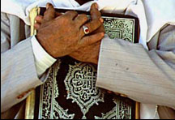
A'amaal for Laylatul Qadr
اعمال للَيْلَةُ الْقَدْرِ
Please DO NOT
place the
Holy Quran
on the floor.

Slide 286
A'amaal for Laylatul Qadr
اعمال للَيْلَةُ الْقَدْرِ
As there are no further Salaat, Brothers are requested to move as far forward as possible.

Slide 287
أَمَّنْ يُجيبُ الْمُضْطَرَّ إِذا دَعاهُ وَ يَكْشِفُ السُّوءَ {27:62}
A'amaal for Laylatul Qadr
اعمال للَيْلَةُ الْقَدْرِ
Du`á E Shifa Mareez
O, Who listens to the distressed when he calls on Him, and Who relieves his suffering (27:62)
Amman yujeebu almudtarra itha daAAahu wayakshifu alssooa

Slide 288
Please recite
Sūrat al-Fātiḥah for
ALL MARHUMEEN
اعمال للَيْلَةُ الْقَدْرِ
A'amaal for Laylatul Qadr
For any errors / comments please write to: duas.org@gmail.com
Kindly recite Sūrat al-Fātiḥah for Marhumeen of all those who have worked towards making this small work possible.

