Slide 1
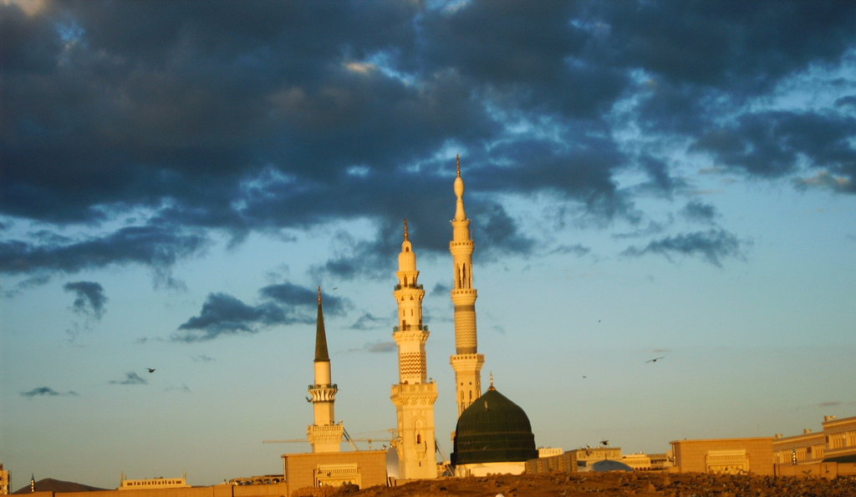
27 Rajab -A'amaal for the Day of Mabáth
Press SPACEBAR or ENTER key on the Keyboard or use mouse click to move along the slides.
For any errors/comments please write to: duas.org@gmail.com Kindly recite Sura E Fatiha for Marhumeen of all those who have worked towards making this small work possible.

Slide 2
A’maal for the day of Mab'ath
Supplication On the Divine Mission Day
Supplication On the Divine Mission Day
As is mentioned in ‘Iqb¡l al-A`mal’ and some manuscripts of ‘Misbah al-Mutahajjid’, it is recommended to recite the following supplication on this day:
Translation Reference:
THE RITES OF RAJAB, SHAABAN, RAMADAN –[Ansariyan Publication]
It is worth mentioning that this supplication, which is one of the excellent supplications of Rajab, was recited by Imam Musa ibn Ja`far al-Kadhim (a.s) on the day when the ruling authorities took him to Baghdad.
That day was the twenty-seventh of Rajab.

Slide 3
A’maal for the day of Mab'ath
Supplication On the Divine Mission Day
اَللَّهُمَّ صَلِّ عَلَى مُحَمَّدٍ وَ آلِ مُحَمَّد
O' Alláh send Your blessings on Muhammad
and the family of Muhammad.

Slide 4
A’maal for the day of Mab'ath
Supplication On the Divine Mission Day
بِسْمِ اللهِ الرَّحْمنِ الرَّحِيمِ
In the name of Allah,
the Beneficent, the Merciful.

Slide 5
يَا مَنْ أَمَرَ بِالْعَفْوِ وَالتَّجَاوُزِ،
A’maal for the day of Mab'ath
Supplication On the Divine Mission Day
O He Who has ordered us to forgive and overlook

Slide 6
وَضَمَّنَ نَفْسَهُ الْعَفْوَ وَالتَّجَاوُزَ،
A’maal for the day of Mab'ath
Supplication On the Divine Mission Day
and has taken upon Himself to forgive and overlook!

Slide 7
يَا مَنْ عَفَا وَتَجَاوَزَ
A’maal for the day of Mab'ath
Supplication On the Divine Mission Day
O He Who did forgive and overlook:

Slide 8
اعْفُ عَنِّي وَتَجَاوَزْ يَا كَرِيمُ.
A’maal for the day of Mab'ath
Supplication On the Divine Mission Day
(please do) forgive me and overlook (my evildoings) O the All-generous.

Slide 9
اللّهُمَّ وَقَدْ أَكْدَى الطَّلَبُ،
A’maal for the day of Mab'ath
Supplication On the Divine Mission Day
O Allah: surely, all requests have been rejected,

Slide 10
وَأَعْيَتِ الْحِيلَةُ وَالْمَذْهَبُ،
A’maal for the day of Mab'ath
Supplication On the Divine Mission Day
and all means and ways have been inaccessible,

Slide 11
وَدَرَسَتِ الآمَالُ،
A’maal for the day of Mab'ath
Supplication On the Divine Mission Day
and all hopes have been eradicated,

Slide 12
وَانْقَطَعَ الرَّجَاءُ إلاَّ مِنْكَ
A’maal for the day of Mab'ath
Supplication On the Divine Mission Day
and all expectations have been cut off from everybody save You

Slide 13
وَحْدَكَ لا شَرِيكَ لَكَ.
A’maal for the day of Mab'ath
Supplication On the Divine Mission Day
alone, there is no partner with You.

Slide 14
اللّهُمَّ إنِّي أَجِدُ سُبُلَ الْمَطَالِبِ إلَيْكَ مُشْرَعَةً،
A’maal for the day of Mab'ath
Supplication On the Divine Mission Day
O Allah: I find the ways to requesting from You wide open,

Slide 15
وَمَنَاهِلَ الرَّجَاءِ لَدَيْكَ مُتْرَعَةً،
A’maal for the day of Mab'ath
Supplication On the Divine Mission Day
and springs of hoping for You quenching,

Slide 16
وَأَبْوَابَ الدُّعَاءِ لِمَنْ دَعَاكَ مُفَتَّحَةً،
A’maal for the day of Mab'ath
Supplication On the Divine Mission Day
and doors of supplication unlocked for him who implores You,

Slide 17
وَالاسْتِعَانَةَ لِمَنِ اسْتَعَانَ بِكَ مُبَاحَةً،
A’maal for the day of Mab'ath
Supplication On the Divine Mission Day
and Your aid available for those who seek it.

Slide 18
وَأَعْلَمُ أَنَّكَ لِدَاعِيكَ بِمَوْضِعِ إجَابَةٍ،
A’maal for the day of Mab'ath
Supplication On the Divine Mission Day
I also know that You are in the position of response for him who beseeches You,

Slide 19
وَلِلصَّارِخِ إلَيْكَ بِمَرْصَدِ إغَاثَةٍ،
A’maal for the day of Mab'ath
Supplication On the Divine Mission Day
and in the position of relief for him who resorts to You,

Slide 20
وَأَنَّ فِي اللَّهْفِ إلَى جُودِكَ وَالضَّمَانِ بِعِدَتِكَ
A’maal for the day of Mab'ath
Supplication On the Divine Mission Day
and that hastening to Your magnanimity and the reliance upon Your promise

Slide 21
عِوَضاً مِنْ مَنْعِ الْبَاخِلِينَ
A’maal for the day of Mab'ath
Supplication On the Divine Mission Day
compensate from the stinginess of the misery ones

Slide 22
وَمَنْدُوحَةً عَمَّا فِي أَيْدِي الْمُسْتَأْثِرِينَ،
A’maal for the day of Mab'ath
Supplication On the Divine Mission Day
and suffice from that which is grasped by the mean ones.

Slide 23
وَأَنَّكَ لا تَحْتَجِبُ عَنْ خَلْقِكَ
A’maal for the day of Mab'ath
Supplication On the Divine Mission Day
And [I know for sure] that You never screen Yourself against Your beings

Slide 24
إلاَّ أَنْ تَحْجُبَهُمُ الأَعْمَالُ دُونَكَ،
A’maal for the day of Mab'ath
Supplication On the Divine Mission Day
but it is their evildoings that prevent them from journeying toward You.

Slide 25
وَقَدْ عَلِمْتُ أَنَّ أَفْضَلَ زَادِ الرَّاحِلِ إلَيْكَ عَزْمُ إرَادَةٍ يَخْتَارُكَ بِهَا
A’maal for the day of Mab'ath
Supplication On the Divine Mission Day
I have also known for sure that the best provisions of his who intends to travel to You is a true willpower by which He chooses You among others.

Slide 26
وَقَدْ نَاجَاكَ بِعَزْمِ الإرَادَةِ قَلْبِي،
A’maal for the day of Mab'ath
Supplication On the Divine Mission Day
Hence, my heart has called at You with full willpower;

Slide 27
وَأَسْأَلُك بِكُلِّ دَعْوَةٍ دَعَاكَ بِهَا رَاجٍ بَلَّغْتَهُ أَمَلَهُ،
A’maal for the day of Mab'ath
Supplication On the Divine Mission Day
and I pray You in the name of all supplications said by a hopeful and thus You have achieved his hope,

Slide 28
أَوْ صَارِخٌ إلَيْكَ أَغَثْتَ صَرْخَتَهُ،
A’maal for the day of Mab'ath
Supplication On the Divine Mission Day
or said by a seeker of aid and thus You have admitted his request,

Slide 29
أَوْ مَلْهُوفٌ مَكْرُوبٌ فَرَّجْتَ كَرْبَهُ،
A’maal for the day of Mab'ath
Supplication On the Divine Mission Day
or said by an aggrieved, depressed one and thus You have relieved him,

Slide 30
أَوْ مُذْنِبٌ خَاطِئٌ غَفَرْتَ لَهُ،
A’maal for the day of Mab'ath
Supplication On the Divine Mission Day
or said by a guilty sinner and thus You have forgiven him,

Slide 31
أَوْ مُعَافَىً أَتْمَمْتَ نِعْمَتَكَ عَلَيْهِ،
A’maal for the day of Mab'ath
Supplication On the Divine Mission Day
or said by a healthy one and thus You have perfected Your favors on him,

Slide 32
أَوْ فَقِيرٌ أَهْدَيْتَ غِنَاكَ إلَيْهِ،
A’maal for the day of Mab'ath
Supplication On the Divine Mission Day
or said by a poor one and thus You have conferred upon him with Your wealth,

Slide 33
وَلِتِلْكَ الدَّعْوَةِ عَلَيْكَ حَقٌّ وَعِنْدَكَ مَنْزِلَةٌ
A’maal for the day of Mab'ath
Supplication On the Divine Mission Day
and that these supplications occupy a considerable position with You and enjoy a standing with You—

Slide 34
إلاَّ صَلَّيْتَ عَلَى مُحَمَّدٍ وَآلِ مُحَمَّدٍ
A’maal for the day of Mab'ath
Supplication On the Divine Mission Day
I pray You to send blessings upon Muhammad and the Household of Muhammad

Slide 35
وَقَضَيْتَ حَوَائِجِي حَوَائِجَ الدُّنْيَا وَالآخِرَةِ،
A’maal for the day of Mab'ath
Supplication On the Divine Mission Day
and to settle all my needs for this world and the Next World.

Slide 36
وَهذَا رَجَبٌ الْمُرَجَّبُ الْمُكَرَّمُ
A’maal for the day of Mab'ath
Supplication On the Divine Mission Day
This is Rajab, the honored and dignified month,

Slide 37
الَّذِي أَكْرَمْتَنَا بِهِ أَوَّلُ أَشْهُرِ الْحُرُمِ
A’maal for the day of Mab'ath
Supplication On the Divine Mission Day
which You have honored us through it, being the first of the Sacred Months,

Slide 38
أَكْرَمْتَنَا بِهِ مِنْ بَيْنِ الأُمَمِ،
A’maal for the day of Mab'ath
Supplication On the Divine Mission Day
and You have selected us for this honor among the other nations.

Slide 39
يَا ذَا الْجُودِ وَالْكَرَمِ
A’maal for the day of Mab'ath
Supplication On the Divine Mission Day
O the Lord of Magnanimity and Generosity.

Slide 40
فَنَسْأَلُكَ بِهِ وَبِاسْمِكَ الأَعْظَمِ الأَعْظَمِ الأَعْظَمِ،
A’maal for the day of Mab'ath
Supplication On the Divine Mission Day
I thus beseech You by Your Name, the grandest, the grandest, the grandest,

Slide 41
الأَجَلِّ الأَكْرَمِ
A’maal for the day of Mab'ath
Supplication On the Divine Mission Day
the most majestic, the most honorable,

Slide 42
الَّذِي خَلَقْتَهُ فَاسْتَقَرَّ فِي ظِلِّكَ
A’maal for the day of Mab'ath
Supplication On the Divine Mission Day
that You have created so that it has settled under Your Shadow

Slide 43
فَلا يَخْرُجُ مِنْكَ إلَى غَيْرِكَ
A’maal for the day of Mab'ath
Supplication On the Divine Mission Day
and it thus shall never transfer to anyone other than You—

Slide 44
أَنْ تُصَلِّيَ عَلَى مُحَمَّدٍ وَأَهْلِ بَيْتِهِ الطَّاهِرِينَ
A’maal for the day of Mab'ath
Supplication On the Divine Mission Day
I beseech You to send blessings upon Muhammad and his Household, the immaculate,

Slide 45
وَتَجْعَلَنَا مِنَ الْعَامِلِينَ فِيهِ بِطَاعَتِكَ،
A’maal for the day of Mab'ath
Supplication On the Divine Mission Day
and to include us, during this month, with those who practice acts of obedience to You

Slide 46
وَالآمِلِينَ فِيهِ بِشَفَاعَتِكَ،
A’maal for the day of Mab'ath
Supplication On the Divine Mission Day
and those who hope for Your admission.

Slide 47
اللّهُمَّ وَاهْدِنَا إلَى سَوَاءِ السَّبِيلِ،
A’maal for the day of Mab'ath
Supplication On the Divine Mission Day
O Allah: (please do) lead us to the Right Path,

Slide 48
وَاجْعَلْ مَقِيلَنَا عِنْدَكَ خَيْرَ مَقِيلٍ فِي ظِلٍّ ظَلِيلٍ،
A’maal for the day of Mab'ath
Supplication On the Divine Mission Day
and choose for us the best resting-place with You, under a dense shade

Slide 49
فَإنَّكَ حَسْبُنَا وَنِعْمَ الْوَكِيلُ،
A’maal for the day of Mab'ath
Supplication On the Divine Mission Day
and abundant possession. Surely, You are Sufficient for us! Most Excellent are You, and in You do we trust!

Slide 50
وَالسَّلامُ عَلَى عِبَادِهِ الْمُصْطَفَيْنَ
A’maal for the day of Mab'ath
Supplication On the Divine Mission Day
Peace be upon His servants, the chosen,

Slide 51
وَصَلَوَاتُهُ عَلَيْهِمْ أَجْمَعِينَ.
A’maal for the day of Mab'ath
Supplication On the Divine Mission Day
and His blessings be upon them all.

Slide 52
اللّهُمَّ وَبَارِكْ لَنَا فِي يَوْمِنَا هذَا الَّذِي فَضَّلْتَهُ،
A’maal for the day of Mab'ath
Supplication On the Divine Mission Day
O Allah: (please do) bless us on this day that You have honored,

Slide 53
وَبِكَرَامَتِكَ جَلَّلْتَهُ،
A’maal for the day of Mab'ath
Supplication On the Divine Mission Day
and covered with Your nobility,

Slide 54
وَبِالْمَنْزِلِ الْعَظِيمِ الأَعْلَى أَنْزَلْتَهُ،
A’maal for the day of Mab'ath
Supplication On the Divine Mission Day
and implanted in the great and highest Dwelling.

Slide 55
صَلِّ عَلَى مَنْ فِيهِ إلَى عِبَادِكَ أَرْسَلْتَهُ،
A’maal for the day of Mab'ath
Supplication On the Divine Mission Day
(Please do) send blessings upon him whom You sent (as Your Messenger) to Your servants

Slide 56
وَبِالْمَحَلِّ الْكَرِيمِ أَحْلَلْتَهُ.
A’maal for the day of Mab'ath
Supplication On the Divine Mission Day
and whom You accommodated in the Noble Place.

Slide 57
اللّهُمَّ صَلِّ عَلَيْهِ صَلاةً دَائِمَةً تَكُونُ لَكَ شُكْراً،
A’maal for the day of Mab'ath
Supplication On the Divine Mission Day
O Allah: send upon him blessing that is never-ending being in the form of thanks to You

Slide 58
وَلَنَا ذُخْراً،
A’maal for the day of Mab'ath
Supplication On the Divine Mission Day
and reward to us.

Slide 59
وَاجْعَلْ لَنَا مِنْ أَمْرِنَا يُسْراً،
A’maal for the day of Mab'ath
Supplication On the Divine Mission Day
And make easy for us all our affairs;

Slide 60
وَاخْتِمْ لَنَا بِالسَّعَادَةِ إلَى مُنْتَهَى آجَالِنَا،
A’maal for the day of Mab'ath
Supplication On the Divine Mission Day
and make our end result up to the last of our lives pleasant

Slide 61
وَقَدْ قَبِلْتَ الْيَسِيرَ مِنْ أَعْمَالِنَا،
A’maal for the day of Mab'ath
Supplication On the Divine Mission Day
after You accept our little deed

Slide 62
وَبَلَّغْتَنَا بِرَحْمَتِكَ أَفْضَلَ آمَالِنَا،
A’maal for the day of Mab'ath
Supplication On the Divine Mission Day
and achieve for us all our hopes out of Your mercy.

Slide 63
إنَّكَ عَلَى كُلِّ شَيْءٍ قَدِيرٌ،
A’maal for the day of Mab'ath
Supplication On the Divine Mission Day
Verily, You have power over all things.

Slide 64
وَصَلَّى اللّهُ عَلَى مُحَمَّدٍ وَآلِهِ وَسَلَّمَ.
A’maal for the day of Mab'ath
Supplication On the Divine Mission Day
May Allah bless and exalt Muhammad and his Household.

Slide 65
A’maal for the day of Mab'ath
Supplication On the Divine Mission Day
اَللَّهُمَّ صَلِّ عَلَى مُحَمَّدٍ وَ آلِ مُحَمَّد
O' Alláh send Your blessings on Muhammad
and the family of Muhammad.

